Slide 1
The First 1,000 Days: A Crucial Time for Mothers and Children—And the World
Roger Thurow

Slide 2
Guatemala

Slide 3
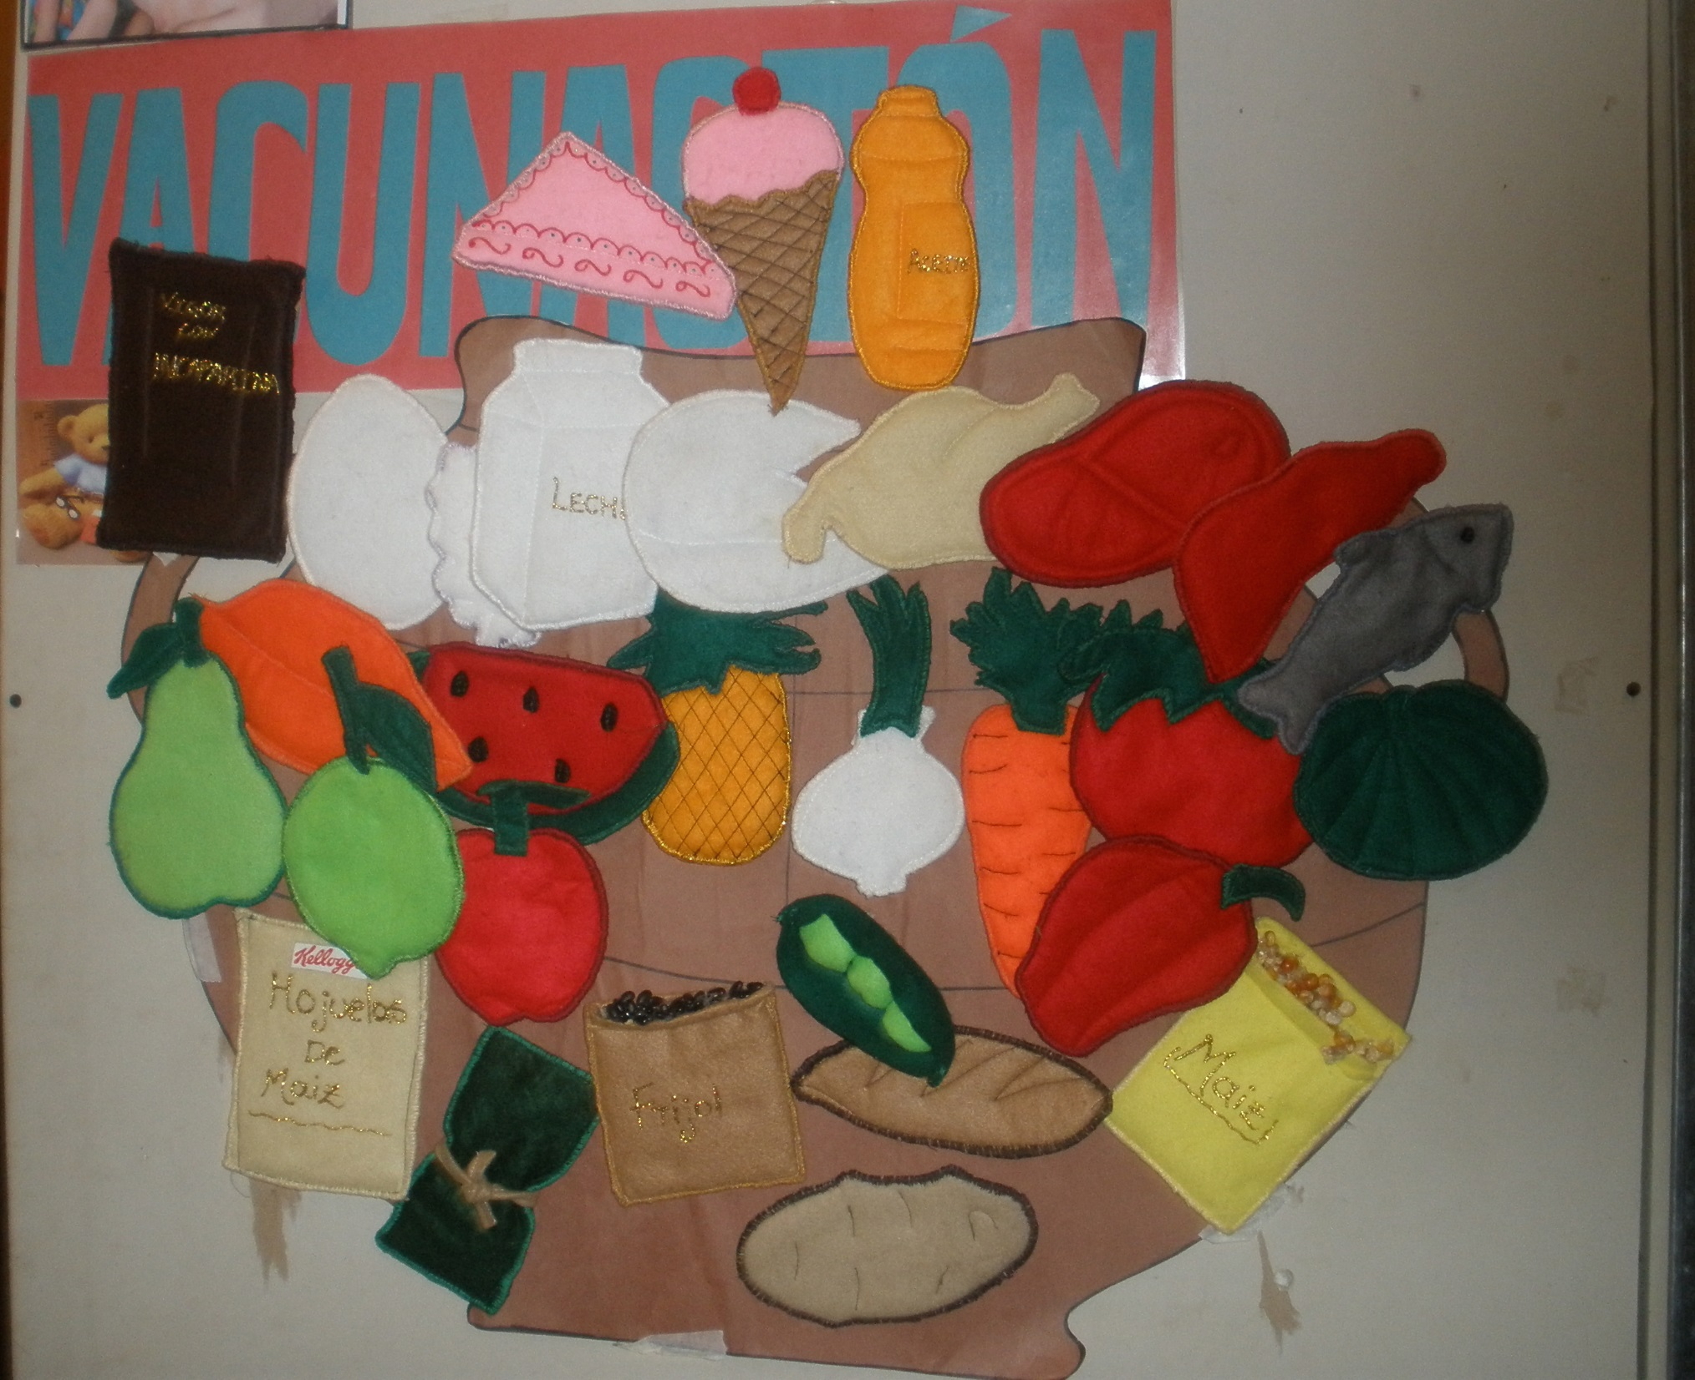

Slide 5
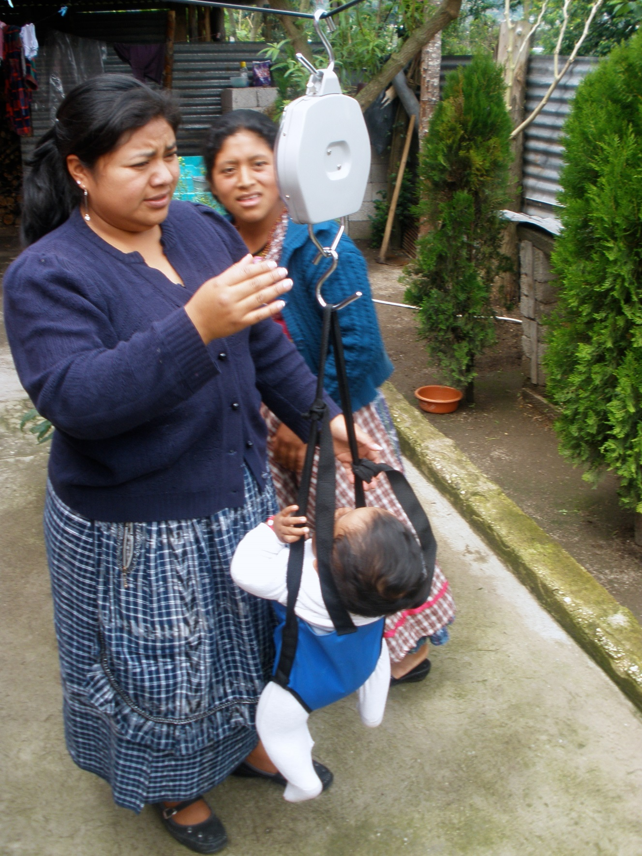

Slide 6
Jorge and Yesica

Slide 7
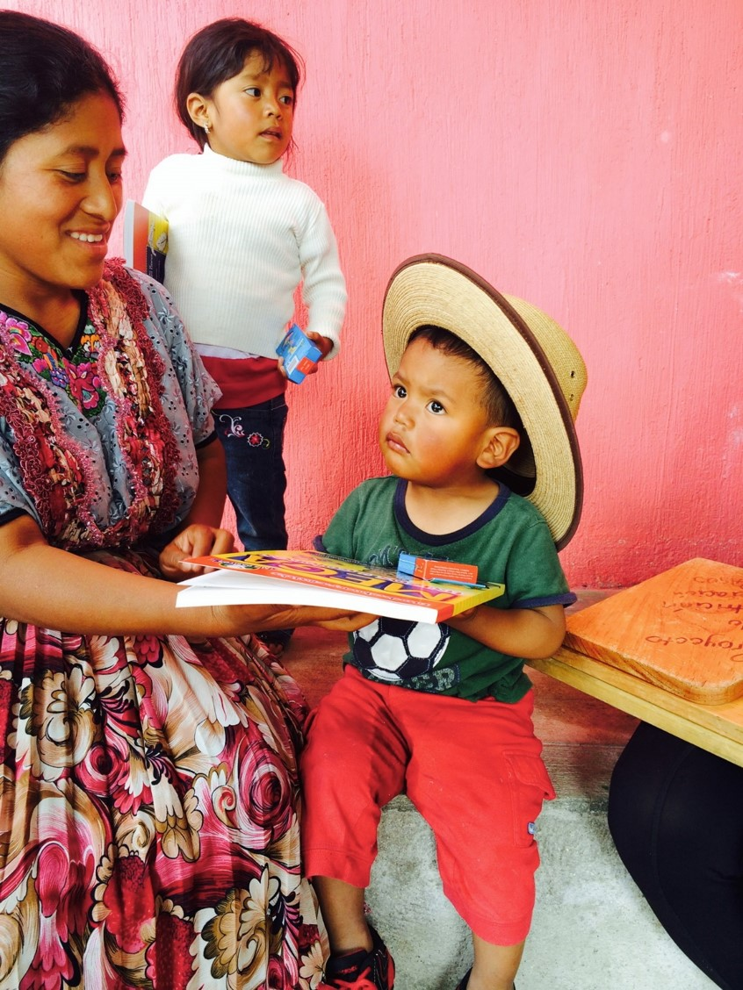
Maria Estella, Jorge, and Yesica

Slide 8
Jorge and Yesica

