Slide 1
COVID-19 in 2023 Selected Links for Questions and Answers with Dr. Esther Tan, UN DHMOSH Public Health Conversation Series
Daniel R. Lucey MD, MPH
Clinical Professor of Medicine Geisel School of Medicine at Dartmouth
The Dartmouth Institute for Healthcare Policy & Clinical Research, Hanover, NH
&
Anthropology Research Associate, Smithsonian Museum of Natural History, DC
28 February 2023
Daniel.R.Lucey@Dartmouth.edu

Slide 2
These Views and Opinions are Mine Alone
The views and opinions in this slide presentation and conversation are mine alone, and do not necessarily represent those of any medical institutions, academic centers, museums, or professional medical organizations.

Slide 3
WHO 2023 Webinar Monthly Series on TRUST: Led by Dr. Sylvie Briand: WHO/OMS Geneva
“WHO Webinar Series on Trust and Pandemic Preparedness”:
“The COVID-19 pandemic highlighted trust as an important determinant of successful pandemic response and leadership; a prerequisite for the uptake of interventions and behaviour change among communities; and a contributing factor in community resilience. “
https://www.who.int/news-room/events/detail/2023/01/25/default-calendar/who-webinar-series-on-trust-and-pandemic-preparedness--webinar-1--trust-and-pandemics

Slide 4
WHO COVID-19 Weekly Epidemiologic Updates
February 22 Report:
“As of 19 February 2023, over 757 million confirmed cases and over 6.8 million deaths have been reported globally.”
https://www.who.int/emergencies/diseases/novel-coronavirus-2019/situation-reports

Slide 5
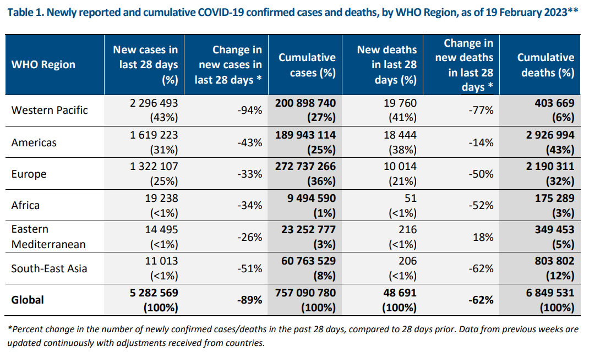

Slide 6
SARS-CoV-2 Variant of Concern: Omicron Resistant to Monoclonal Antibodies but not Antiviral Drugs
Globally as of 19 February 2023: 99.7% were the Omicron variant of concern (VOC).
No new “Variant of Concern (VOC)” has appeared anywhere in the world, including China, since Omicron in late 2021.
The mutations in Omicron and its descendants have caused monoclonal antibody treatments to lose their efficacy, but:
Omicron variants have not become resistant to antiviral drugs.

Slide 7
WHO and COVID-19 Vaccines
WHO Strategic Advisory Group of Experts (SAGE) for Vaccines. Updated advice on many international COVID-19 vaccines.
https://www.who.int/groups/strategic-advisory-group-of-experts-on-immunization/covid-19-materials
February 20, 2023 document on most recent “bivalent” vaccines that include the “Omicron” variant.
https://www.who.int/publications/i/item/WHO-2019-nCoV-Vaccines-SAGE-Variants-2022.1

Slide 8
WHO: Post-Covid-19 (“Long Covid”)
“It is defined as the continuation or development of new symptoms 3 months after the initial SARS-CoV-2 infection, with these symptoms lasting for at least 2 months with no other explanation.”
“While common symptoms of long COVID can include fatigue, shortness of breath and cognitive dysfunction over 200 different symptoms have been reported that can have an impact on everyday functioning.”
“Studies show that around 10–20% of people infected by SARS-CoV-2 may go on to develop symptoms that can be diagnosed as long COVID. Although exact numbers of those living with the condition are uncertain, it is believed that more than 17 million people across the WHO European Region may have experienced it during the first two years of the pandemic (2020/21).”
https://www.who.int/europe/news-room/fact-sheets/item/post-covid-19-condition

Slide 9
Virus Origin Remains Uncertain But One Key Question on Live Mammals in the Seafood Market
WHO-convened global study of origins of SARS-Cov-2: China part”. “Joint WHO-China study”. Report of March 30, 2021.
https://www.who.int/publications/i/item/who-convened-global-study-of-origins-of-sars-cov-2-china-part
“No evidence of the sale of live mammals was found in our visit – e.g. cages of the type used to house mammals like raccoon dogs…” (page 122 of Annex D4 on The Wuhan Huanan Seafood Market and page 98 of the main report).

Slide 10
18 species of mammals (e.g., racoon dogs, mink) were sold since 2017 in the Wuhan Huanan Seafood Market. Xiao et al. Nature Scientific Reports June 7, 2021. https://www.nature.com/articles/s41598-021-91470-2

Slide 11
Were live mammals (e.g., racoon dogs, mink) tested in the Wuhan Huanan Seafood Market?
If these live mammals were tested for SARS-CoV-2, then what were the results?
If these 18 species of live mammals in this seafood market were not tested, then why not?

Slide 12
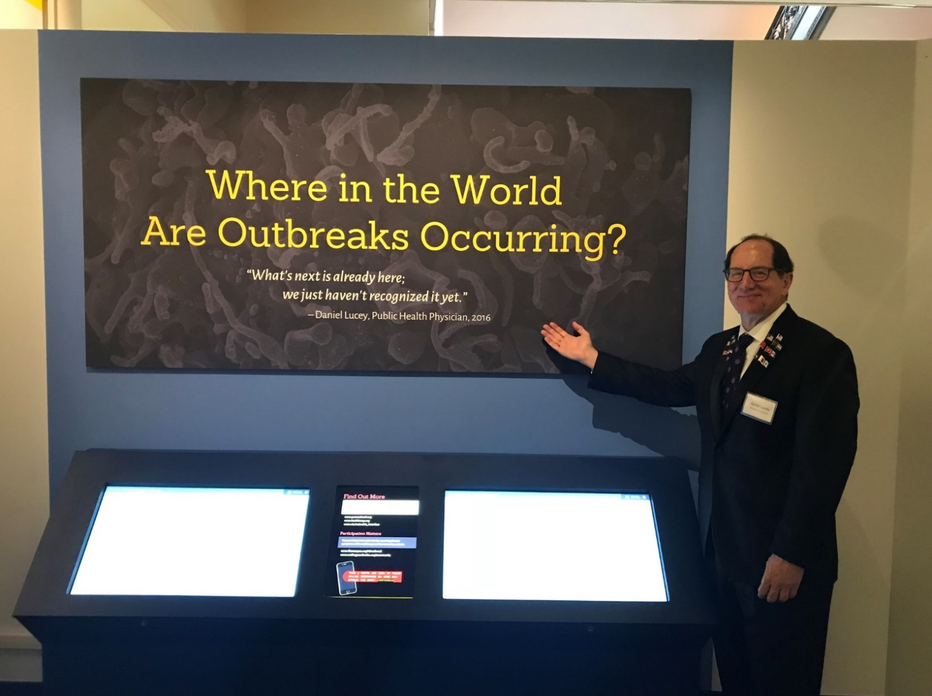
“What’s next is already here, we just haven’t recognized it yet”: Anticipate, Recognize, Act Smithsonian Museum of Natural History Exhibit on Epidemics 2018-2022

