Slide 1
Hypertension is High Blood Pressure The World health Organization has announced that hypertension has become the leading cause of premature death and disability worldwide – the first time that a non-communicable disease has been responsible for such a major health problem
Michael A. Weber, MD, Professor of Medicine
State University of New York, Downstate Medical Center

Slide 2
Consequences of High Blood Pressure
Premature death
Strokes
Heart attacks
Heart failure
Kidney disease
Peripheral artery disease
Dementia (Alzheimer’s disease)

Slide 3
Epidemiology of Hypertension and Aging
Hypertension is defined as BP higher than 140/90
Without treatment, approximately 30% of adults in the U.S. have hypertension (HTN).¹
HTN prevalence increases markedly with age:²
-by 60 years, ~60% have HTN
-by 70 years, ~65% of men and ~75% of women have HTN
In Framingham Study, HTN eventually developed in >90% of people with normal BP at age 55 years.³
¹Ong Hypertension 2007;49:69-75 ²Burt Hypertension 1995;25:305-313
³Vasan N Engl J Med 2001;345:1291-1297

Slide 4
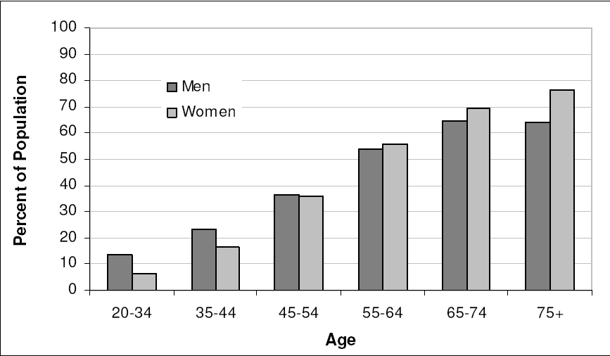
Prevalence of High Blood Pressure in Adults by Age and Sex: NHANES 2005-2006 9 NHLBI.

Slide 5
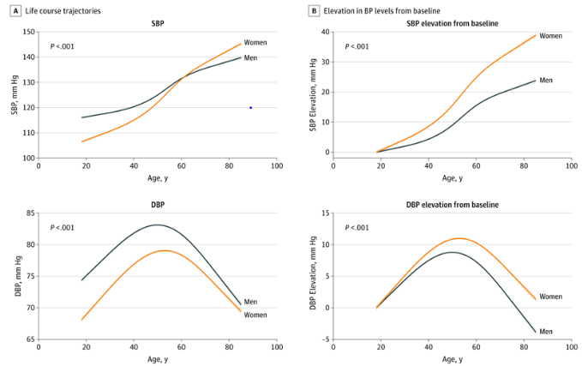
Life Trajectories of Blood Pressure in Men and Women in the U.S. (JAMA Cardiol. 2020; 5:18-26)

Slide 6
Current Categories of BP in Adults 2021
BP Category | SBP |  | DBP
Normal | <120 mm Hg | and | <80 mm Hg
Elevated | 120–129 mm Hg | and | <80 mm Hg
Hypertension
Stage 1 | 130–139 mm Hg | or | 80–89 mm Hg
Stage 2 | ≥140 mm Hg | or | ≥90 mm Hg
*Individuals with SBP and DBP in 2 categories should be designated to the higher BP category.
BP indicates blood pressure (based on an average of ≥2 careful readings obtained on ≥2 occasions, as detailed in DBP, diastolic blood pressure; and SBP systolic blood pressure.

Slide 7
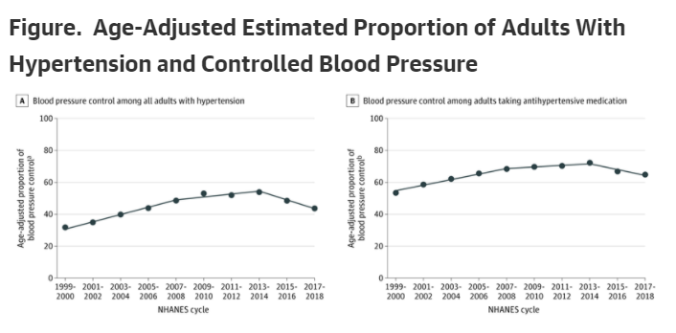
Hypertension Control Rates (BP <140/90 mmHg) in the U.S. 1999 – 2018 Disappointing, and even worse in most other countries: a huge task for the WHO Muntner P. et al. JAMA 2020; doi: 10.1001/jama2020.14545

Slide 8
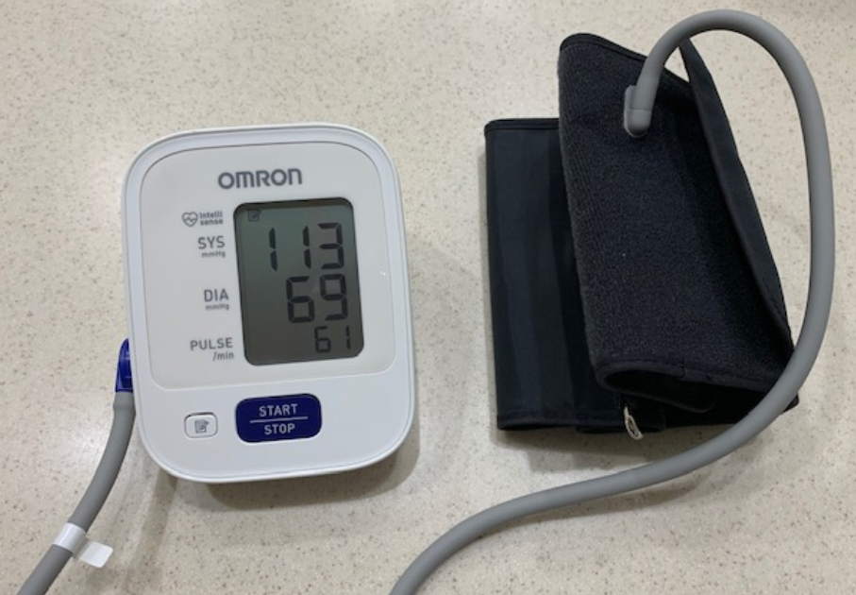
A small, inexpensive and validated Home BP Monitor (can also be used in the clinic)

Slide 9
Main Causes of Hypertension
Getting older
Being overweight
Eating too much salt
Drinking too much alcohol
Not being physically active
Underlying causes that can be diagnosed by doctors:
kidney disease
sleep apnea
abnormalities of the adrenal glands

Slide 10
How to prevent hypertension
Active lifestyle
Reduce dietary salt
Keep weight under control
Be moderate with alcohol consumption
Check your blood pressure regularly so that treatment can be started if necessary – new measurement devices are inexpensive and easy to use at home
Remember: Treatment of high blood pressure – usually done by doctors using medications -- is highly effective in preventing heart disease, strokes and kidney disease

