Slide 1
The CDC Worksite Health ScoreCard: A Tool to Advance Workplace Health Promotion Programs and Practices
JASON LANG, MPH, MS
DHMOSH Public Health Leadership Series
May 3, 2023
Centers for Disease Control and Prevention
National Center for Chronic Disease Prevention and Health Promotion
Division of Population Health

Slide 2
Learning Objectives
Benefits of workplace health programs
Understand the CDC Worksite Health ScoreCard development and evidence-base
Describe the type of current CDC Worksite Health ScoreCard user and their workplace health program activity
Describe the main features of the CDC Worksite Health ScoreCard and how it can be used
2

Slide 3
BENEFITS OF WORKPLACE HEALTH PROGRAMS
3

Slide 4
Benefits of Workplace Health Promotion for Employers
Chronic and mental health conditions represent about 90% of the nation’s $3.3 trillion annual health care expenditures
Interventions in the workplace can help to mitigate this trend:
Improve employee health, well-being and safety
Decrease disability, healthcare utilization and costs
Reduce absenteeism and presenteeism
Increase worker productivity, creativity and engagement
Attract/retain top talent
Bolster stock market performance
SOURCE: Buttorff C, Ruder T, Bauman M. Multiple Chronic Conditions in the United States. Santa Monica, CA: Rand Corp.; 2017.
Center for Medicare & Medicaid Services. National Health Expenditure Data for 2016—Highlights.
Fabius R, Thayer RD, Konicki DL, et al. The link between workforce health and safety and the health of the bottom line: tracking market performance of
companies that Nurture a ‘culture of health’. J Occup Environ Med. 2013;55:993–1000.
Goetzel RZ, Fabius R, Fabius D, Roemer EC, Thornton N, Kelly RK, Pelletier KR. The Stock Performance of C. Everett Koop Award Winners Compared With the Standard & Poor's 500 Index. J Occup Environ Med. 2016 Jan;58(1):9-15.
4

Slide 5
46% of U.S. Worksite Offer Any Type of Health Promotion Program
Percentages based on weighted estimates.
Linnan LA, Cluff L, Lang JE, Penne M, Leff MS. Results of the Workplace Health in America Survey. American Journal of Health Promotion 2019, Vol. 33, No. 5, pp. 652-665.
https://www.cdc.gov/workplacehealthpromotion/data-surveillance/index.html

Slide 6
However, Only 12% of U.S. Worksite Have Comprehensive Programs in place
Note: 5 elements of a comprehensive health promotion program as defined by Healthy People 2010.
Percentages based on weighted estimates.
Linnan LA, Cluff L, Lang JE, Penne M, Leff MS. Results of the Workplace Health in America Survey. American Journal of Health Promotion 2019, Vol. 33, No. 5, pp. 652-665.
https://www.cdc.gov/workplacehealthpromotion/data-surveillance/index.html

Slide 7
WHAT IS THE CDC WORKSITE HEALTH SCORECARD AND HOW CAN IT BE USED
7

Slide 8
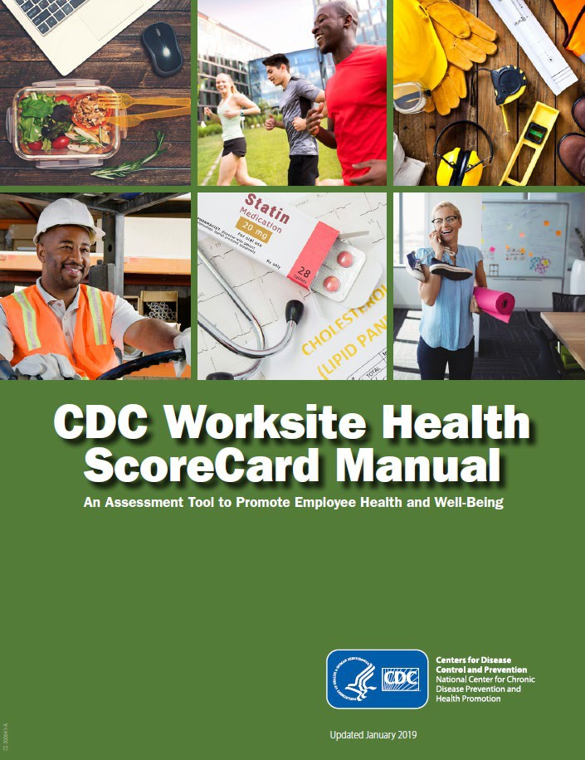
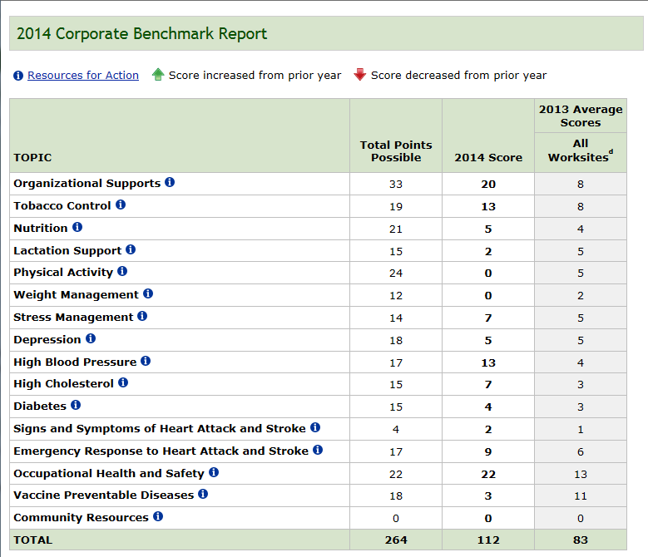
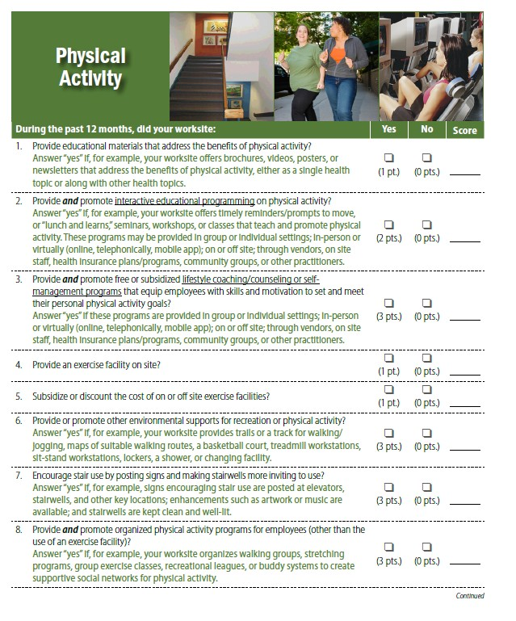
CDC Worksite Health ScoreCard
•
Edit text
• Second level
http://www.cdc.gov/workplacehealthpromotion http://www.cdc.gov/healthscorecard/index.html
8

Slide 9
Why Develop the CDC Worksite Health ScoreCard?
The United States - chronic disease epidemic
Chronic and mental health conditions represent 90% of the nation’s $3.3 trillion annual health care expenditures
Comprehensive worksite health promotion works
Individual risk reduction
Environmental supports
Policy and wellness activities
Less than 20% of employers offer a comprehensive worksite health promotion program
Linnan LA, Cluff L, Lang JE, Penne M, Leff MS. Results of the Workplace Health in America Survey. American Journal of Health Promotion 2019, Vol. 33, No. 5, pp. 652-665.
McCleary K, Goetzel RZ, Roemer EC, et al. Employer and Employee Opinions About Workplace Health Promotion (Wellness) Programs: Results of the 2015 Harris Poll Nielsen Survey. J Occup Environ Med. 2017 Mar;59(3):256-263.
Few validated worksite tools
9

Slide 10
How is the CDC Worksite Health ScoreCard Organized?
154 Yes/No questions assesses best practice health promotion interventions (policies, programs, environmental supports, health benefits) in 18 topic areas
Organizational supports
Tobacco use
Nutrition
Physical activity
Maternal health and lactation support
Weight management
Stress management
Depression
High blood pressure
High cholesterol
Prediabetes and diabetes
Heart attack and stroke
Sleep and fatigue
Occupational health & safety
Vaccine-preventable diseases
Musculoskeletal disorders
Alcohol and other substance use
Cancer
10

Slide 11
Program Strategies and Interventions
Health behaviors
Risk factors
Current health status
Relationship with management / coworkers
Social support
Individual
Interpersonal
Environment
Organization
Facilities that support health
Access and opportunities
Leadership support
Culture
Work climate
11

Slide 12
Social Determinants of Health to Advance Health Equity
Built Environment
Spaces for physical activity such as walking trails or routes, showers and changing facilities, and stairwell enhanced with artwork and music to make them more inviting.
Food and Nutrition Security
Having a written policy that makes healthy foods and beverages available in all onsite points of purchase such as cafeterias and vending machines or examining subsidies and discounts on healthy food items available for purchase.
Community-Clinical Linkages
Improve access to and use of telemedicine, chronic disease self-management programs, and ensuring prescription drug coverage for common chronic conditions such as hypertension, high cholesterol, and diabetes.
Social Connectedness
Establishing active and diverse health promotion committees, employee needs and interest survey for planning health promotion activities, using tailored health promotion communications to ensure that they are accessible and appealing to all employees.
Tobacco-Free Policy
Tobacco free environment, coverage for cessation medications and NRT, access to cessation programs

Slide 13
THE 2019 update PROCESS: Survey Development
Literature Review (n=1,131)
Subject Matter Expert Panels
(n= 18 panels, 67 participants)
Draft 2019 CDC ScoreCard
Pilot Testing
Stakeholder Interviews
(n=9)
Source: Roemer EC, Kent KB, Mummert A, McCleary K, Palmer JB, Lang JE, Matson Koffman DM, Goetzel RZ. Validity and Reliability of the Updated CDC Worksite Health ScoreCard. J Occup Environ Med. 2019 Sep;61(9):767-777.
Notes:
The CDC ScoreCard went through a rigorous update process. We conducted a review of the peer-reviewed journal articles published between 2005 and 2016, with an initial emphasis on systematic reviews and meta-analyses. In total, we reviewed 1,131 studies across 18 different topic areas, of which 530 of those studies were cited in the updated version of the tool.
We also conducted stakeholder interviews in a one-hour focus group sessions. These included representatives from key groups, such as employers, workplace wellness vendors and advocacy groups, academic researchers, state and local agencies, and health plans and non-profits.
The CDC ScoreCard was revised based on the combined recommended updates we gathered from the stakeholder interviews and recent research identified through the literature review. Once these changes were incorporated into the tool, the updated tool was reviewed by a panel of Subject Matter Experts over a series of 18 meetings that used a Delphi-like process. These meetings included representatives from CDC, academics, and other leaders from the workplace health community.
The instrument was updated once again to incorporate changes identified from the panel meetings, and used for pilot testing.
The purpose of the pilot testing and follow-up interviews and site visits was to validate the updated survey with a heterogeneous sample representing a range of employer and worksite sizes, business and industry types, and U.S. geographies.
Our objectives were to:
1. Identify any problems with the wording and interpretation of the questions, and
2. Understand the information retrieval, decision making and response processes

Slide 14
THE 2019 update PROCESS: Survey Testing
Pilot Study Worksites
(n=93, 2 respondents each)
Additional Literature Reviews
Vetting by CDC and Project Team
Revised 2019 CDC ScoreCard
Final 2019 CDC ScoreCard
Interviews (n=9)
Site Visits (n=5)
Source: Roemer EC, Kent KB, Mummert A, McCleary K, Palmer JB, Lang JE, Matson Koffman DM, Goetzel RZ. Validity and Reliability of the Updated CDC Worksite Health ScoreCard. J Occup Environ Med. 2019 Sep;61(9):767-777.
Notes:
We piloted the updated CDC ScoreCard with 93 worksites. Two employees from each worksite completed the tool for the purpose of testing inter-rater reliability (i.e., the degree of agreement between independent respondents).
We then conducted follow-up cognitive interviews with 9 worksites and site visits with 5 worksites (invited from the list of all participating organizations). One of the main purposes was to examine questions that had low agreement rates to determine whether there was something inherently flawed about the question that would require revision or even consideration of deletion.
We asked respondents to explain their understanding of the general intent of the question; the meaning of specific terms; with whom they consulted to gather relevant information; how much effort was required to answer the question. We also asked how useful and applicable they found the CDC ScoreCard as an evaluation tool to their worksite setting.
The survey was refined based on the combination of results from the interviews, site visits, and validation study results. Final changes were made after returning to the literature to ensure that the revised wording still reflected the evidence, and then vetted by the CDC and project team.

Slide 15
How is the CDC Worksite Health ScoreCard Scored?
The Health ScoreCard scoring system was developed to reflect the relative impact of proven health promotion strategies.
Each item on the HSC survey has been assigned a point value between 1 and 3 (where 1=good, 2=better, and 3=best)
This point value reflects the level of impact that the strategy has on the intended health behaviors or outcomes and the strength of scientific evidence supporting this impact
Example:
Awarenes-sbuilding materials such as brochures (1 point) have less of an affect on employee health than lifestyle counseling or self-management programs (3 points).
15

Slide 16
The CDC Worksite Health ScoreCard Scoring Methodology
Describes
Rating system
Scores for each question
Citations and references
https://www.cdc.gov/workplacehealthpromotion/initiatives/healthscorecard/pdf/CDC - Worksite -Health -ScoreCard-Methodology -Updated -FINAL-508.pdf
Centers for Disease Control and Prevention. CDC Worksite Health ScoreCard Scoring Methodology, Evidence and Impact Ratings and Supporting Citations. Atlanta: U.S. Department of Health and 16
Human Services; 2019.

Slide 17
Who Can Use the CDC Worksite Health ScoreCard?
Employers, human resource managers, health benefit managers, health education staff, occupational nurses, medical directors, wellness directors, or others responsible for worksite health promotion to:
Help employees adopt healthy lifestyles
Establish benchmarks and track improvements
Integrate efforts with business objectives
CDC awardees and state health departments to:
Assist employers and business coalitions
Monitor and track worksite practices over time
Establish best practice benchmarks

Slide 18
PROFILE OF CDC WORKSITE HEALTH SCORECARD USERS

Slide 19
CDC Worksite Health ScoreCard Employer Location (2013-2022)
Unique Employers Only
At least one ScoreCard submission No ScoreCard submission
Collaboration/Partnership with state or academic partner
N=2779

Slide 20
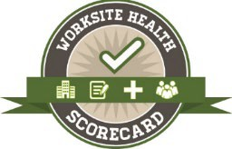
CDC Worksite Health ScoreCard Employer Profile (2017-2022)
Year | ScoreCards | New Employers | Employers who Reassess | Total Employers | Total Unique Employees | Reassessment Rate
2017 | 568 | 231 | 132 | 363 | 255,326 | 36.4%
2018 | 873 | 385 | 152 | 537 | 420,104 | 28.3%
2019 | 970 | 352 | 266 | 618 | 639,871 | 43.0%
2020 | 480 | 236 | 172 | 408 | 414,975 | 42.2%
2021 | 347 | 167 | 126 | 293 | 243,006 | 43.0%
2022 | 542 | 128 | 207 | 335 | 199,744 | 61.8%
Total | 3,780 | 1,499 | 1,055 | 2,554 | 2,173,026 | 42.5%

Slide 21
CDC Worksite Health ScoreCard Employer Business Type (2017-2022)
Unique Employers Only
30.5%
30.5%
39.0%
Government
For-Profit
N=1499
Non-Profit

Slide 22
CDC Worksite Health ScoreCard Employer Size (2017-2022)
Unique Employers Only
21.3%
35.2%
19.2%
20.7%
Very Small (1-100 Employees) Mid-Size (251-750 Employees)
Small (101-250 Employees)
Large (751+ Employees)
N=1499

Slide 23
CDC Worksite Health ScoreCard Employer Industry Sector (2013-2022)
Percent
30.0% _{26.8%}
25.0%
20.0%
_{15.0%} 15.4%_{13.4%}
10.0%
10.0%
6.0% _{5.1%}
5.0%
5.4%
2.2% 2.2% 2.0% 1.9% 2.0% 1.7%
1.5% 1.4% 1.3% _{0.7% 0.4% 0.4% 0.1%}
0.0%
N=3,996 Employers
Employers may report multiple industry sectors

Slide 24
Percent of Employers with Select Health Promotion Interventions
(2021-2022)
Organizational Supports | Very Small (1-100 FTE) |  | Small (101-250 FTE) |  | Medium (251-750 FTE) |  | Large (751+ FTE) |  | Overall
 | 2021 | 2022 | 2021 | 2022 | 2021 | 2022 | 2021 | 2022 | 2021 | 2022
Demonstrate organizational commitment and support of worksite health promotion at all levels of management | 67% | 73% | 86% | 91% | 91% | 85% | 84% | 86% | 82% | 84%
Use and combine incentives with other strategies to increase participation in health promotion programs | 38% | 59% | 81% | 81% | 89% | 80% | 80% | 82% | 73% | 77%
Have a champion(s) who is a strong advocate for the health promotion program | 47% | 59% | 71% | 73% | 91% | 76% | 83% | 80% | 74% | 74%
Have an annual budget or received dedicated funding for health promotion programs | 32% | 45% | 61% | 63% | 88% | 73% | 73% | 72% | 65% | 65%
Promote and market health promotion programs to employees | 54% | 62% | 67% | 73% | 91% | 84% | 85% | 92% | 76% | 82%
Conduct ongoing evaluations of health promotion programming that use multiple data sources | 17% | 35% | 49% | 52% | 78% | 52% | 65% | 68% | 54% | 56%
Have a paid health promotion coordinator whose job (either part-time or full-time) is to implement a worksite health promotion program | 28% | 35% | 49% | 58% | 64% | 68% | 80% | 78% | 59% | 64%
Provide flexible work scheduling policies | 67% | 77% | 72% | 78% | 75% | 84% | 80% | 79% | 75% | 80%
2019-2020 ScoreCard Submissions, N=889

Slide 25
Percent of Employers with Select Health Promotion Interventions
(2021-2022)
Physical Activity Interventions | Very Small (1-100 FTE) |  | Small (101-250 FTE) |  | Medium (251-750 FTE) |  | Large (751+ FTE) |  | Overall
 | 2021 | 2022 | 2021 | 2022 | 2021 | 2022 | 2021 | 2022 | 2021 | 2022
Provide an exercise facility on-site | 24% | 36% | 48% | 46% | 64% | 33% | 54% | 53% | 48% | 44%
Provide other environmental supports for recreation or physical activity | 60% | 62% | 84% | 81% | 92% | 74% | 73% | 79% | 77% | 75%
Post signs at elevators, stairwell entrances or exits, and other key locations that encourage employees to use the stairs | 33% | 41% | 43% | 34% | 36% | 40% | 48% | 47% | 41% | 42%
Provide organized individual or group physical activity programs for employees (other than the use of an exercise facility) | 35% | 53% | 70% | 68% | 89% | 77% | 71% | 70% | 67% | 68%
Nutrition Interventions | Very Small |  | Small |  | Medium |  | Large |  | Overall
Use pricing to encourage purchase of healthy options | 6% | 32% | 17% | 18% | 23% | 21% | 18% | 17% | 17% | 20%
Provide free or subsidized nutrition counseling or self-management programs on healthy eating | 36% | 47% | 65% | 70% | 80% | 74% | 77% | 78% | 66% | 69%
Label foods with nutritional information | 34% | 38% | 32% | 29% | 45% | 33% | 51% | 43% | 43% | 38%
Have a written policy or formal communication that makes healthier food and beverage choices available in cafeterias or snack bars | 25% | 36% | 32% | 30% | 52% | 33% | 49% | 37% | 42% | 35%
2019-2020 ScoreCard Submissions, N=889

Slide 26
OVERVIEW OF THE ONLINE CDC WORKSITE HEALTH SCORECARD SYSTEM
26

Slide 27
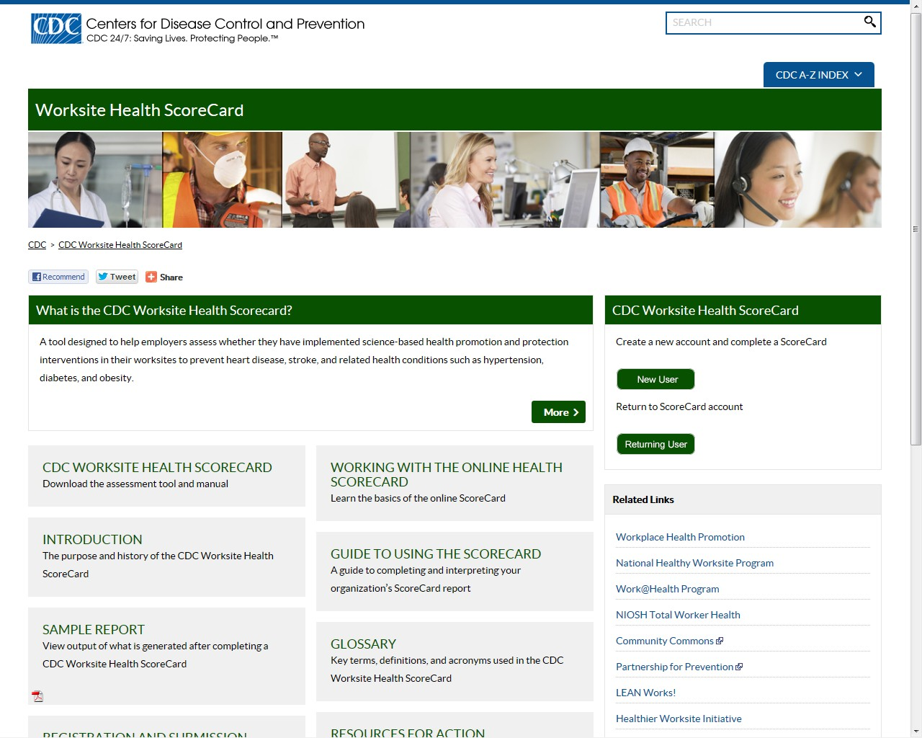
CDC Worksite Health ScoreCard Web Application
http://www.cdc.gov/healthscorecard/index.html
27

Slide 28
CDC Worksite Health ScoreCard Online System Main Features
Free, easy to access and use system
Employer Account (includes Employer Profile)
Employer Dashboard
Worksites (includes Worksite Profile)
Worksite Dashboard
Health ScoreCard
Reports
Automated Reminder Messages
28

Slide 29
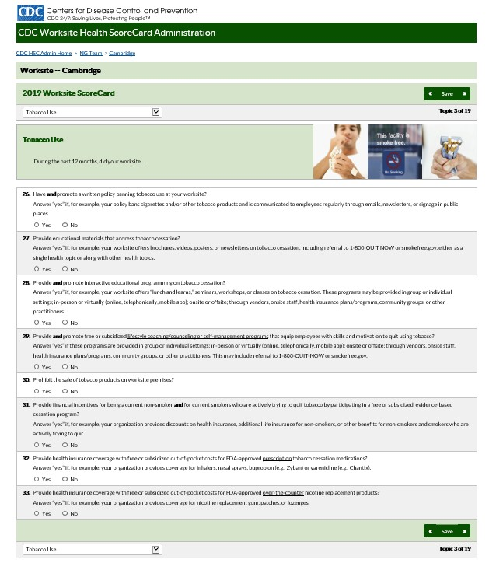
29

Slide 30
CDC Worksite Health ScoreCard Reports
ScoreCardResults Report Name | Format | Description
Summary Benchmark Report | Table | Scoreslisted by topic; comparisons by year, worksite, a employers
Detailed Benchmark Report | Table | Detail of answers and points by question; comparisonsby year, worksite, percentage employers
Interventions In Place | Chart | Number of good,better, and best interventions in place at worksite- overall and by topic
Scoresfor Employers (for employer accounts with multiple worksites) | Chart | Comparisons of worksites by overall score, by topic, and by year
Program Progress Report | Table | % of total points by quartile showing program development
30

Slide 31
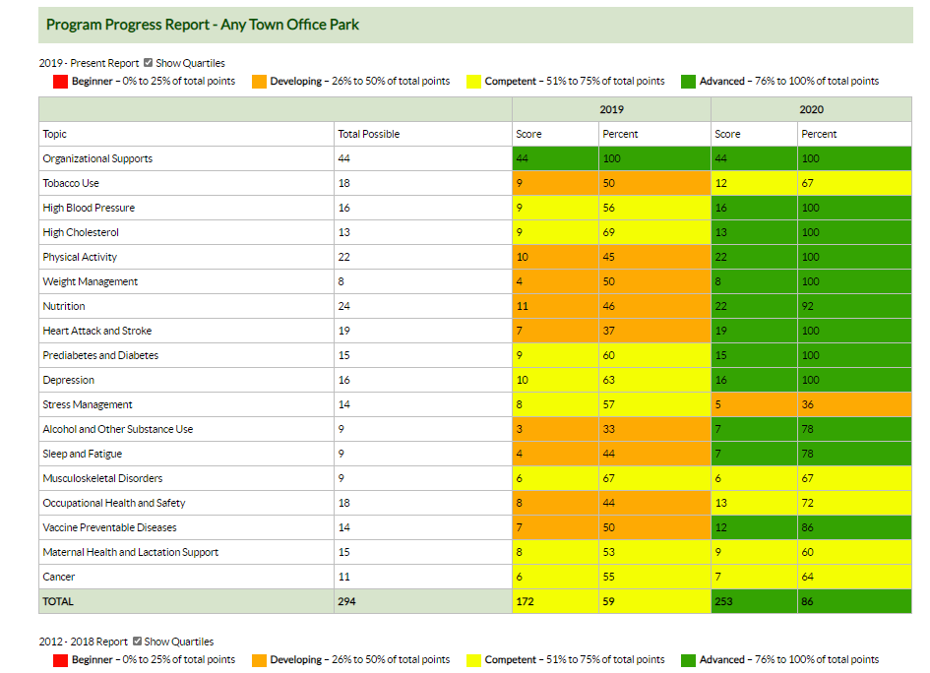
Program Progress Report
31

Slide 32
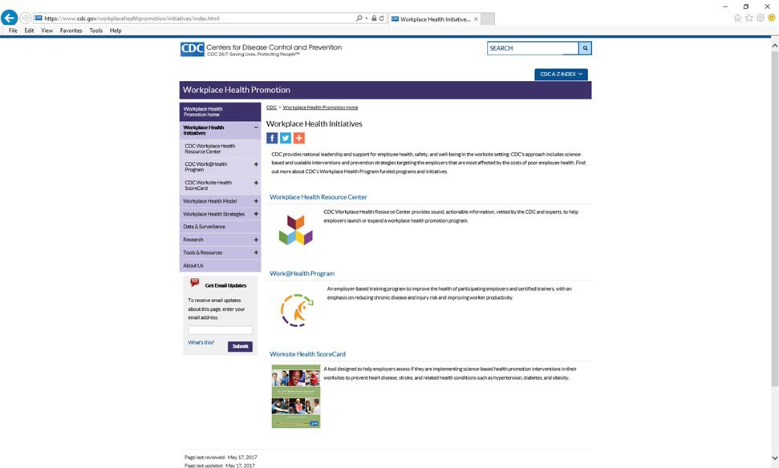
Sign Up for the CDC Workplace Health Newsletter
https://www.cdc.gov/other/emailupdates/index.html
Topic: Workplace Health

Slide 33
Questions?

Slide 34
Thank you
E-mail: jlang@cdc.gov
Web http://www.cdc.gov/workplacehealthpromotion http://www.cdc.gov/healthscorecard/
Centers for Disease Control and Prevention
National Center for Chronic Disease Prevention and Health Promotion
Division of Population Health
The findings and conclusions in this report are those of the authors and do not necessarily represent the official position of the Centers for Disease Control and Prevention.

