Slide 1
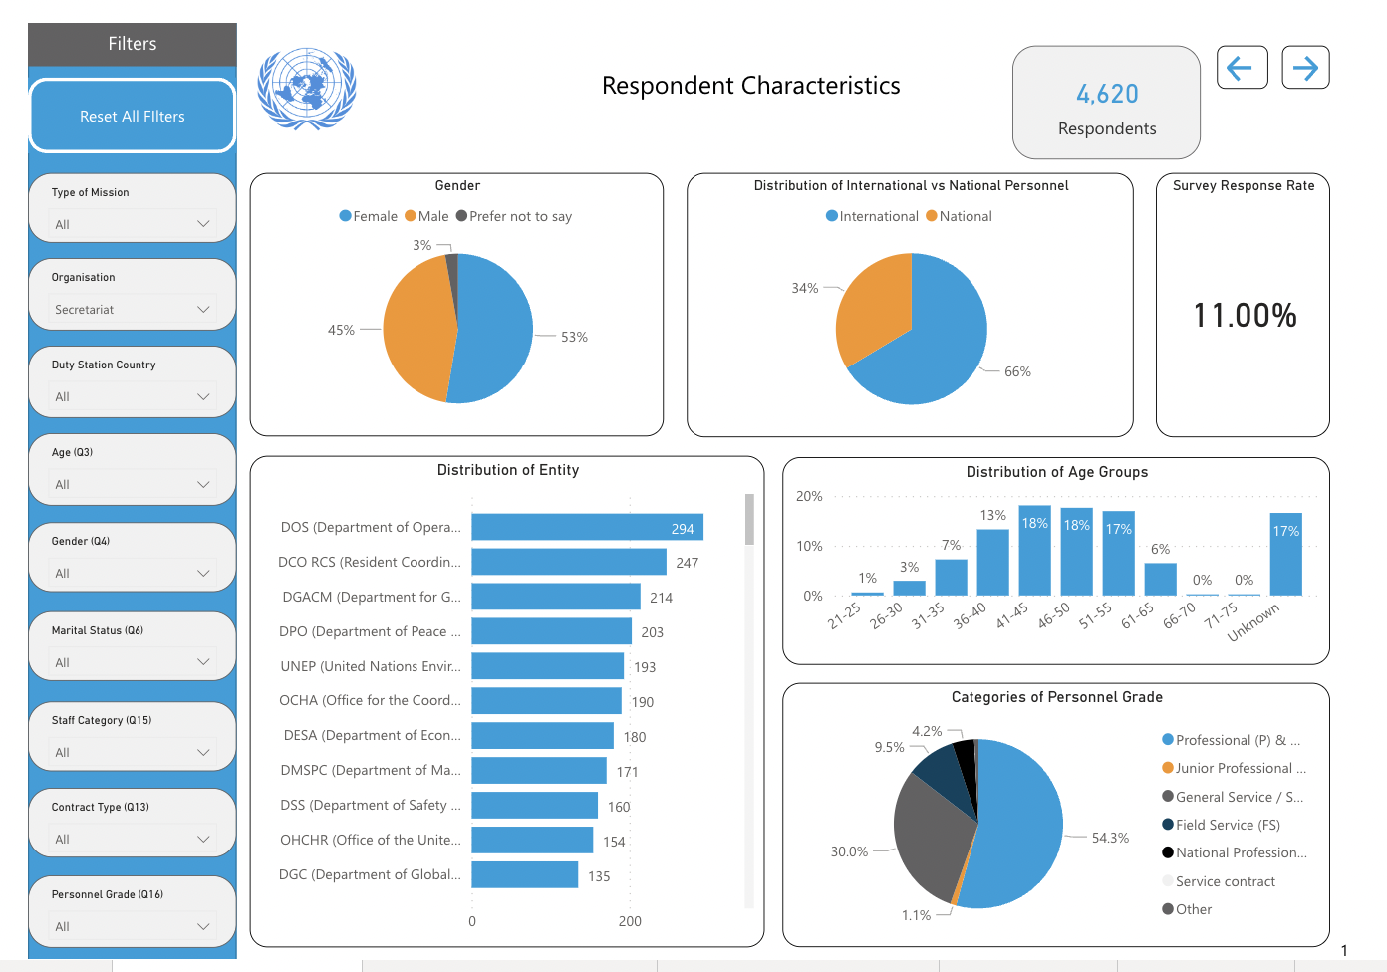
UN Staff Health & Wellness Survey and Interactive Dashboard: An Introduction
Dr Esther Tan
Senior Medical Officer
Chief of Public Health Section
DHMOSH, United Nations

Slide 2
Background
UN Medical Directors Survey on Staff Health & Wellness
UN Secretariat participated in the survey for the first time in late 2021
In total, 23 participating UN System agencies, with 19,034 respondents
Survey aimed to evaluate the overall staff health and wellbeing including mental and physical health
Survey results will help the organization improve its current staff health and wellbeing policies and shape its future approaches

Slide 3
Background (cont.)
A total of 4,620 UN Secretariat personnel worldwide responded - Includes personnel from DPO and DPPA
Represents 11% of the total UN Secretariat personnel world-wide
This survey represents the first time the UN Secretariat has conducted a Staff health and wellness survey of its personnel globally
Questions included physical health and mental health components.

Slide 4
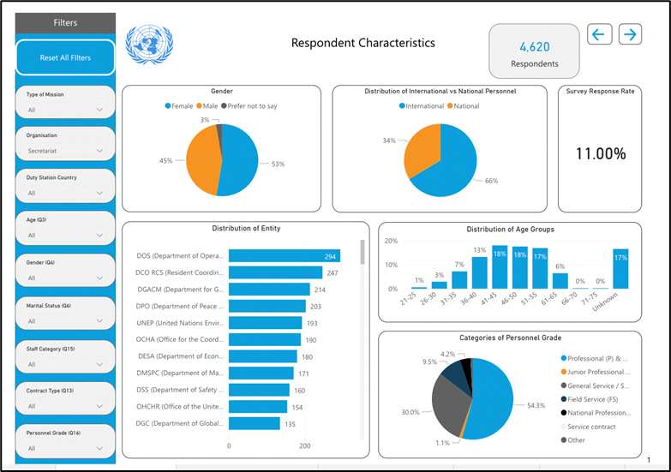
Data Analysis & Visualization
Physical Health Data collected has been visualized by DHMOSH Public Health using Power BI
Data can be filtered by location, entity, gender, age, personnel type etc.
High level summary and subsequent pages organize all questions by category
Dashboard Currently hosted on Iseek @ https://iseek.un.org/UN-Staff-Health-and-Wellness-Dashboard

Slide 5
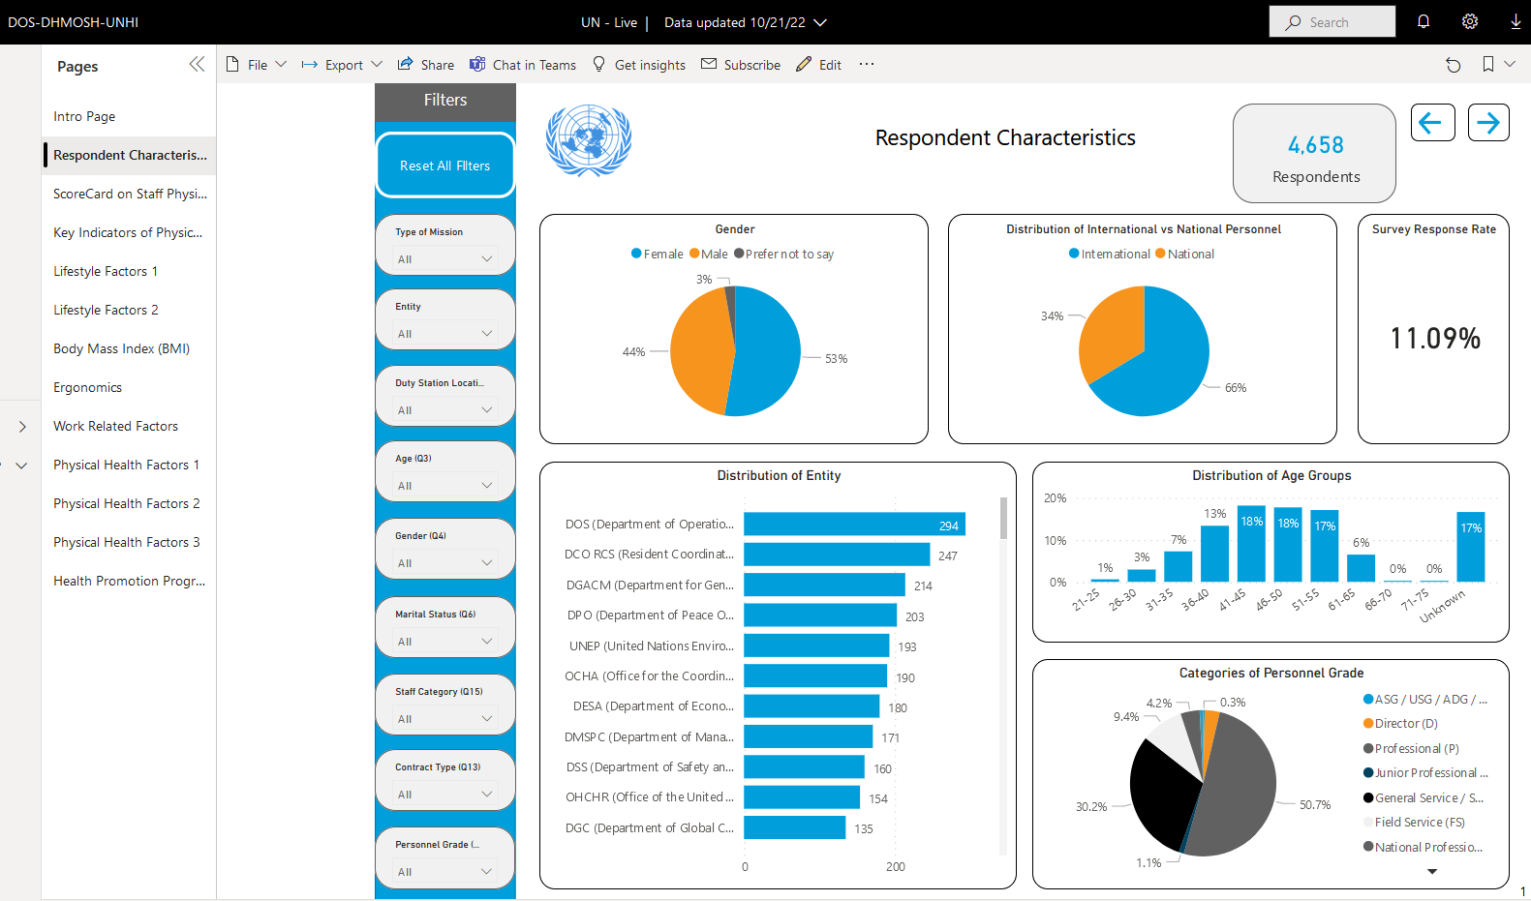
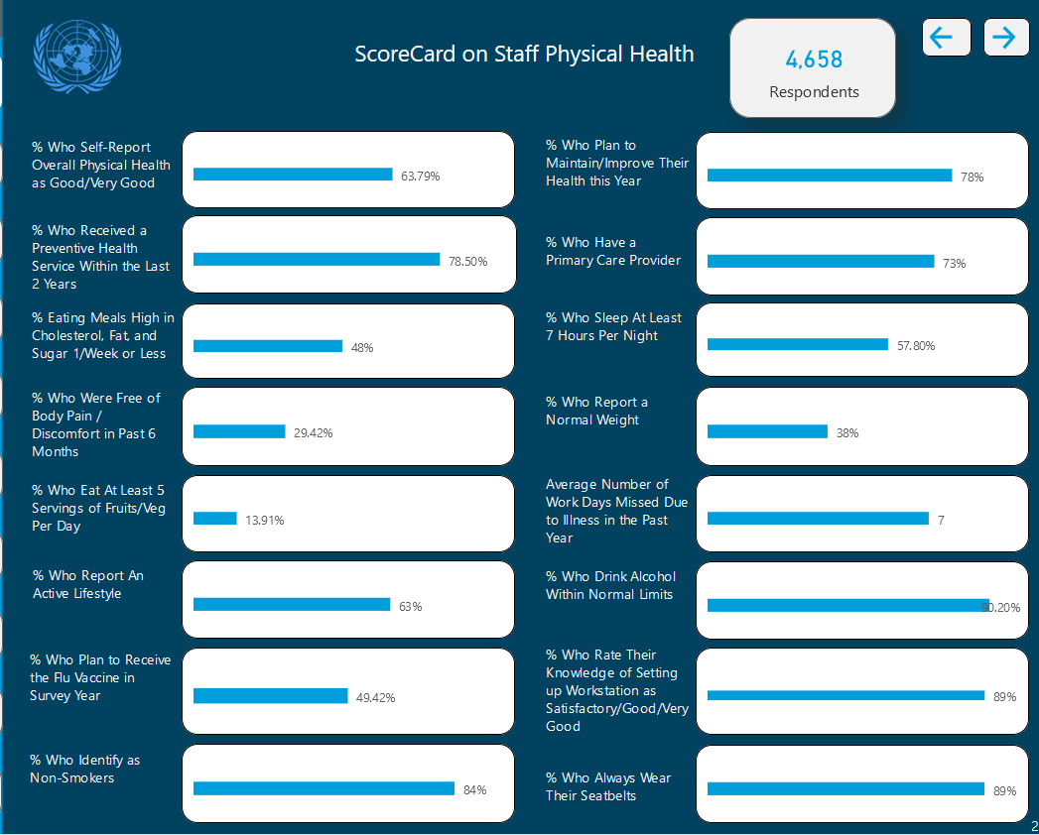
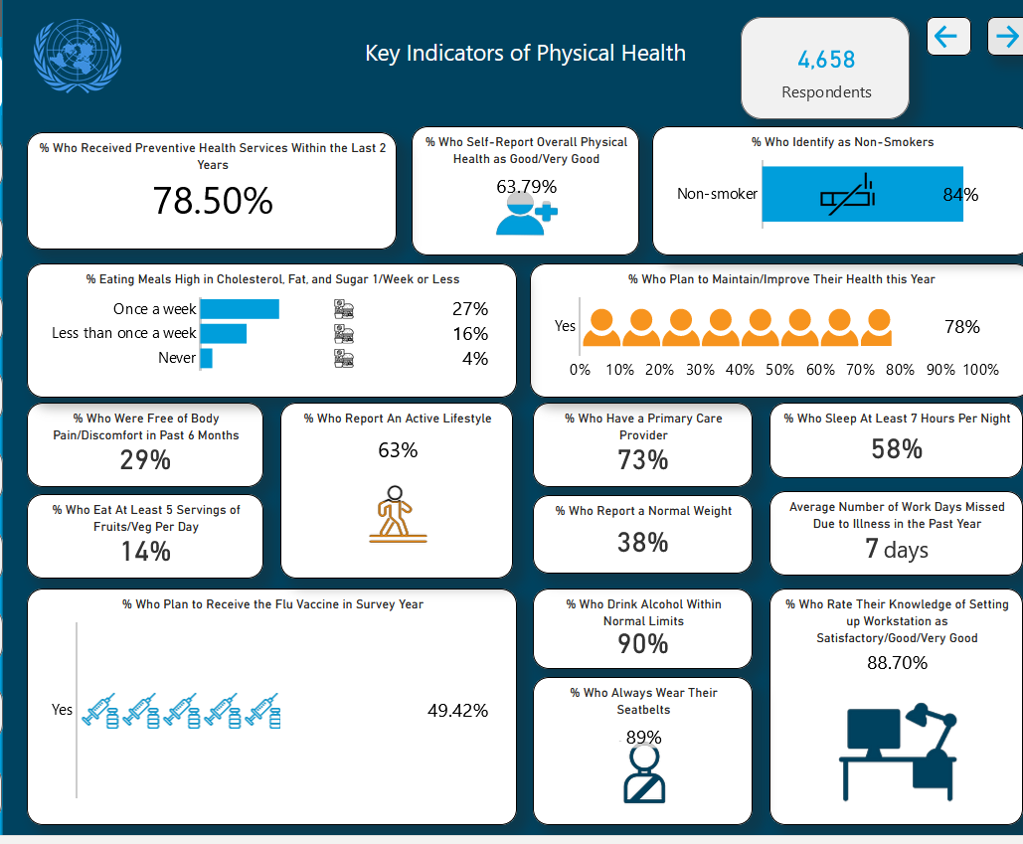
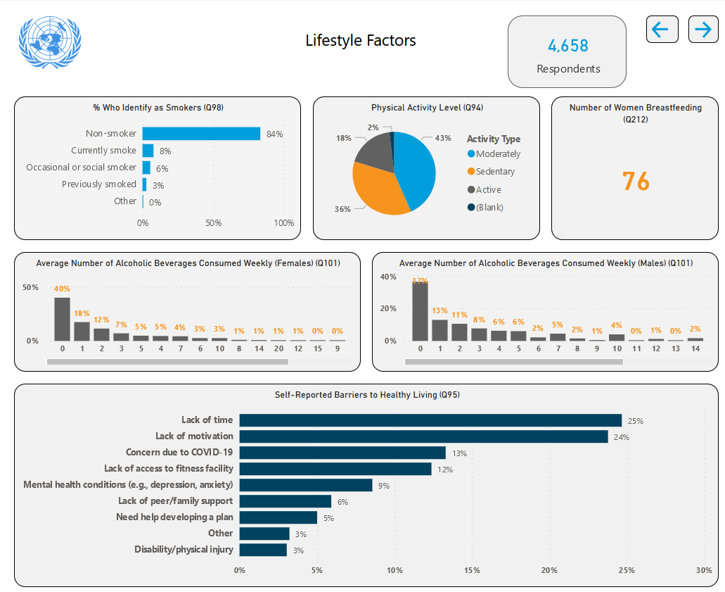
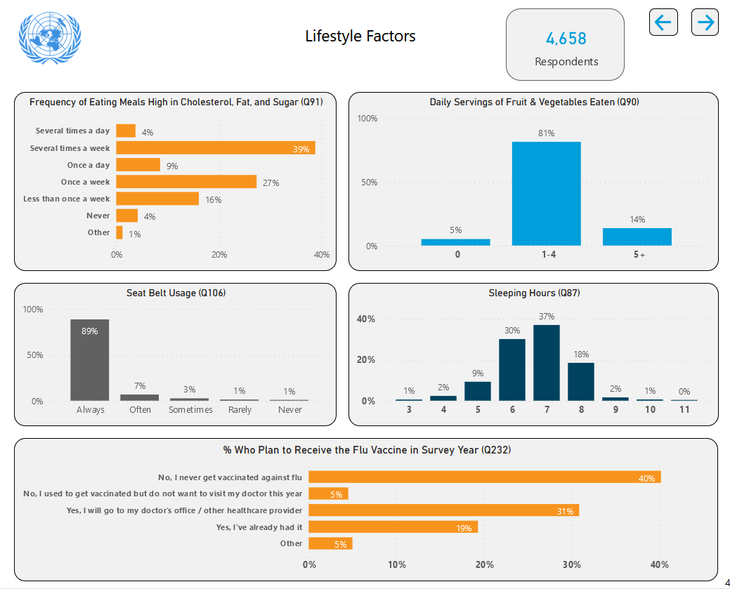
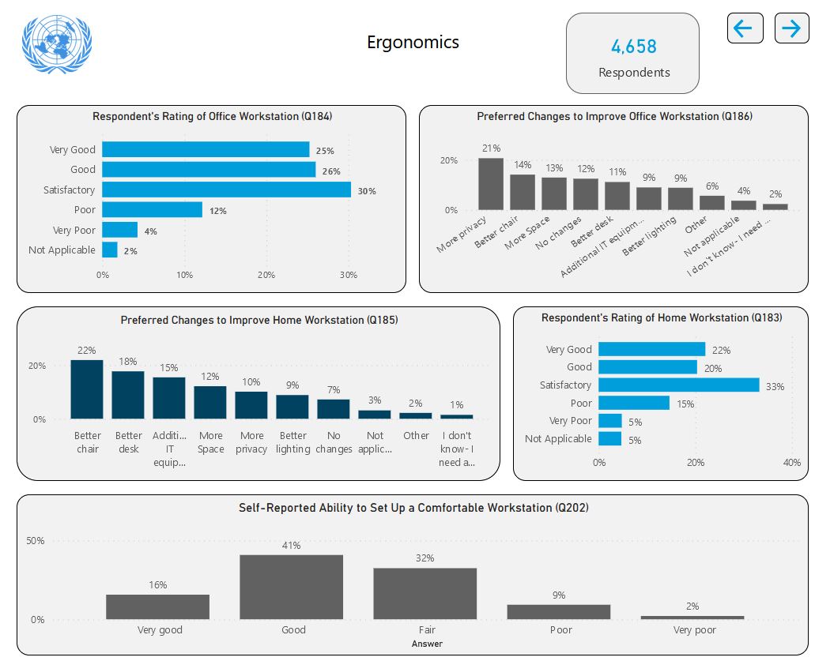
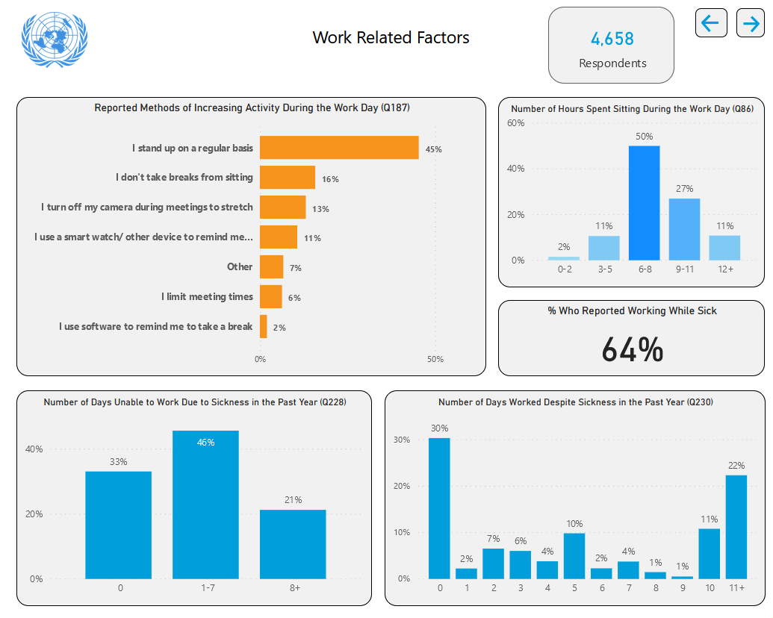
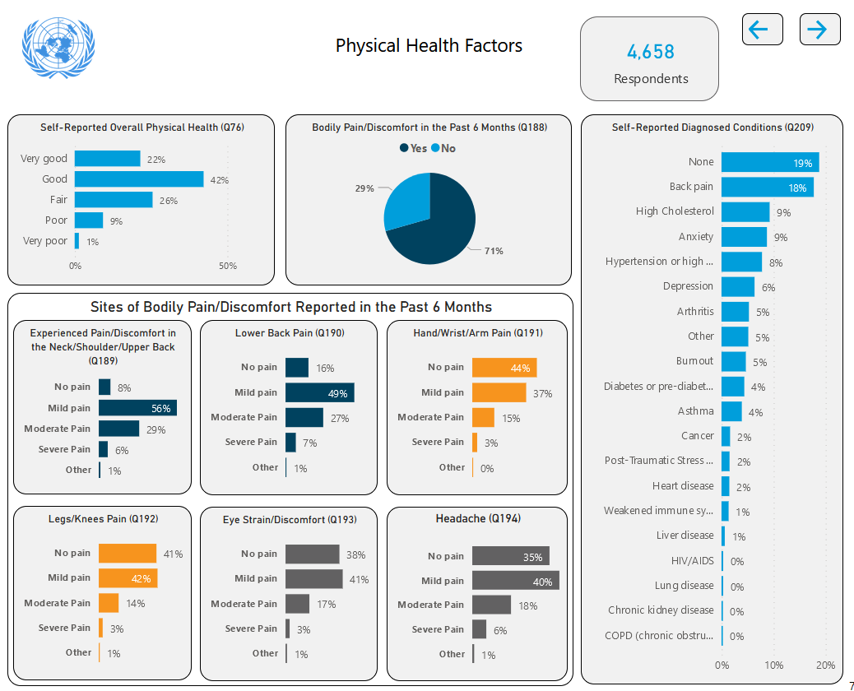
Screenshots of Dashboard

Slide 6
Screenshots of Dashboard

Slide 7
Screenshots of Dashboard

Slide 8
Screenshots of Dashboard

Slide 9
Screenshots of Dashboard

Slide 10
Screenshots of Dashboard

Slide 11
Initial Screenshots of Dashboard

Slide 12
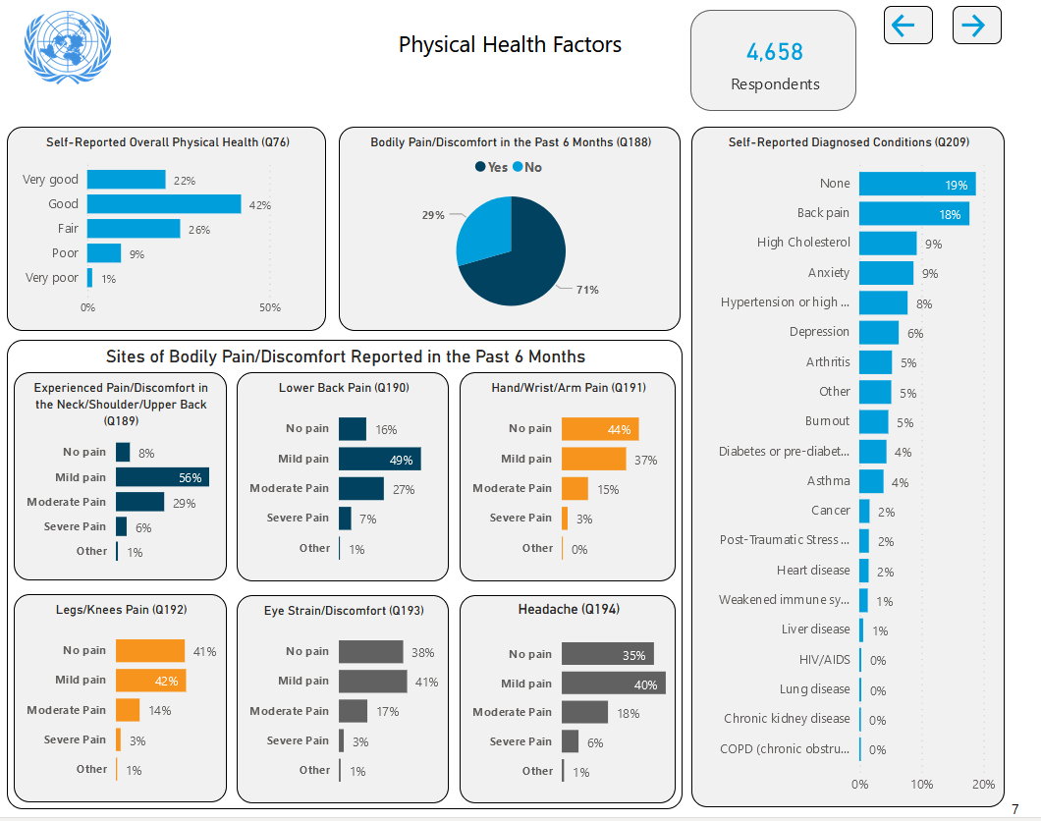
Initial Screenshots of Dashboard

Slide 13
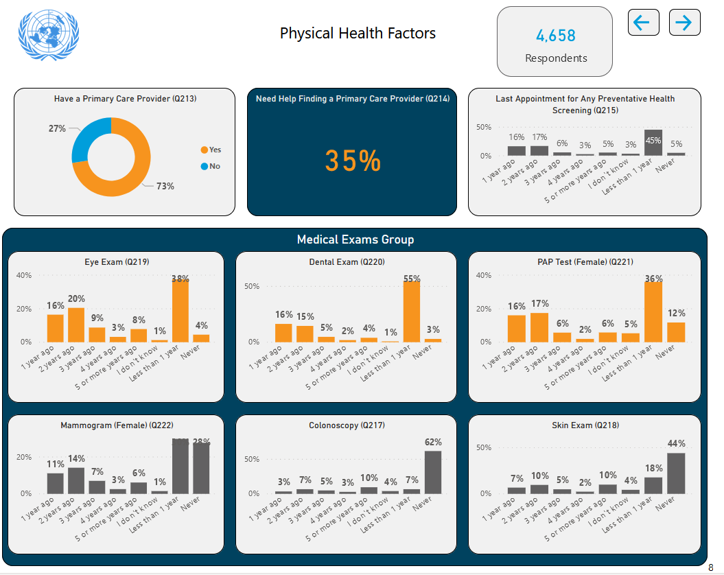
Screenshots of Dashboard

Slide 14
Key Survey Findings For UN Secretariat Global Cohort – Positive

Slide 15
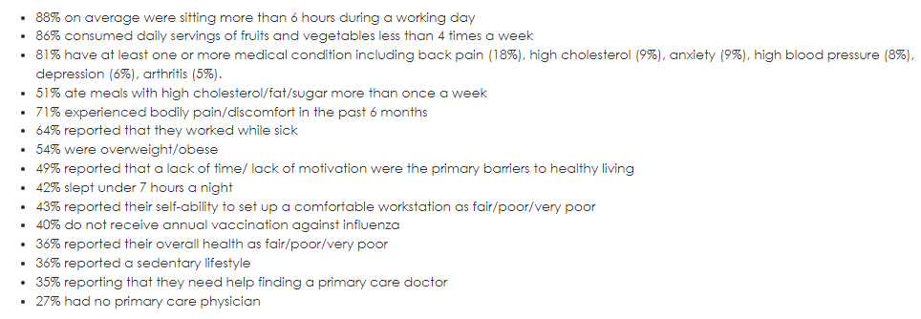
Key Survey Findings – Areas of Improvement

Slide 16
Key Survey Findings
Please Note: Current results focus solely on the physical health questions of the survey; a separate analysis of the mental health-related questions will be released in a later phase.

Slide 17
Next Steps/Action Plan
The dashboard / specific results has been shared with Secretariat management, including head of missions
DHMOSH working with individual entities/offices to develop action plan to address specific findings for their cohort
Each entity/office can utilize the dashboard to analyse results and develop their own health and well-being programs for staff.
Mental health module will be added soon
Survey likely repeated later this year – please encourage staff to respond!

Slide 18
Resources
Summary of Staff Health and Wellness Survey 2021 Key Findings: https://hr.un.org/page/un-secretariat-staff-health-wellness-survey-2021
UN Staff Health and Wellness Interactive Dashboard: https://iseek.un.org/UN-Staff-Health-and-Wellness-Dashboard

Slide 19
Thank You dos-dhmosh-public-health@un.org

