Slide 1
UN HIV PEP briefing
HIV Post-Exposure Prophylaxis (PEP)
Division of Healthcare Management and Occupational Safety and Health (DHMOSH)
Public Health Unit

Slide 2
Why HIV Post-Exposure Prophylaxis?
It is an emergency medical response for individual exposed to HIV
Consists of medications, laboratory tests and counseling services to the exposed
Must be initiated within hours of possible HIV exposure and must continue for a period of 28 days
Research studies suggest that if the medication is initiated quickly after the possible exposure Ideally within two hours and not later than 72 hours following possible HIV exposure- it may be beneficial in preventing HIV infection.
The main objective of PEP is prevention of HIV infection

Slide 3
How is HIV Transmitted?
What's the Fluid?
Where’s the Door?
Blood
Semen
Vaginal fluids
Breast milk
Saliva
Diarrhoea
Vomit
Sweat
Tears
Urine
Cuts, sores, and bruises
Open wounds
Vaginal lining
Mucous membrane
Rectum
Urethra

Slide 4

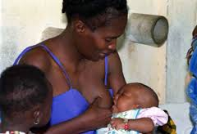
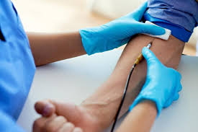
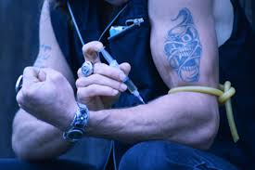
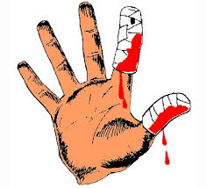
Most common ways through which HIV is transmitted
During sexual contact
Unprotected anal, vaginal sex
with infected partner
- Possibly oral sex
From mother to child
During pregnancy, child birth, breast feeding
Transfusion
of untested HIV-infected blood or blood products
  Injury from/sharing contaminated needles & syringes
Accidental contact with contaminated blood, other body fluids

Slide 5





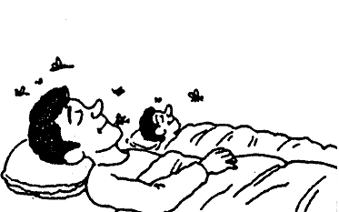
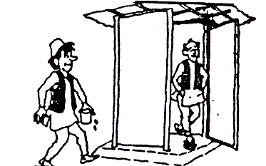
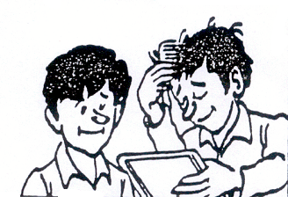

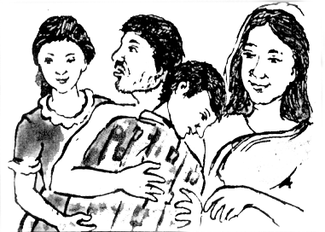
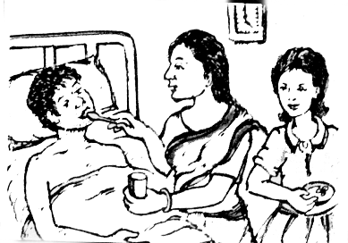
HIV is NOT transmitted by
Kissing Sharing Clothes
Eating together
Coughing /Sneezing Shaking Hands
Mosquito bites
Sharing Toilets Sharing Combs
Sharing Swimming Pool
Living together in a Family
Caring for Infected Persons

Slide 6

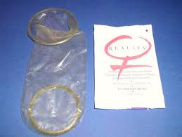

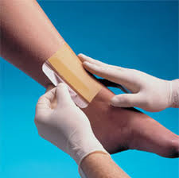
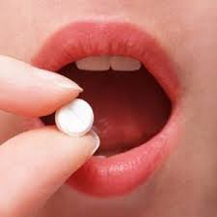
Preventing HIV Infection
Post-exposure Prevention
Pre-exposure prevention
Condoms
Emergency HIV Post-Exposure Prophylaxis
Standards Precautions
Pre-Exposure Prophylaxis
An HIV-negative person at high risk of exposure taking a pill a day of anti-HIV medication to prevent HIV infection in case of accidental exposure.

Slide 7
HIV Post-Exposure Prophylaxis (PEP)
Post-Exposure Prophylaxis (PEP) – emergency medical response given to prevent transmission of blood-borne pathogens following a potential exposure.
HIV Post-Exposure Prophylaxis (HIV PEP) - a set of services provided to
prevent HIV infection following potential exposure to the virus.
- Services include first aid, counselling, HIV exposure risk assessment, HIV
testing (with informed consent), a course of anti-HIV medication, with
appropriate support and follow up.
Should be initiated as soon as possible after exposure – Ideally within 2 hours
or less – and no later than 72 hours post- exposure.
Adherence to a full 28-day course of anti-retroviral (ARV) medicines is critical
to successful treatment.

Slide 8
Why the UN Provides HIV PEP.
1. Ideally, HIV PEP treatment should be available from any emergency medical
service anywhere in the world.
2. This is true already in many places, but not yet in all.
3. Therefore, the UN provides HIV PEP to field offices
  - As a responsible employer, because personnel can be at risk while working
  for the UN, especially in locations where HIV PEP is not available from
  local medical services.
  -To standardize access to HIV PEP for UN personnel as different countries
  still apply various degrees of restriction to access to HIV PEP.

Slide 9
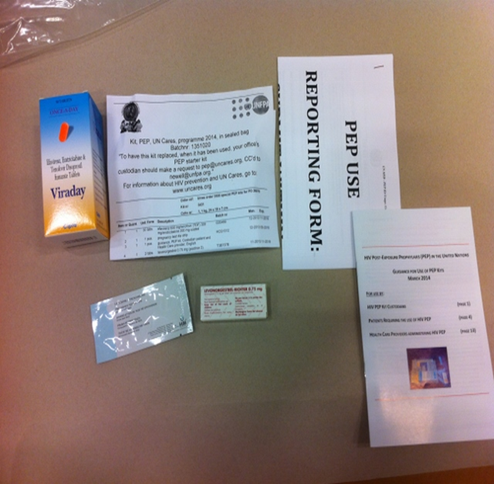
UN HIV PEP Kit
- An emergency UN HIV PEP Kit that provides a full 28-day HIV Post-Exposure Prophylaxis to UN personnel and their recognised dependants who may have been accidentally exposed to HIV.
Notes:
The purpose of this slide is to emphasise the basic contents of the kit, as listed on the left, which aren't changing, but to also show the difference in looks.

Slide 10
Who is Not Eligible for HIV PEP ?
The kits are not available for individuals who are/may be;
  Already infected with the HIV virus, or
  For medical reasons, PEP kits are not available to personnel or
  recognized dependents who are already living with HIV.

Slide 11
UN HIV PEP Kit
Contents
1. Anti-retroviral drugs:
  - A full 28-day anti-retroviral HIV medication
  - A combination tablet (3 drugs in one tablet).
  - ONE tablet a DAY for 28 days
2. Pregnancy test strip
  - To identify if an exposed woman of childbearing age was already
  pregnant before potential exposure to the virus
3. Emergency oral contraception (“morning-after” pill)
  - Tablets of Levonorgestrel to prevent unwanted pregnancy.
4. Guidance booklet on the use of PEP Kits
  - Guidance for the PEP Kit custodian, Patient, and attending Physician

Slide 12
Why have the Kits in duty stations?
The kits are provided so that
    the medication can be initiated as soon as feasible after possible HIV exposure – that is, within 2 hours and not later than 72 hours after possible exposure, and
    the necessary arrangements can be made for the evacuation of the patient to a location with adéquater medical facilities, in order to continue the PEP Treatment

Slide 13
Is the Patient’s Consent required?
YES
BEFORE the attending physician initiates the PEP Treatment, he /she must first obtain the consent of the patient.
CONFIDENTIALITY: Yes, all information and documentation regarding HIV PEP and sexual assault incident or occupational accidents must be treated with the strictest confidentiality.

Slide 14
Who is Eligible for UN HIV PEP Kit
UN HIV PEP Kits are available to all individuals with a United Nations agency contract and their spouses and dependent children who may have been accidentally exposed to HIV, regardless of means of exposure.
The relevant fundamental principle is that UN Security Management System personnel and their eligible dependents should have rapid and reliable access to PEP treatment, if required, as a means of managing personal and organizational risks.
Post-Exposure Prophylaxis (PEP) Kits are available for the immediate treatment of UN Security Management System personnel (including long-term, short-term, SSA and others) and eligible dependents, who may have been exposed to HIV infection, regardless of means of exposure.

Slide 15
Procurement and distribution of PEP kits
The selection and validation of the PEP kit contents are coordinated by DHMOSH with UN Medical directors and other stakeholders.
DHMOSH coordinates the procurement and distribution of PEP kits to duty stations with UNDSS and countries UN senior management team/Office of the Designated Official (DO)
Some UN Peacekeeping Missions are currently doing direct procurement of their PEP Kits.

Slide 16
Country-Level PEP Kit Management Structure
Designated Official
Security Management Team
Country
PEP Kit Manager
UN Location A
Custodian
Alternate
UN Location B
Custodian
Alternate
UN Location C
Custodian
Alternate
UN Location D
Custodian
Alternate
UN Location E
Custodian
Alternate
UN Location F
Custodian
Alternate

Slide 17
Role of Country Management
In all countries receiving PEP kits, must ensure that the PEP Annex has been included in the country security plans all their country .
Must ensure the PEP kits manager has been designated for the country
The UN Designated Official and UN Security Management team will coordinate the selection of Country PEP manager

Slide 18
Role of Country PEP Manager
Responsible for all PEP kits sent to the duty stations and the country.
Send a confirmation of receipt of PEP kits for the country to DOS_DHMOSH_PUBLIC_HEALTH@UN.ORG
Ensure that PEP kit custodian have been designated for all UN locations/duty stations in their respective country and provided them with PEP kits.
Ensure that all selected PEP kits custodians have designated alternates or deputies.
Ensure that all PEP kits custodians in the country have undergone training on their roles and responsibilities.

Slide 19
Role of Country PEP Manager
Ensure that PEP kits in all UN locations are safety kept under tamper-proof and hygienic conditions.
Ensure that expired PEP kits are collected and safely destroyed (or returned to WHO Medical Services ,Geneva , for destruction).
Ensure that PEP kit custodians contact list has been shared with all UN personnel in the country through most commonly used communications channels- emails. Security bulletin etc.
Ensure that staffs are provided with PEP kit information through UN HIV orientation and other staff briefings.

Slide 20
Role of PEP kit Custodian
Provide PEP services to all clients based on the PEP guidelines and country management protocol.
For every PEP kit used, must complete a MANDATORY report form and send to UN Division of Healthcare Management and Occupational Safety and Health New York at Dos_dhmosh_public_health@un.org
Must send request for replacement of used PEP kit through their country manager to Dos_dhmosh_public_health@un.org immediately after usage.
Provide PEP kit users the option to receive follow-up support from UN Division of Healthcare Management and Occupational Safety and Health New York

Slide 21
Key Steps in Releasing a PEP Kit.
1. If necessary, offer basic emotional support and reassure the person.
2. PEP kit Custodian Conduct administrative eligibility evaluation to determine if
the individual qualifies for a UN HIV PEP Kit usage.
3. Full PEP treatment eligibility evaluation is only done by a health care provider.
4. Custodian and Healthcare provider must mention to the individual what PEP
treatment means and that it is important to go through the full treatment.
5. Contact the UN Physician in the country or the health care provider listed
in the PEP Annex to the Country Security Plan informing him/her of the case
and making arrangements for PEP treatment.
6. Accompany the individual to the health care provider and hand over the kit to
the provider.

Slide 22
Key Duties and Responsibilities of a Custodian
7. Ensure safe and proper storage of PEP Kit.
8. Maintain Proper inventory and record of the Kits, ensuring uninterrupted
supply and availability.
9. Evaluation of the administrative right of the person to receive the UN PEP
Kit
10. Release a kit to a Health Care Provider after ensuring administrative
eligibility of the individual.
11. Ensure confidentiality of all related information and documentation.
12. Ensure 24/7 accessibility of Kits.

Slide 23
Key Duties and Responsibilities of a Custodian
13. Ensure that where a health care provider cannot be reached within 72
hours of exposure, that they advise exposed persons to call a
center of excellence on HIV, as listed in the PEP Annex to the Country
Security Plan.
14. A medical provider at the center of excellence can perform a risk
assessment over the telephone.

Slide 24
Care and Storage of PEP Kits
PEP Kits contain medication that should be carefully stored according to
manufacturer’s specifications.
Locked containers to avoid misuse, theft or vandalism.
Temperatures below 30ºC. No refrigeration is required though.
- Dry and protected from light, humidity and excessive heat.

Slide 25
PEP Kit Record Keeping
Keep proper inventory of kits under custody
Record and monitor expiry dates.
- Promptly record and report usage of every Kit
- Order replenishment of a used Kit.
- Promptly record new stock when received.
- All done in consultation with Country PEP Kit Manager

Slide 26
Resources and Contacts
For more information on HIV/AIDS and staff wellbeing : https://hr.un.org/page/health-and-wellbeing
For further information and enquiries contact Division of Healthcare Management and Occupational Safety and Health : dos_dhmosh_public_health@un.org

