Slide 1
PEP Kit Mandatory Custodian Training
Notes:
Good morning , good afternoon and good evening colleagues. This presentation will take us through the HIV basics, and HIV PEP in UN system

Slide 2
What is HIV?
What is HIV?
Notes:
. Lets start. What is HIV,

Slide 3
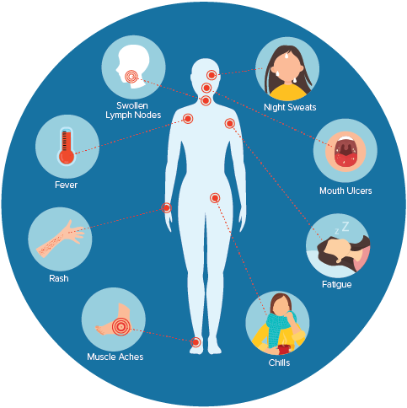
What is HIV/AIDS?
HIV stands for Human Immunodeficiency Virus and it attacks body immune system
AIDS stands for Acquired Immuno-Deficiency Syndrome is caused by HIV.
HIV interferes with body’s ability to fight infection and diseases.
Notes:
HIV Stands for Human Immuno deficiency virus which when it infect human attacks the body immune system. When one is infected this virus and with not treatment can leads to what we called AIDS which stands for Acquired Immunodeficiecy Syndrome which is a consequence of poor immune system cause by the virus. HIV interferes with our body’s ability to fight infection and diseases

Slide 4
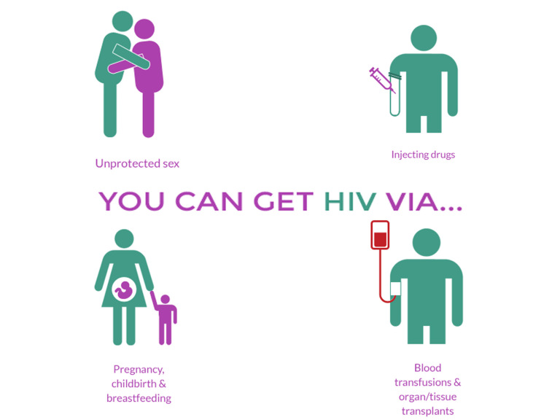
How is HIV Transmitted?
Major revisions of PEP training materials,
During unprotected sexual contact (Vaginal, Anal and oral sex) with infected partner.
Transfusion of blood and blood product.
From mother to child ( during pregnancy, childbirth and breastfeeding).
Sharing of contaminated needle and syringes.
Notes:
How is HIV transmitted, the commonest mode of transmission of HIV includes unprotected sexual contact with infected partners, this can be through vaginal sex, anal sex and oral sex. Though oral sex carries the least risk when compared to the others. The Second way of getting HIV is through transfusion with blood or blood products like plasma or platelets that are not screened properly for presence of HIV VIRUS.. The third way is mother to child transmission either when the woman during pregnancy, during childbirth or when breastfeeding the child . The fourth way is from sharing of contaminated needles and syringes which is very common among IV drug users and in communities where they re-use needles

Slide 5
HIV is NOT Transmitted By…….
Major revisions of PEP training materials,
Kissing
Coughing and Sneezing
Eating together
Shaking of hands
Mosquito bites
Sharing toilets
Sharing combs
Sharing swimming pool
Sharing clothes
Caring for infected persons
Notes:
Are there ways in which HIV is not transmitted ? YES. HIV is not transmitted by kissing, by coughing or sneezing, by eating together with infected person, by shaking hands with infected person, not through mosquito bites, sharing of toilets, sharing of combs, clothes and HIV is not transmitted by caring for infection person.

Slide 6
What is PEP?
Notes:
What is PEP

Slide 7
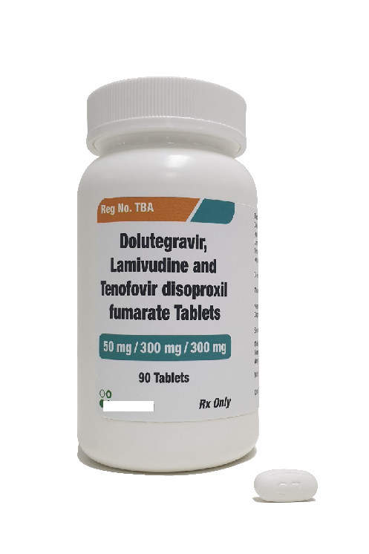
What is PEP?
PEP = Post Exposure Prophylaxis
HIV PEP = medications given after exposure to HIV, to prevent HIV infection
For effectiveness, need to start as soon as possible after HIV exposure, ideally within 72 hours
Must be taken daily for 28 days
Notes:
PEP stands for Post Exposure Prophylaxis and HIV PEP are medications you administer after exposure to HIV to prevent HIV infection. When an individual is exposed, HIV PEP need to start as soon as possible and ideally within 72 HOURS for it to be effective and the treatment DURATION is for 28 days.

Slide 8
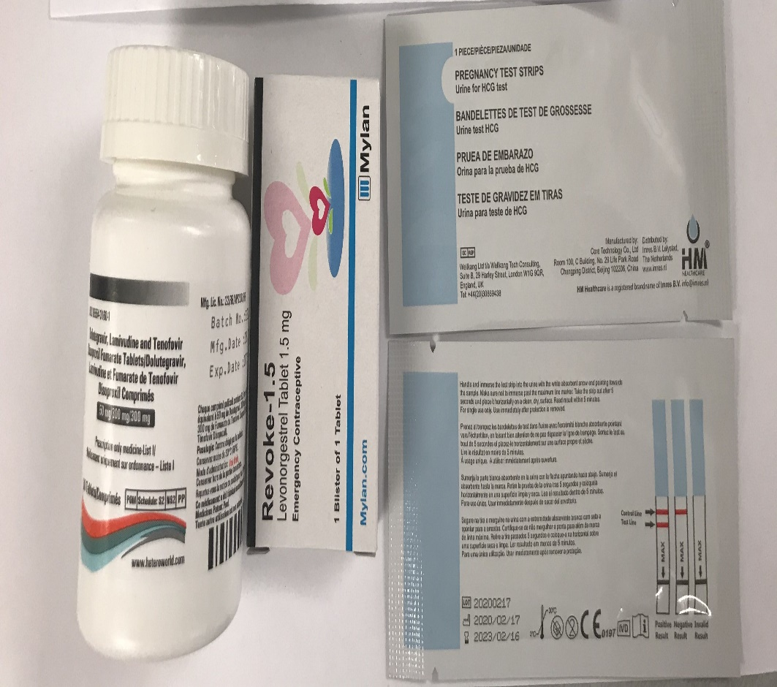
What Else is In the PEP Kit?
Antiretroviral 3-in-1 tablet (Tenofovir Disoproxil Fumarate 300mg + Lamivudine 300mg + Dolutegravir 50mg). One tablet taken daily for 28 days
Morning after pill – emergency contraception ( Tablet Levonorgestrel 1.5mg), 1 tablet only.
Pregnancy test kit (2 strips)
Notes:
What is in the HIV PEP KIT? Number 1 ARV DRUGS 3in 1 tablets. This is a fixed dose combination of Tenofovir disoproxil fumarate 300mg, lamivudine 300mg and dolutegravir 50mg. One tablet to be taken daily for 28 days. The second item in the kit is the morning after pill that is given for emergency contraception, to prevent pregnancy in exposed female patient before taking HIV PEP. And the third item is the two pregnancy test strips to check if a woman is pregnant before initiation of HIV PEP. Because if the patient is pregnant there may be need to modify the medication

Slide 9
New Kit Does Not Come with Hardcopies of Forms / Guidelines
Please note that the new kit does NOT come with the hardcopies of the forms and the guidelines
It is mandatory that you print out the full set of guideline (https://hr.un.org/page/pep-kit-programme-0) and pass to the patient.
The above guidelines also contain a copy of the two forms needed to be completed.
Put here the screen shot of the guideline cover and the 2 forms
Notes:
The new kit does not come with the hardcopies of the UN Medical Directors HIV PEP guidelines and the two required forms. The HIV PEP guideline contains all information required for administration of HIV PEP within the UN system and it is approved by the UNMD. It is important that custodian print out the HIV guidelines and pass to the patient . The Guidelines also contains two forms required when giving PEP out.

Slide 10
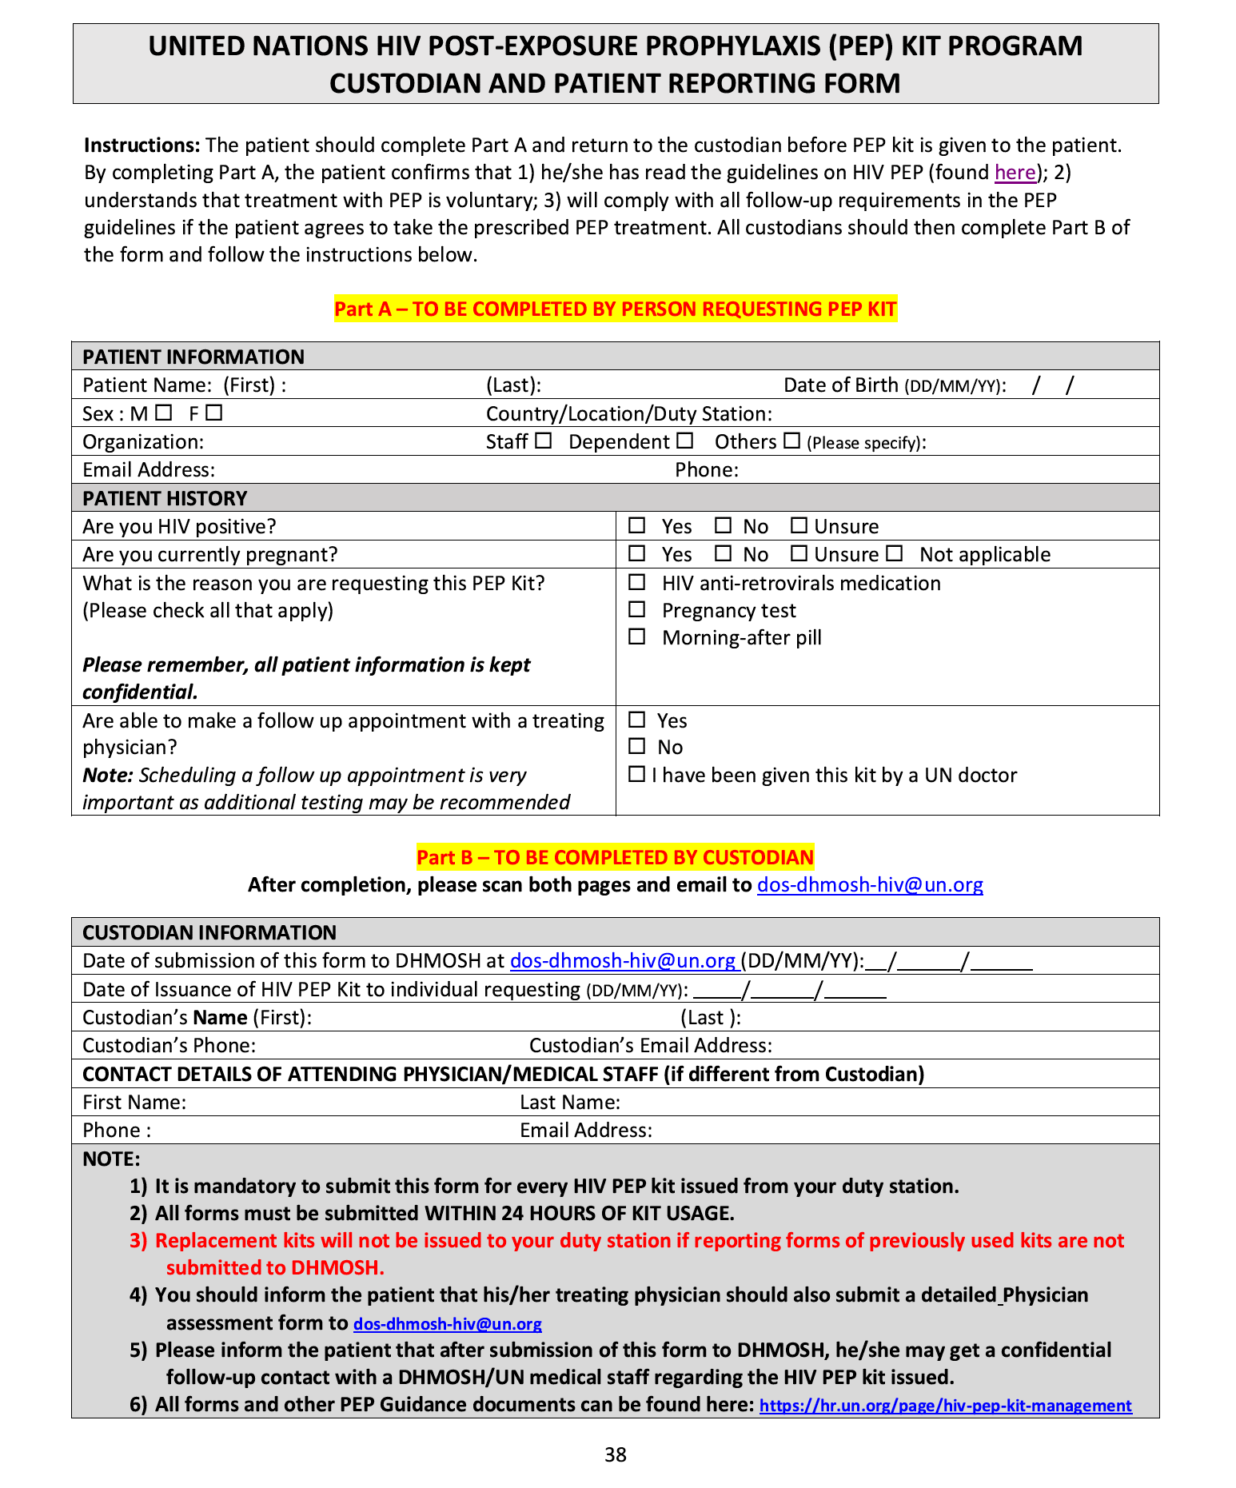
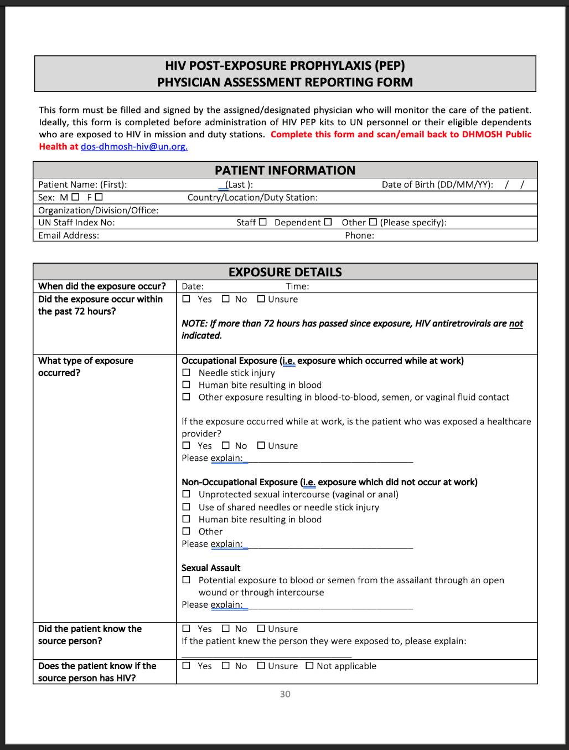
Two Forms to Be Completed
Custodian & Patient Reporting Form
Physician Assessment Form
Notes:
The two important forms required when giving out PEP are the Custodian and Patient reporting form on the left of your screen and the Physician assessment form on the right .

Slide 11
Custodian and Patient Reporting Form
Patient should complete “Part A” of the form and return to custodian before PEP kit is given.
Custodian must complete “Part B” of the form before submission of the entire form to DHMOSH at dos-dhmosh-hiv@un.org .
All section of the form must be filled by both patient and custodian
Notes:
For the custodian and patient reporting form, the patient must complete Part A of the form which contains the patient biodata and organization information, while the custodian must complete the Part B of the form and submit to DHMOSH using the email address shown . It is Mandatory to fill all section of this form before sending it to us.

Slide 12
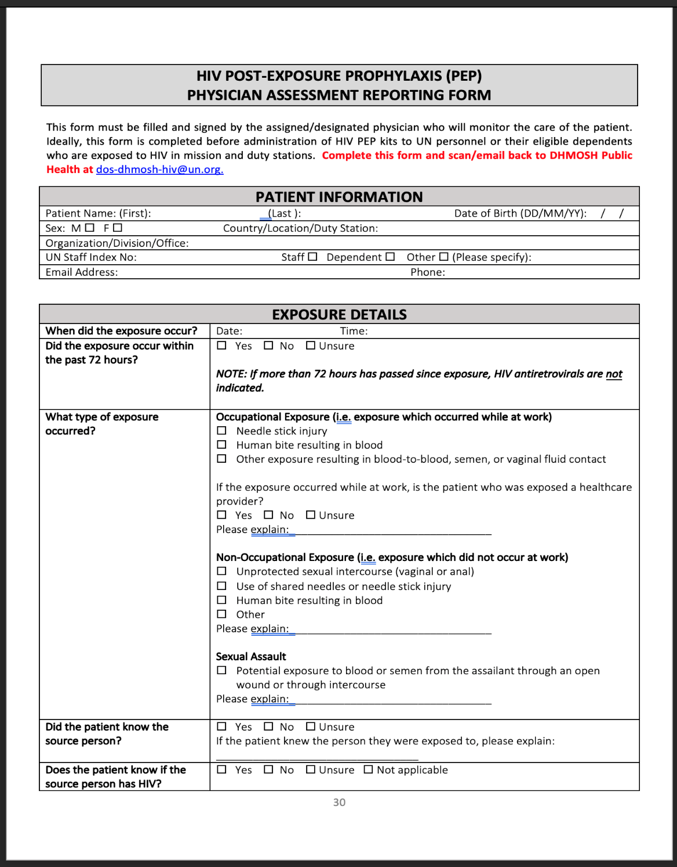
Physician Assessment Form
It is MANDATORY for attending physician to do the following whenever HIV PEP kits is being administered:
Provide all required information to the client before administration of HIV PEP
Where the Custodian is the healthcare provider, the Physician Assessment form must be completed in addition to the Custodian Reporting form.
xx
Notes:
The second form is the Physician Assessment form , this is for documentation of the attending healthcare provider assessment findings in the patient or client before HIV PEP is given out. In instances where the custodian is the healthcare provider, they must fill both custodian and physician assessment form and send to DHMOSH

Slide 13
Why Does the UN Provide HIV PEP?
Notes:
Why does the UN PROVIDE HIV PEP her personnel?

Slide 14
Why Does UN Provide HIV PEP?
Not all locations have access to HIV PEP from local health providers
UN therefore makes this available as a responsible employer
Still need to be followed up accordingly by UN/personal physician
Notes:
This is is because not all location have access to HIV PEP services from their local healthcare providers and UN as a responsible employer and as part of duty of care need to make this service available to all personnel working for the organization. And also because of neccsity to follow up with all UN personnel when they are exposed.

Slide 15
Who Is Eligible for HIV PEP?
UN HIV PEP kits are available to all personnel covered under the United Nations Security Management System in the country and their eligible dependents, who may have been accidentally exposed to HIV, regardless of means of exposure .
Notes:
Do we give HIV PEP to just anybody , NO . If so , who is eligible for HIV PEP? UN HIV PEP kits are available to all personnel covered under the United Nations Security Management System in the country and their eligible dependents, who may have been accidentally exposed to HIV, regardless of means of exposure .Part of the role of the custodian is to check the staff eligibility whenever they are accessing PEP services

Slide 16
How Should a Custodian Administer the PEP Kit?
Notes:
How Should a Custodian Administer the PEP Kit?, and what are the steps to follow before giving out PEP KIT?

Slide 17
Steps for Administering the HIV PEP Kit -1
Custodian Conduct administrative eligibility to determine if the individual qualifies for a UN HIV PEP Kit usage.
Custodian contact UN Physician or healthcare provider listed in country security plan PEP annex.
Custodian accompany patient to healthcare provider and handover kit
Healthcare provider conduct full PEP assessment and eligibility and proceed with treatment if exposure is confirmed
Notes:
Number 1, Custodian must Conduct administrative eligibility to determine if the individual qualifies for a UN HIV PEP Kit usage. Number 2: Custodian must contact UN Physician or healthcare provider listed in country security plan PEP annex and inform them that they have a HIV PEP case. Number 3 the Custodian accompany patient to healthcare provider and handover kit, Number 4 the Healthcare provider will conduct full PEP assessment and eligibility and proceed with treatment if exposure is confirmed

Slide 18
Steps for Administering the HIV PEP Kit-2
Custodian and Healthcare provider inform patient about all information about PEP treatment and what it means.
Custodian release the kit to the healthcare provider after confirming administrative eligibility and physician assessment.
Where healthcare provider cannot be reached with 72 hours, patient will be advice to call Center of Excellence as listed in the Country Security Plan HIV PEP Annex
Healthcare provider at this center will perform a risk assessment over the telephone and kit can then be given.
Notes:
Number 5 the Custodian and Healthcare provider will provide patient with all information about PEP treatment and what it means and importance of compliance and adherence to the treatment and also answer all questions the patient may ask, Number 6 : The Custodian will release the kit to the healthcare provider after confirming administrative eligibility and after the physician assessment has been finalized , Number 7 In situation Where an healthcare provider cannot be reached with 72 hours, patient will be advice to call Center of Excellence as listed in the Country Security Plan HIV PEP Annex, Number 8 :The Healthcare provider at this center will perform a risk assessment over the telephone and kit can then be given

Slide 19
Steps for Administering the HIV PEP Kit-3
Custodian and patient will complete the “Custodian & Patient Reporting form” and send to dos-dhmosh-hiv@un.org .
Healthcare provider complete “Physician Assessment Form” and send to dos-dhmosh-hiv@un.org .
DHMOSH will follow up with the patient and when requested provide psychosocial support.
Custodian keep up to date inventory of all PEP kits and their usage.
Notes:
Number 9: The Custodian and patient will complete the “Custodian & Patient Reporting form” and send to dos-dhmosh-hiv@un.org , Number 10: The Healthcare provider will complete “Physician Assessment Form” and send to dos-dhmosh-hiv@un.org Number 11: DHMOSH will follow up with the patient and when requested provide psychosocial support. Number 12 : Custodian keep up to date inventory of all PEP kits and their usage.

Slide 20
Care and Storage of PEP Kits
Store according to manufacturers instructions.
Temperature below 30⁰ C and away from direct sunlight and extreme humidity.
Dispose expired kit following your local health authority guidance.
Where not available : Send all expired kit to World Health Organization as shown in the HIV PEP guidance.
Notes:
How to we take care of the kits in our custody. This leads us to Care and storage of pep kits. We need to store according to manufacturers instructions, We keep them at room temperate or Temperature below 30 C and from extremes of temperature, from direct sunglught an extreme humidity. Alll expired kits must be disposed following local health authority guidance, and where thisis not possible , send all expired kit to WHO address that is available in the HIV PEP guidance.

Slide 21
On Maintaining Confidentiality
PATIENT CONSENT REQUIRED: Yes
Attending Physician must obtain before initiating HIV PEP.
CONFIDENTIALITY : All HIV PEP information and documentation must be treated with strictest confidentiality
Notes:
Confidentiality and consent ; Dow we require patient consent , YES. That is why the patient need to fill PART A od the custodian and patient reporting form. And All HIV PEP information and documentation must be treated with strictest confidentiality . This essential to avoid stigmatization

Slide 22
Record Keeping for PEP Kit Use
All PEP Kits used must be documented by completion and submission of form – kits are replenished only if forms are submitted properly.
A log must be kept of all PEP kits given out, date of release etc.
DHMOSH will request for your record monthly
Record and monitor expiry dates of kit items
Notes:
Inventory and Record keeping for PEP kit : All PEP Kits used must be documented by completion and submission of f all required form – kits will only be replenished if forms are submitted properly. A log must be kept of all PEP kits given out, date of release . We (DHMOSH) will request for your record monthly. And Record and monitor expiry dates of kit items

Slide 23
Resources
For more information on HIV PEP Management visit webpage : https://hr.un.org/page/hiv-pep-kit-management
For more information on HIV/AIDS: dos-dhmosh-hiv@un.org

Slide 24
Dr. Esther Tan, Dr. Fola, Michael Almendral
Dos-dhmosh-hiv@un.org
PEP Kit Website: https://hr.un.org/page/hiv-pep-kit-management

