Slide 1
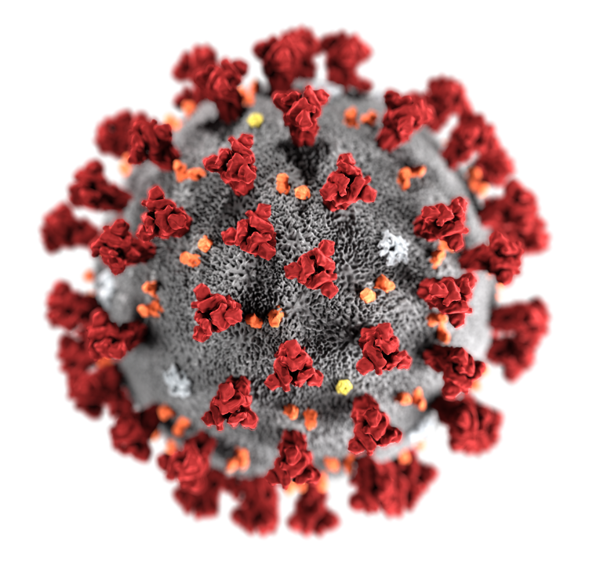
Novel coronavirus
(COVID-19)
Update for UN Personnel
UN Division of Healthcare Management and Occupational Safety and Health DHMOSH/OSO/DOS
Tuesday, February 18, 2020

Slide 2
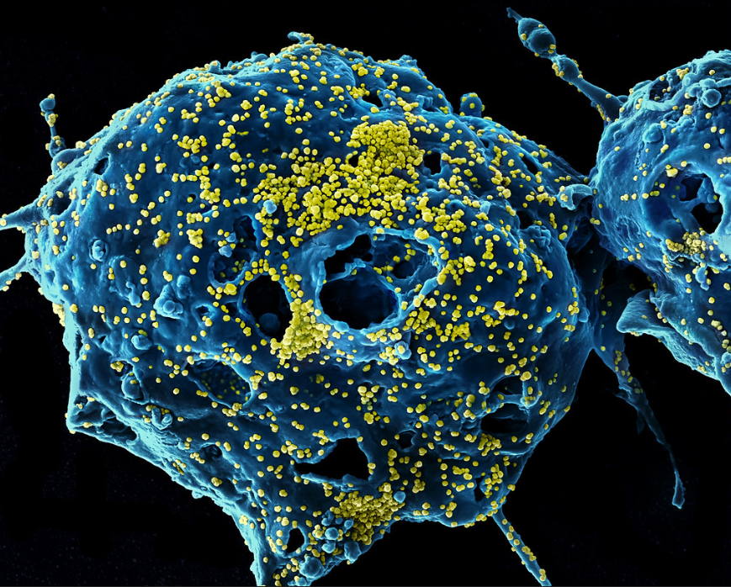
What Are Coronaviruses?
A large family of viruses
Several known coronaviruses that infect people usually only cause mild respiratory diseases e.g. common cold
Two previously identified coronavirus have caused severe diseases
  Severe Acute Respiratory Syndrome (SARS) coronavirus
  Middle East respiratory syndrome (MERS) coronavirus’

Slide 3
What Is 2019 Novel Coronavirus (COVID-19)?
New virus that causes respiratory illness in people
First identified during an investigation into an outbreak in Wuhan China
Probably originally emerged from an animal source but now seems to be spreading from person-to-person
  Spreading from person-to-person in China
  Limited spread among close contacts has been detected in some countries outside China
See latest WHO case numbers here: https://www.who.int/emergencies/diseases/novel-coronavirus-2019/situation-reports/
Unclear now how easily or sustainably this virus is spreading between people
Older adults and people with underlying health conditions may be at increased risk for severe disease
Situation is rapidly evolving
Currently appears to be majority mild disease

Slide 4
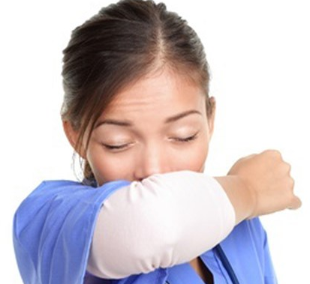
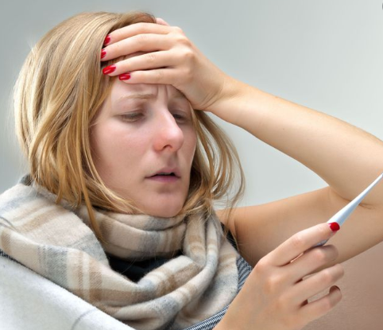
What Are the Symptoms of COVID-19?
Patients had mild to severe respiratory illness with symptoms of:
  Fever
  Cough
  Shortness of breath
Some patients with complications had pneumonia in both lungs
Transmit only when symptomatic
Incubation period (ie time of exposure to symptom onset) is 2-14 days

Slide 5
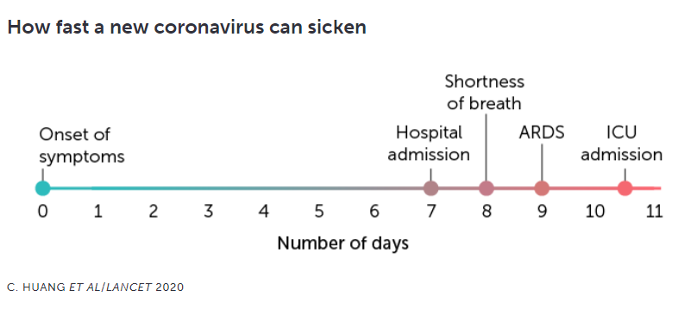

Slide 6
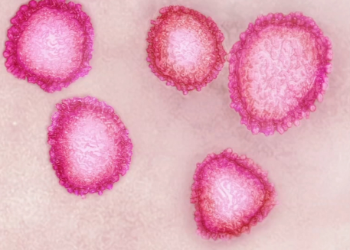
Is There a Vaccine or Treatment?
There is currently no vaccine to protect against COVID-19.
There is no specific antiviral treatment.
  Treatment is mainly supportive to relieve any symptoms.

Slide 7
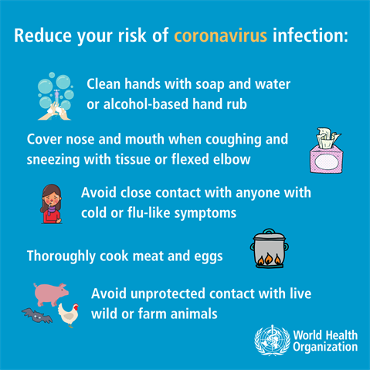
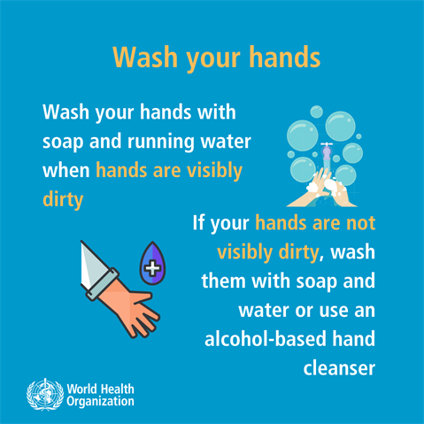
Key Staff Messages: How can I Help Protect Myself?
Avoid close contact with people who are sick
Avoid touching your eyes, nose, and mouth with unwashed hands
Wash your hands often with soap and water for at least 20 seconds. Use an alcohol-based hand sanitizer if soap and water are not available

Slide 8
Performing Hand Hygiene - How to hand rub

Slide 9
How to hand wash

Slide 10
Respiratory Hygiene and cough etiquette
Cover nose and mouth with a disposable towel or elbow when sneezing/coughing. Dispose off used towels in a closed bin and wash hands as above.

Slide 11
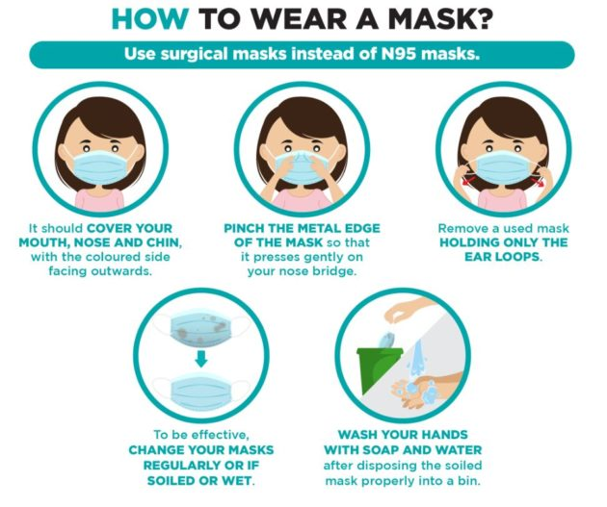
How to Wear a Surgical Mask Properly?
Kalra, A. S. (2020, January 30). How and when to wear a surgical mask during the Wuhan virus outbreak. Retrieved from https://www.humanresourcesonline.net/how-and-when-to-wear-a-surgical-mask-during-the-wuhan-virus-outbreak/

Slide 12
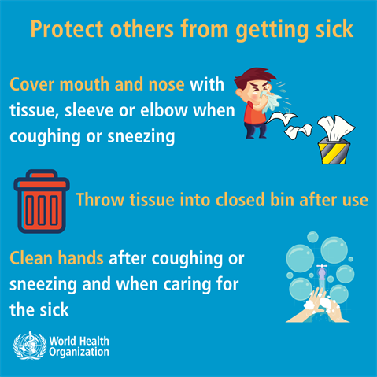
Key Staff Messages: What Should I Do If I Am Sick?
Stay home when you are sick
Cover your cough or sneeze with a tissue, then throw the tissue in the trash
Clean and disinfect frequently touched objects and surfaces
Do not come to workplace until you are free of any symptoms

Slide 13

Specific Recommendations from DHMOSH: Travel
Do not travel while you are sick.
WHO does not recommend any travel restrictions.
Be aware that local authorities may implement travel restrictions and health screening measures at any time.
  If you have to travel, check with embassies, consulates or Ministries of Health to keep up to date with the local health advice. You should comply with any public health measures put in place by local authorities.
If you must travel:
  Avoid contact with sick people
  Discuss travel with your healthcare provider. Older adults and those with underlying health issues may be at risk for more severe diseases
  Avoid animals, animal markets, or products that come from animals that are uncooked
  Wash your hands frequently

Slide 14

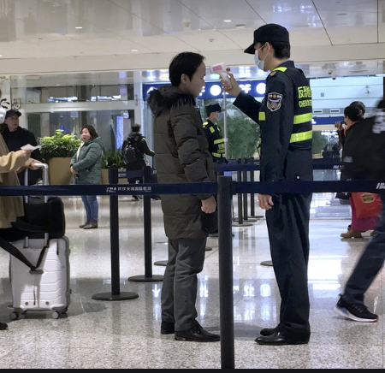
Specific Recommendations from DHMOSH: Meetings
WHO does not recommend any travel restrictions.
Meeting participants should be aware that local authorities may implement travel restrictions and health screening measures at any time.

Slide 15
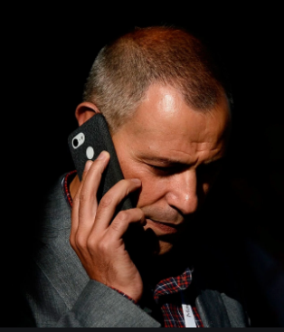

Specific Recommendations from DHMOSH: After Travelling From China
Monitor your health daily for 14 days after leaving China.
If you get any symptoms during the 14-day period, avoid contact with others. Call your doctor to tell them about your symptoms and your recent travel.
For those who are well and have no symptoms, managers are encouraged to exercise flexibility in term so using remote working arrangements.

Slide 16
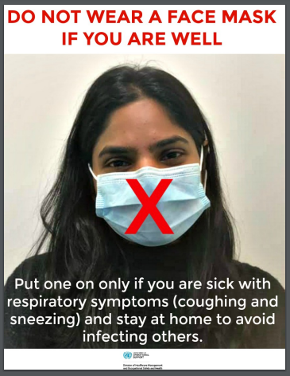
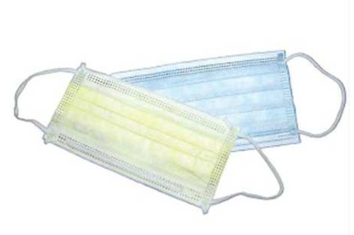
Specific Recommendations from DHMOSH: Face Masks
The WHO does not recommend the use of facemasks for the general public to prevent the spread of COVID-19.
You do not need to use a facemask if you have no symptoms (unless mandated by local authorities).

Slide 17

Solidarity, Not Stigma
WHO has advised against any restrictions of international traffic and UN is aligned with that. Countries may elect to implement bans independently.
Promote message of “Solidarity, Not Stigma”
Do not show prejudice to people of Asian descent, because of fear of this new virus.
Do not assume that someone of Asian descent is more likely to have COVID-19.

Slide 18
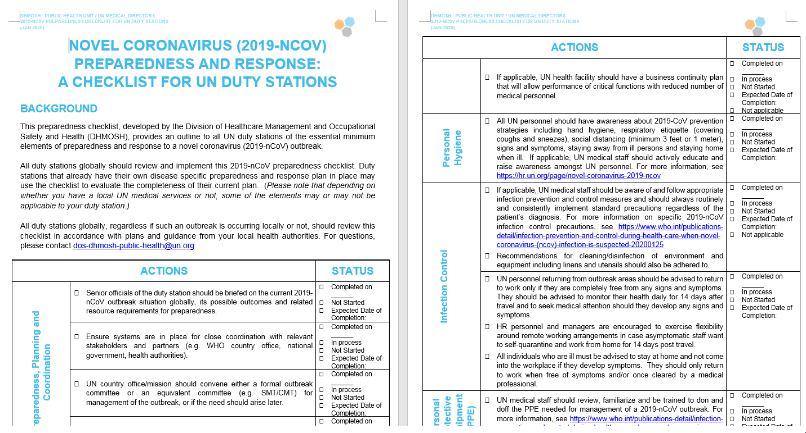
2019-NCoV Preparedness Checklist for All Duty Stations

Slide 19


Slide 20
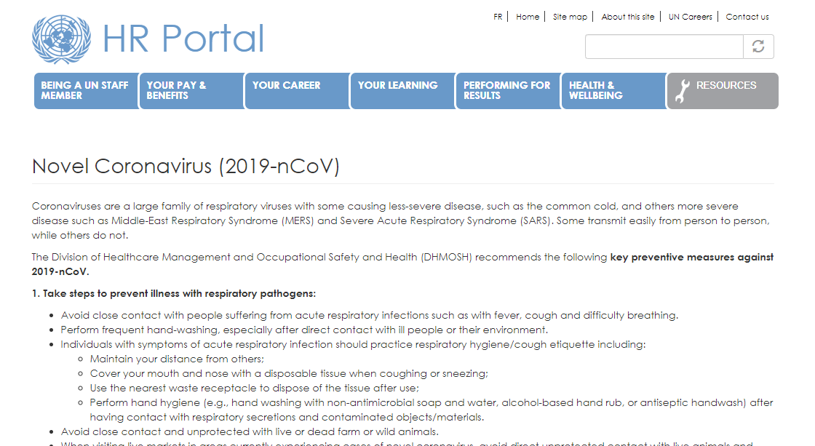
Dedicated Novel Coronavirus Website for UN Personnel
https://hr.un.org/page/novel-coronavirus-2019-ncov

Slide 21
Thank you

