Slide 1
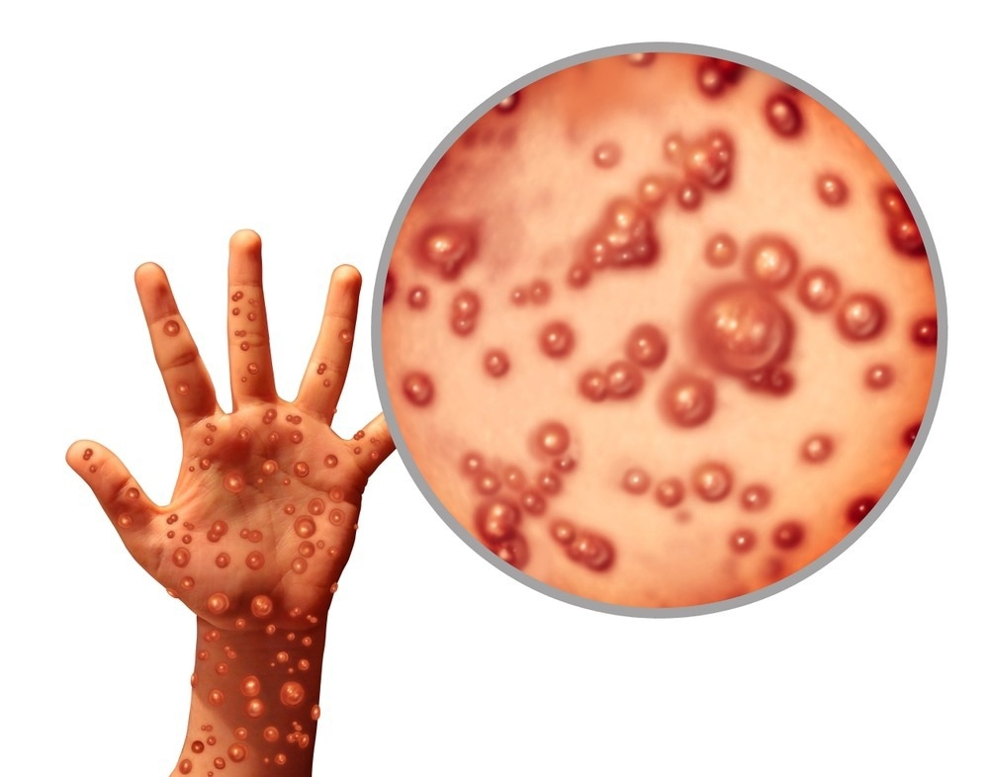
UN Medical Directors Risk Mitigation Plan for Monkeypox: Recommendations for UN Personnel
Dr. Esther Tan, MD MPH
Senior Medical Officer,
DHMOSH Public Health

Slide 2
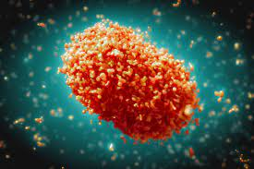
Introduction
Monkeypox is a zoonotic Orthopoxvirus
Since May 13, 2022, there has been a multi-country monkeypox outbreak reported in non-endemic countries in the absence of travel to endemic areas
Duty stations should take into account any local host country/authorities’ guidance and regulations when implementing these recommendations

Slide 3
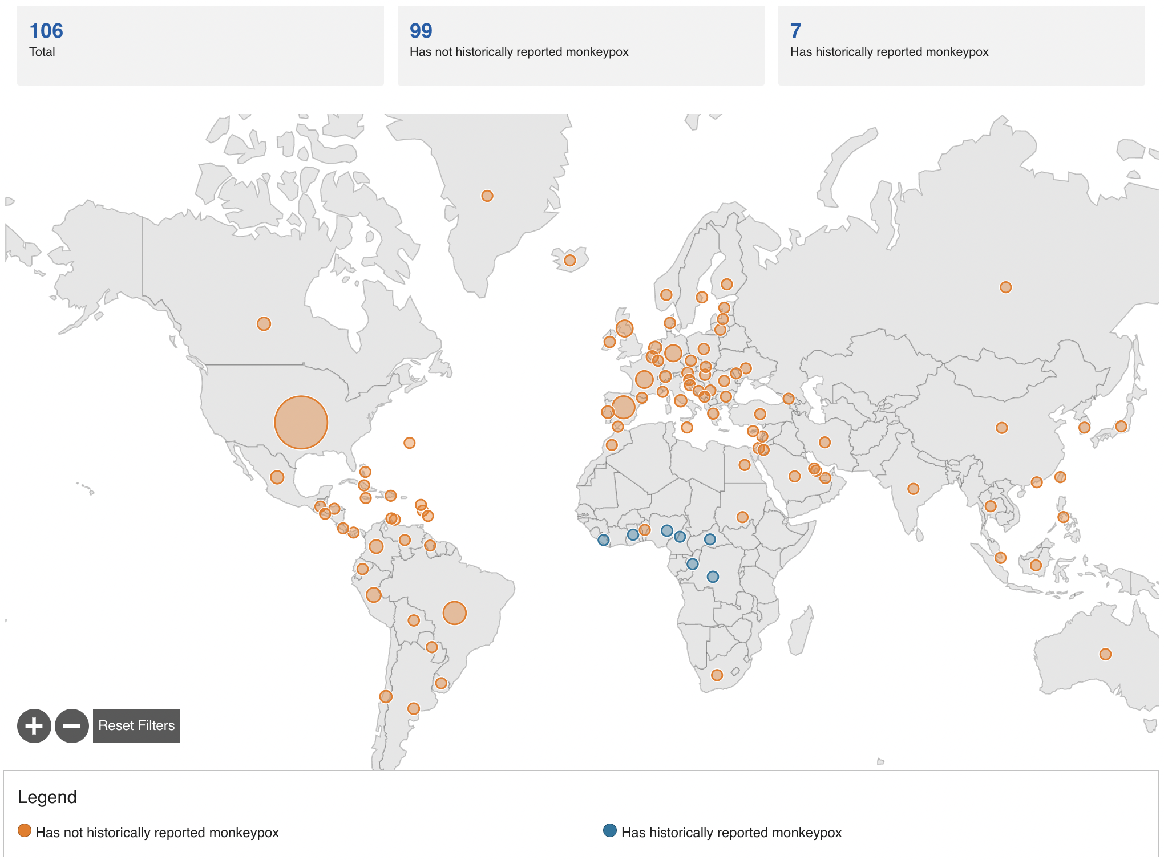

Slide 4
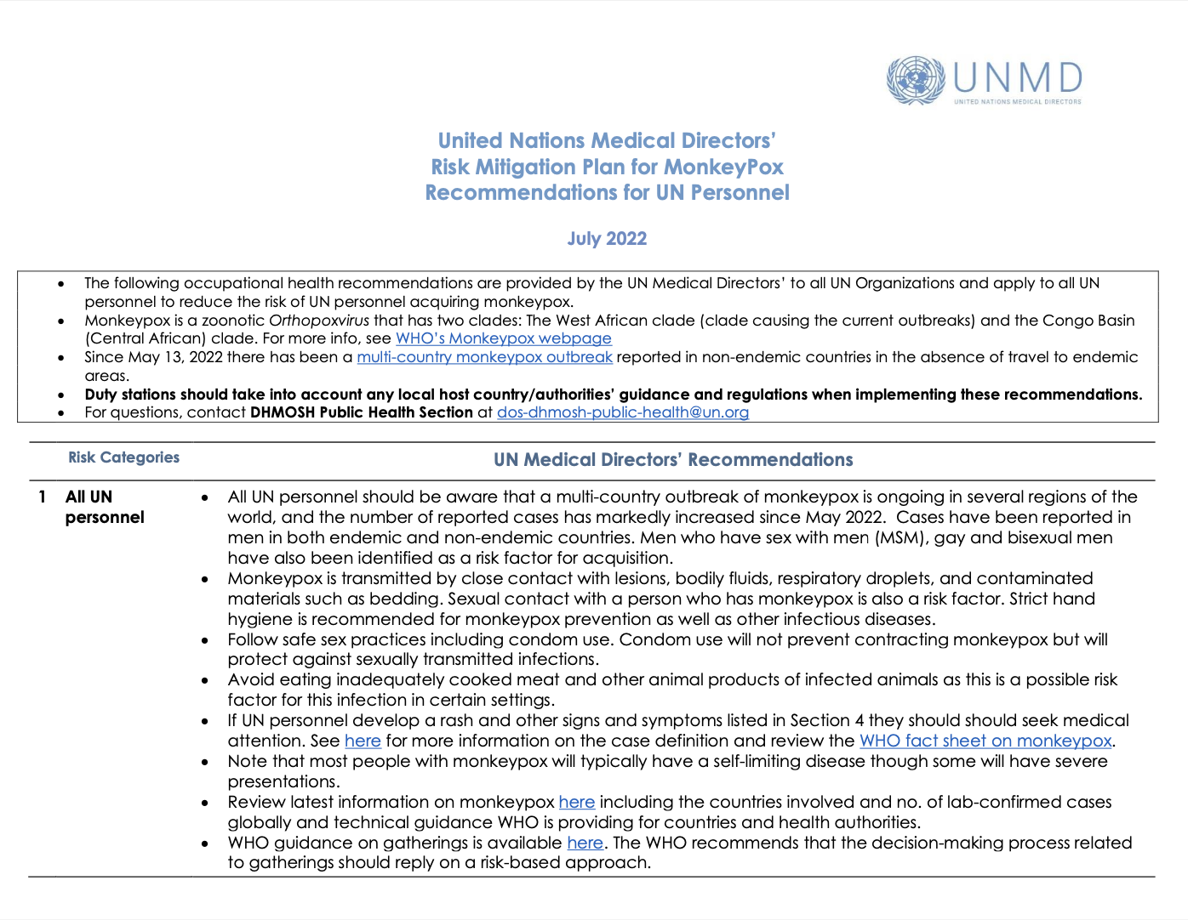
Presentation Outline
UNMD Risk Mitigation Plan for Monkeypox
Questions
Note: All guidelines and documents referenced in this presentation can be found in UN Monkeypox webpage located at: https://hr.un.org/page/monkeypox

Slide 5
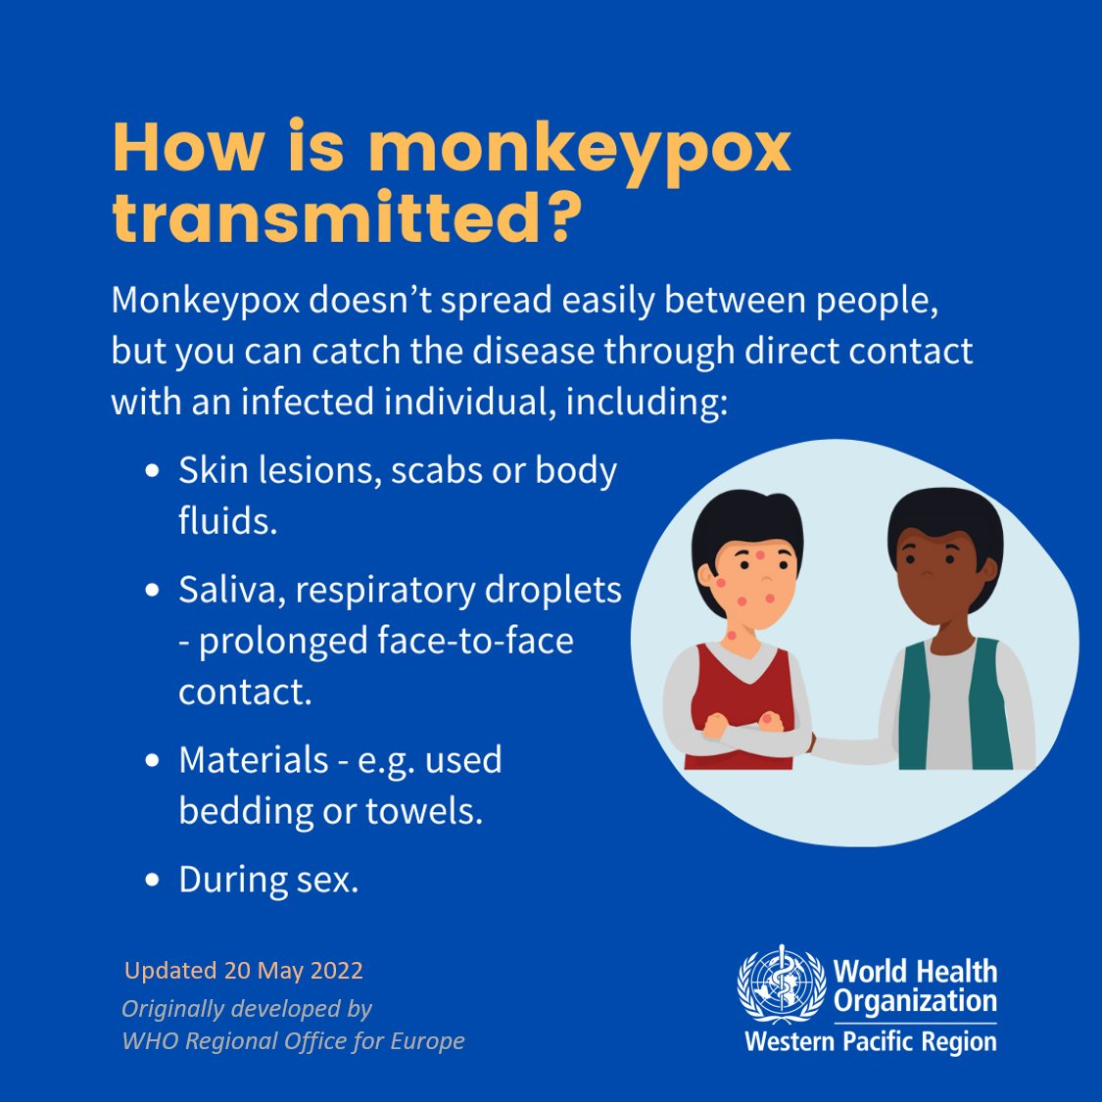
All UN Personnel
Risk factors
Men who have sex with men (MSM)
Gay and bisexual men
Transmission
Close contact with lesions, bodily fluids, respiratory droplets, and contaminated materials (e.g., bedding)
Sexual contact with an infected person
Prevention
Hand hygiene
Safe sex practices
Avoid eating inadequately cooked meat

Slide 6
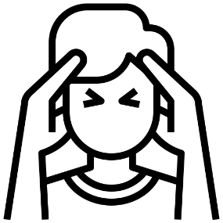
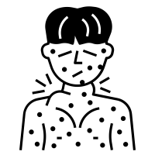
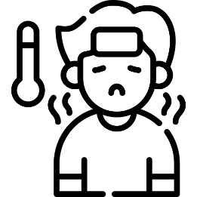
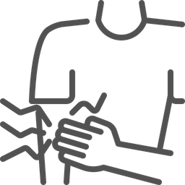
All UN Personnel (cont.)
Individuals with the following symptoms should seek medical attention:
Rash
Headache
Acute Onset of Fever (> 38.5°C)
Swollen Lymph Nodes
Muscle and Body Aches
Profound weakness
Back Pain

Slide 7
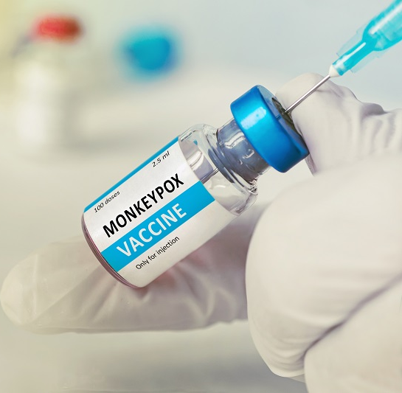
All UN Personnel (cont.)
Most people with monkeypox will typically have a self-limiting disease
Mass vaccination is not recommended at this time
Vaccination can be considered as postexposure prophylaxis (PEP) for contact of cases and as pre-exposure prophylaxis (PrEP) for certain high-risk groups

Slide 8
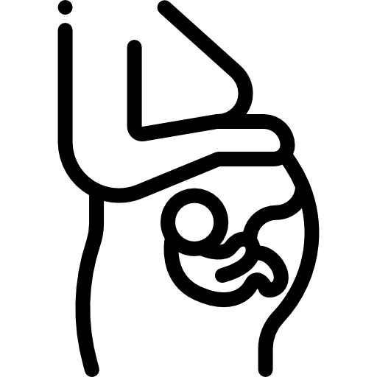
UN Personnel with Health Conditions
Though usually self-limited, the following may be at higher risk for severe disease:
Children (particularly those < 8 years of age)
Pregnant or breastfeeding women
Persons who are immune compromised

Slide 9
Contacts of Positive Cases
Contacts are defined as a person who has had one or more of the following exposure with a probable or confirmed case:
Direct skin-to-skin and skin-to-mucosal physical contact (such as touching, hugging, intimate or sexual contact)
Contact with contaminated materials such as clothing or bedding (including materials dislodged from bedding or surfaces during handling of laundry or cleaning of contaminated rooms)
Prolonged face-to-face respiratory exposure in close proximity
Respiratory exposure (i.e., possible inhalation of) or eye mucosal exposure to lesion material (e.g., crusts/scabs) from an infected person
RECENT
UPDATE

Slide 10
Contacts of Positive Cases (cont.)
Contacts of cases with monkeypox should be monitored or self-monitor for 21 days and monitored for signs and symptoms
Temperature should be monitored twice daily
Contacts of cases should be notified within 24 hours of identification of case
Asymptomatic contacts:
Should not donate blood, tissue, organs, breast milk, or semen
Non-essential travel is discouraged
No need to quarantine if asymptomatic
If a contact develops symptoms other than a rash, they should be isolated and monitored closely for a rash for 5 days

Slide 11
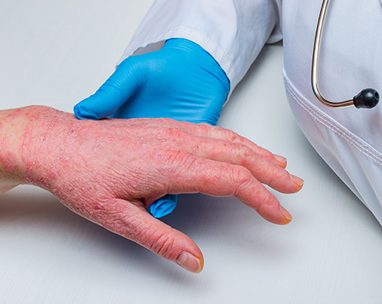
UN Health Workers
UN health workers should:
Review WHO online courses on monkeypox (links in RMP)
Know that people with monkeypox can recover at home and treatment is supportive
Significant pain and psychological distress has also been frequently described which might need specific management
Follow standard precautions for all patients at all times
Establish triage at first point of contact with the health system, screening, triage and prompt isolation and assessment for the presence of severe disease should be conducted

Slide 12
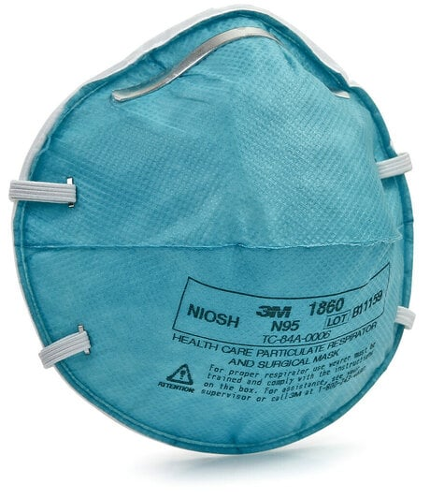
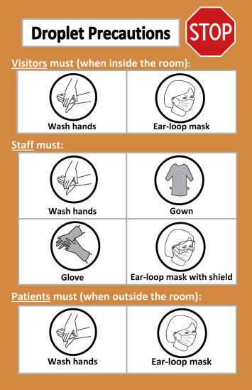
UN Health Workers (cont.)
Isolation recommendations for positive/suspect cases:
Private room, if possible
Droplet precautions should be used in in addition to respirators
Airborne precautions for aerosol generating medical procedures should be applied
Lesions should be covered where possible
Patient should wear a mask when within 1-2m of HCWs

Slide 13
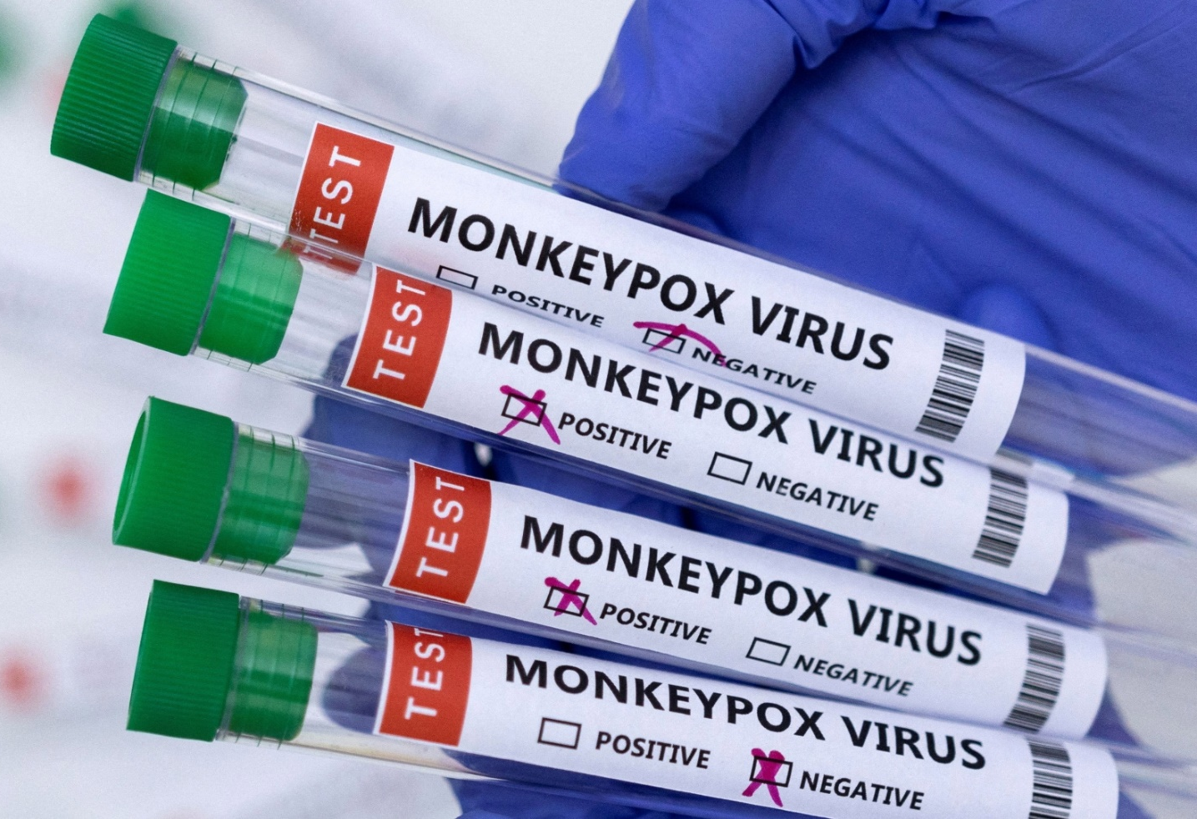
UN Health Workers (cont.)
Know how to collect and properly submit samples for diagnosis of monkeypox
Be aware of the differential diagnosis of rashes as well as the possibility of co-infections with varicella or sexually transmitted infections
Guidelines regarding post-exposure and pre-exposure vaccination can be found in the full RMP

Slide 14
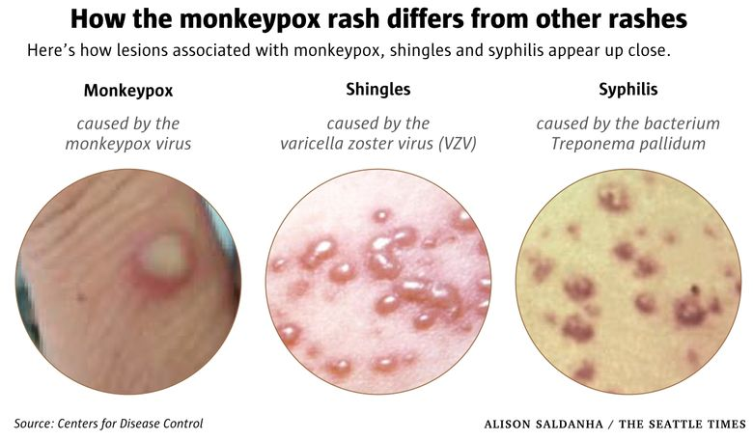

Slide 15
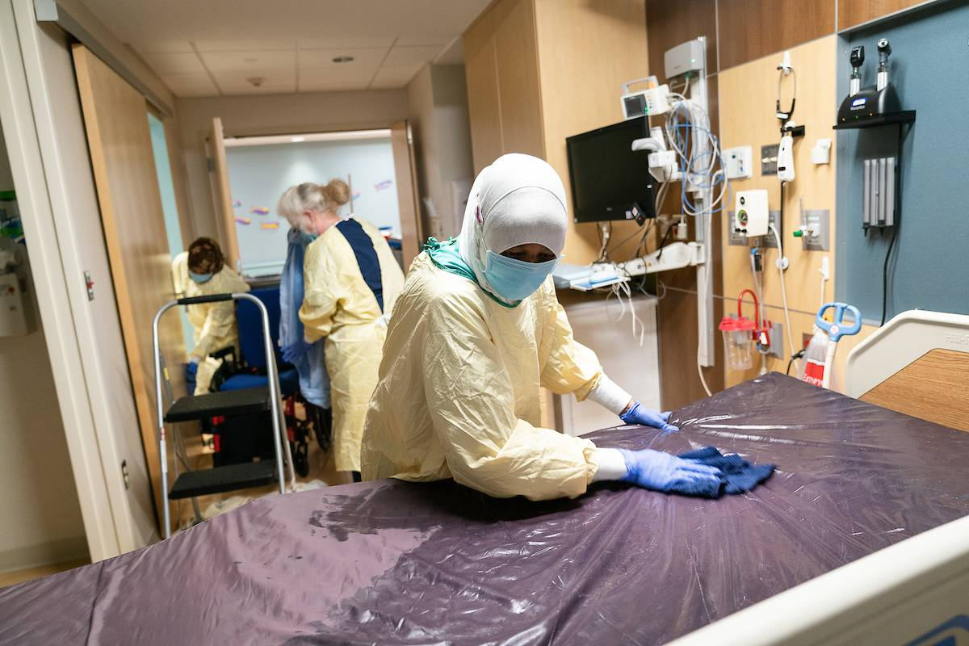
Cleaners in Healthcare Settings
Cleaners should:
Follow cleaning protocols and if in the room with a patient
Apply contact and droplet precautions in addition to standard precautions if in the room with a patient
Masks are advised
Linen, hospital gowns, towels, and other fabric items should be handled and collected carefully

Slide 16
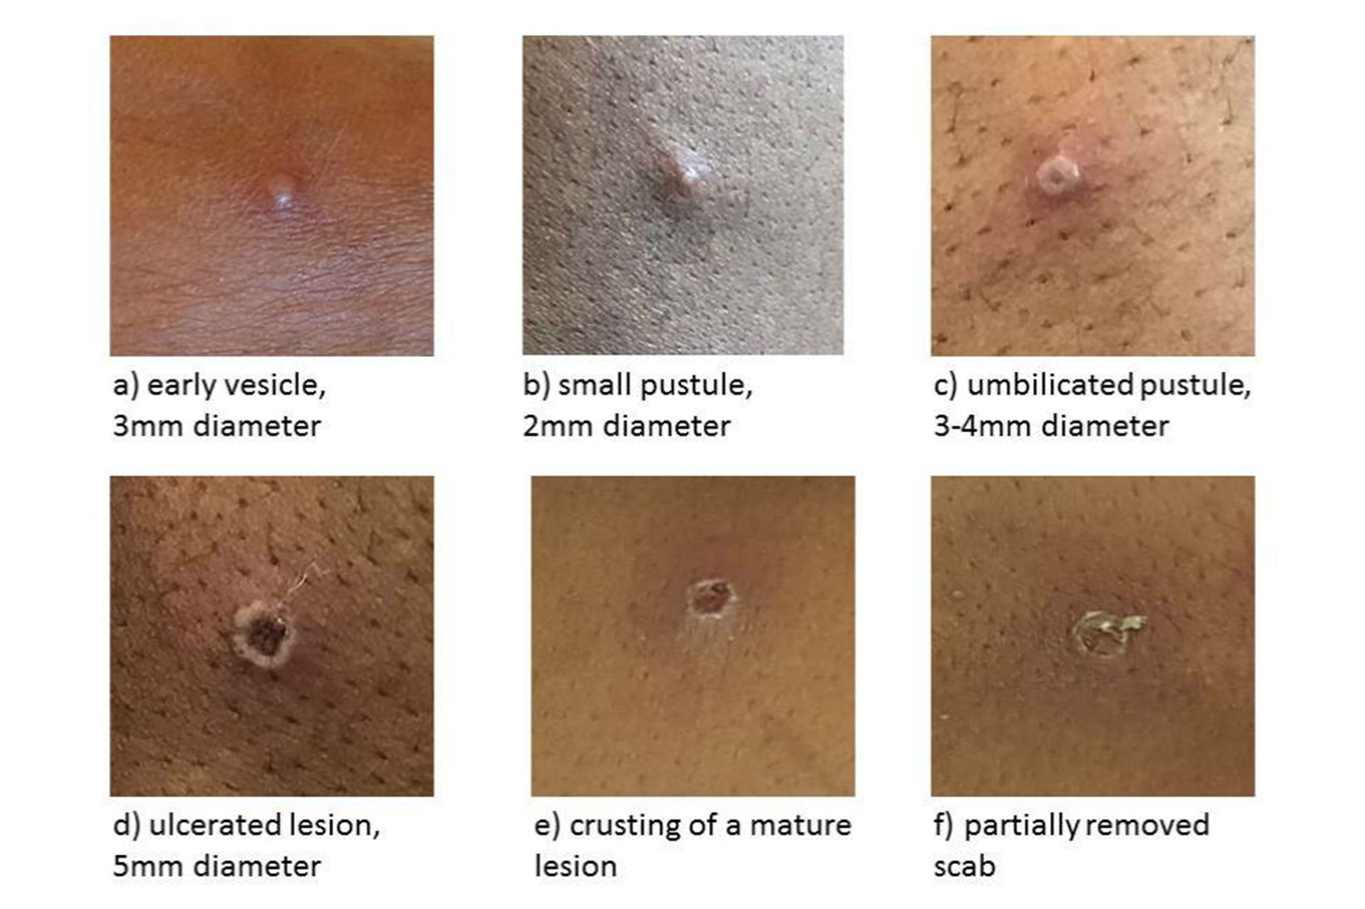
UN Personnel with Suspect / Confirmed/ Probable Monkeypox
Immediately isolate
Isolation should continue until:
All lesions are crusted over
No new lesions are seen
Scabs have fallen off with fresh layer of skin formed underneath
In most instances isolation and recovery can occur at home

Slide 17
Additional Resources Included in RMP
WHO fact sheet on monkeypox
WHO guidance on gatherings
WHO guidance on monkeypox vaccination
WHO guidance on surveillance, case investigation, and contact tracing
WHO online courses on monkeypox
WHO guidance on Clinical Management and IPC
CDC Presentation: What Clinicians Need to Know About Monkeypox in the United States and Other Countries

Slide 18
All guidelines and documents referenced in this presentation can be found on standalone UN Monkeypox Webpage: https://hr.un.org/page/monkeypox

Slide 19
Acknowledgments
Jamie Jablonowski for developing this slide deck
Devika Dixit for developing Monkeypox RMP

