Slide 1
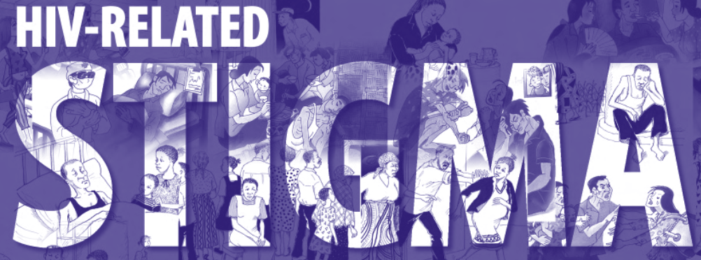
Training for CMOs, FMOs, HIV/AIDS Focal Points, UN Clinic Managers, & HIV Stakeholders in Duty Stations & Missions.
6 December 2022
Stephen Talugende, MPH

Slide 2
Session Outline
Basic understanding of stigma
Stigma & HIV/AIDS
Impact of Stigma on the HIV/AIDS response
Addressing HIV/AIDS Stigma

Slide 3
BASICS – ORIGIN & DIMENSIONS OF STIGMA
The Greeks, originated the term stigma to refer to bodily signs designed to expose something unusual & bad about the moral status of the signifier.
The signs were cut or burnt into the body & advertised that the bearer was a slave, a criminal, etc.
A traitor — a blemished person, ritually polluted, to be avoided, especially in public places, to be investigated & prosecuted.
Kurzban & Leary, 2001

Slide 4
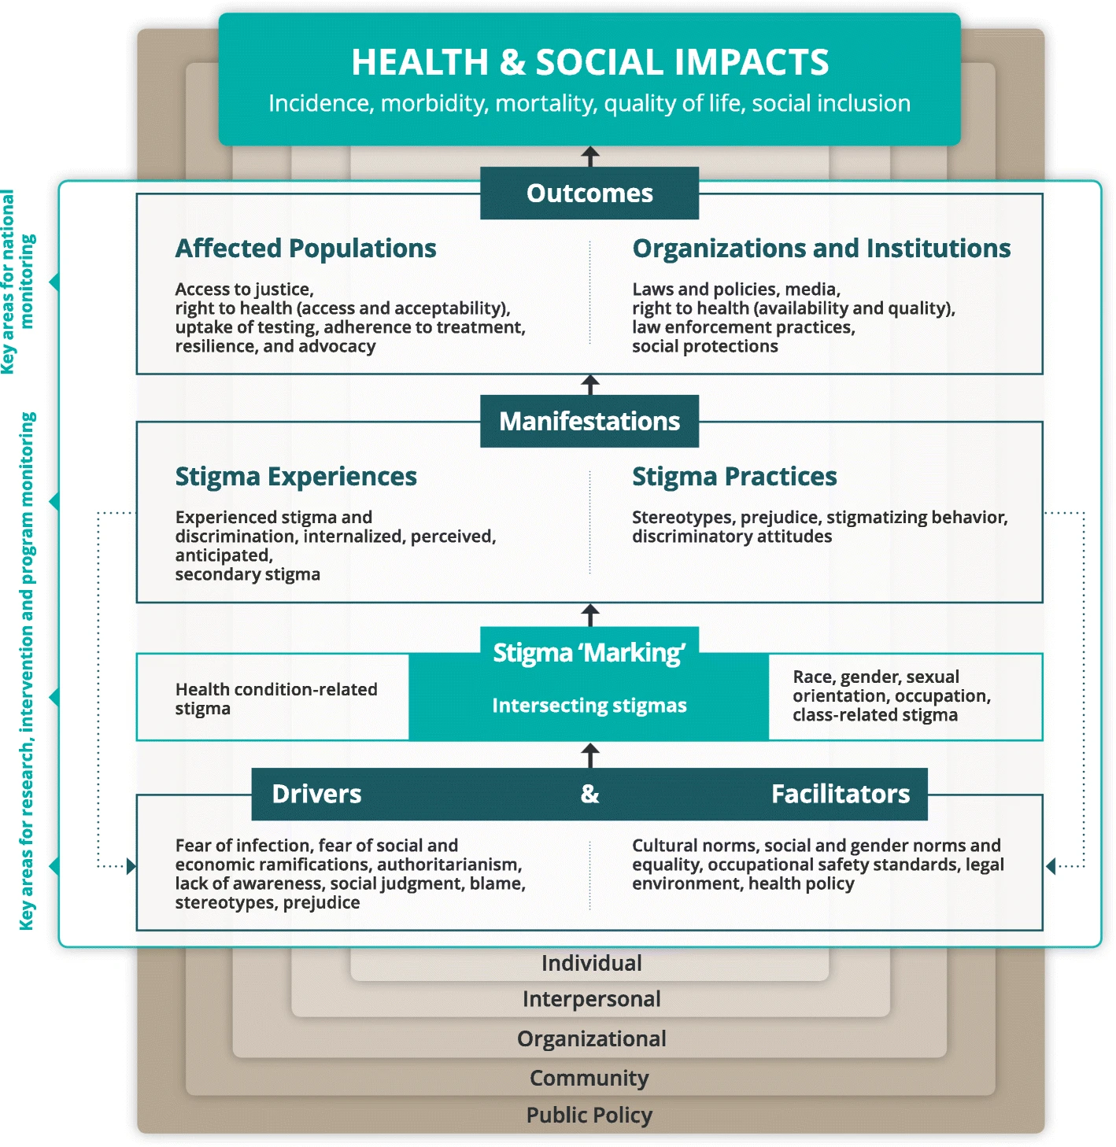
Stigma & discrimination
A social process that creates & perpetuates social inequalities which leads to discrimination
Stigma involves a set of distinct psychological systems designed by natural selection to solve specific problems associated with sociality
A primal human response when it comes to transmissible & incurable health conditions

Slide 5
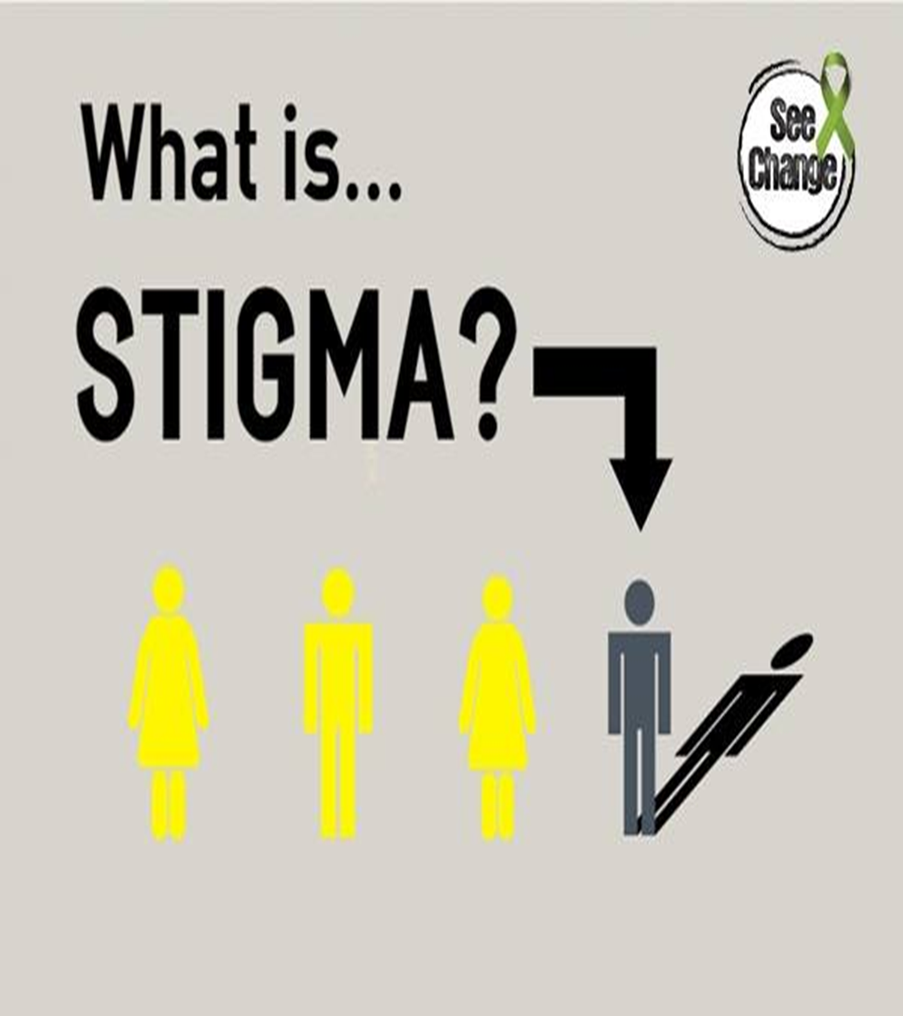
An attribute that is deeply discrediting & reduces people from ’whole & usual people to tainted, & discounted ones’.
The shame or disgrace attached to something regarded as socially unacceptable.
Goffman
Those attributes could be illness, physical deformities, aberrant behaviors, ethnicity, religion, social group, etc.
Stigma lets people or groups see differences of others in a negative way in conformity with own sense of what’s normal.

Slide 6
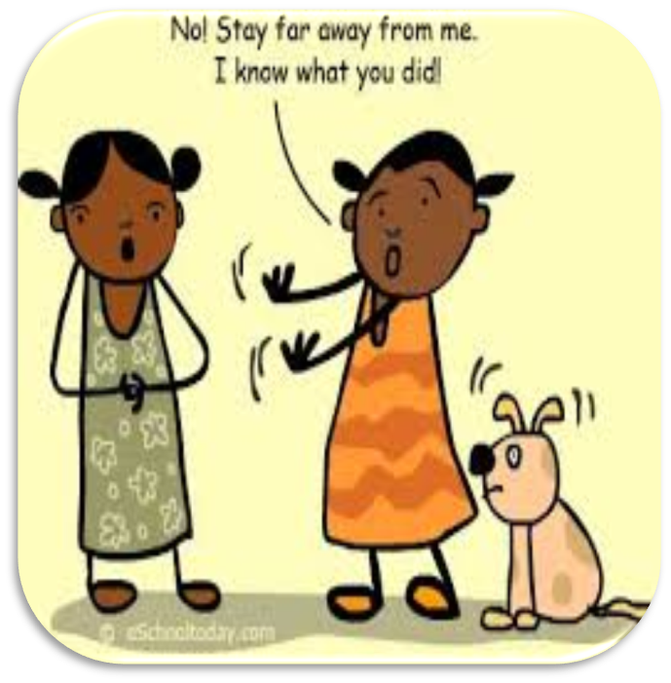
Stigma & discrimination
Discrimination – treating individuals or groups with partiality or prejudice.
Stigmatization reflects an attitude.
Discrimination is an act of behavior

Slide 7
Dimensions of Stigma (Kurzban & Leary, 2001)
Concealability, disruptiveness, aesthetic (visual) qualities, origin, & peril (danger)
Visibility/concealability is a crucial factor
The more visible a stigmatizing condition, the greater its negative impact on interactions
The stigmatized are forced to bear a visible mark denoting their discredited status
E.g., HIV positive personnel are made to believe that they cannot be sent to peacekeeping because it can negatively impact their health
Individuals with stigmatizing conditions perceived as preventable suffer more social censure than those perceived as helpless victims

Slide 8
Dimensions of stigma cont’d
A mark perceived to be under the control of the stigmatized correlates with negative attitudes & behaviors toward the individual(s)
Conditions that are out of control of the individual can also lead to harsh stigmatization
E.g., PLHIV who got infected through exchange of blood, MTCT, etc., which is regarded to be beyond their control, are stigmatized (discriminatory & criminalizing laws, policies & practices)
Disruptiveness – a mark that hinders, strains, & adds to the difficulty of interpersonal relationships, e.g., family members not supporting PLHIV, healthcare workers denying or delaying services to PLHIV
Stigmatization can be more disrupting that living with HIV
Perception of danger triggers reactions of other people on how people estimate danger in an interaction, e.g., demanding for antibody HIV testing pre-surgery even though the method is subject to the ‘Window Period’

Slide 9
Expressions & forms of stigma
Physical stigma
Isolated, shunned, abandoned
Separated living space, easting utensils
Violence
Self Stigma
Applying negative ideas & stereotypes about HIV/AIDS & PLHIV to self
Feelings of shame, fear of disclosure, isolation, suicide, & despair
Prevents people from testing & seeking HIV-related treatment, care & support
Social stigma
Isolated by & from community
Nosiness & tokenism- Mockery of care & support, not genuine concern, e.g., many commitments & standards, but no meaningful support for action
Loss of social role or identity – social ‘death’ loss of standing & respect

Slide 10
Expressions & forms of stigma cont’d
Verbal stigma
Gossip, taunting, scolding – UN system HR networks
Labelling – its in ‘Africa’, moving corpse, promiscuous, unfaithful, sinner, social outfit/disgust, family curse, etc.
Institutionalized stigma
Expedited repatriations, disgrace to the group, group betrayer, etc.
Denial or delayed of healthcare services
Harassment, criminalization,

Slide 11
STIGMA & HIV/AIDS

Slide 12
STIGMA & HIV/AIDS
Stigma & discrimination increases the risk of HIV acquisition & progression to AIDS
Increases HIV-related violence, marginalization & persecution, etc.
Reduces access to education, preparedness of personnel, employment, justice.

Slide 13
HOW STIGMA IMPACTS HIV/AIDS RESPONSE
Stigma is the single greatest challenge to achieving HIV targets
Stigma & discrimination impedes the HIV response at every step, limiting access to:
Broader sexual, reproductive health, & related services
HIV prevention services
Testing, treatment, literacy, adherence, insurance refunds, etc.
Tuberculosis & other services

Slide 14
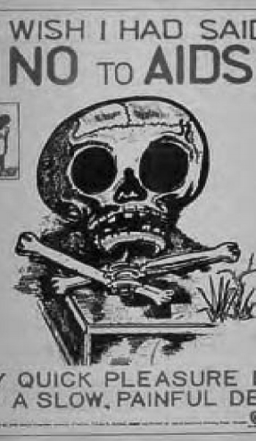
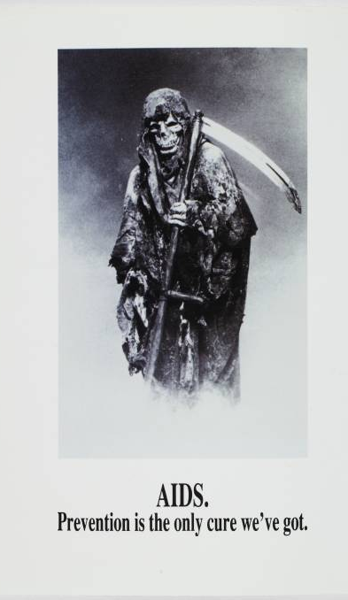
What causes HIV/AIDS Stigma?
HIV stigma is rooted in a fear of HIV
Many of our ideas about HIV come from the HIV images that first appeared in the early 1980s
There are still misconceptions about how HIV is transmitted & how to live with it, what it means to be affected by & vulnerable to it & how to work on it holistically today
What kind of loss reactions do people experience after testing positive to HIV?

Slide 15
WAYS STIGMA IMPACTS THE RESPONSE
In the basis of sex, gender, identity, sexual orientation, IDU, sex work, & HIV status
Stigmatizing experiences include avoidance behaviors, gossip, verbal abuses & social rejection
Stigmatizing behaviors that affect enjoyment of rights, physical abuse, denial of health or social services, denial or loss of employment or education opportunities or even arrest/proscution
Stigma can be enshrined in criminal laws, travel restrictions, mandatory (pre-deployment) HIV testing, employment restrictions, threats of criminalization for testing HIV positive while on mission, etc.

Slide 16
How stigma impacts HIV/AIDS response
Stigma & discrimination increases the risk of getting infected with HIV & progression to AIDS, violence, & marginalization while reducing access to education, employment & justice
UNAIDS 2021

Slide 17
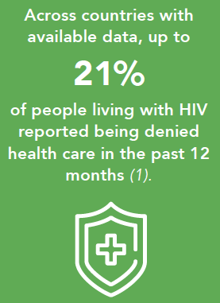
DATA – IMPACT OF STIGMA
In 11 countries with available data, up to 40% of people with HIV report being forced to submit to a medical or health procedure.
26% of women living with HIV reported that receiving HIV treatment was conditional on taking contraceptives
Stigma index analysis found that HIV-related discrimination caused or contributed to job loss in more than 50% of cases in 7 of 11 countries with data
LGBTI workers reported considerably greater incidence of violence in the workplace compared with non-LGBTI workers & frequently experienced discrimination in education & employment

Slide 18
DATA – IMPACT OF STIGMA
47 countries still maintain travel restrictions for people living with HIV
People from key populations face high levels of stigma, discrimination & violence

Slide 19
LINKING RIGHTS & HEALTH OUTCOMES
People living with HIV who perceive high levels of HIV related stigma are 2.4 times more likely to delay enrolment in care & wait until they are very ill
Those who had experienced discrimination in healthcare settings are 3 times more likely to avoid healthcare settings than those who had not
Where programs are in place against stigma & discrimination, access to services for HIV prevention, testing, & treatment has measurably improved
Adjusting to UN rules & standards of conduct removes laws that criminalize HIV transmission. Example, decriminalization of sex work is estimated to prevent 33% & 46% of new infections among sex workers & “their clients”

Slide 20
Examples of HIV/AIDS stigma
Stigma scenarios:
1) A service colleague responds on call to fix a technical issue. After completing the tax, he later finds out that the colleague he just served was living with HIV. He rushes to the HIV/AIDS unit to seek for PEP. After a risk assessment, it was established that no risk existed……
2) A publicly open HIV positive colleagues got regularly excluded him from implementing mandated tasks of the section. On consultation, he was informed that he was not fit to carryout substantial work because of his HIV positive status. Fortunately, the MLT took disciplinary action to set an example for a stigma free environment.
3) A uniformed colleague went to a medical unit for a minor surgical procedure. The attendant doctor demanded for an HIV test. The patient objected & the procedure was delayed. It took intervention of the HIV/AIDS unit for him to be served.
Denial, inconsistent leadership support, reduced budgetary commitment, & decrease of visibility of HIV/AIDS response activities
Delayed or denial of healthcare services for refusal to do pre-service HIV testing
Dis & misinformation – e.g., argument that advancement of treatment means it is not an issue anymore
Fear by some staff members to claim HIV-related healthcare costs, & enrolment into HIV treatment programs

Slide 21
STIGMA MITIGATING MEASURES
Training for health-care providers on human rights, medical ethics for HIV, & safe & standard procedures & practices.
Harmonize & replace our diverse laws, policies, practices & perspectives of home countries with Standards of Conduct, legislation & policies of the UN
Monitor stigma related violations; reinforce stigma & discrimination reduction campaigns; provide consistent policy literacy & sensitization of all personnel on HIV-related stigma violation & prevention
Strengthen coordination with other functions across all pillars to activate holistic & multidisciplinary actions against stigma

Slide 22
