Slide 1
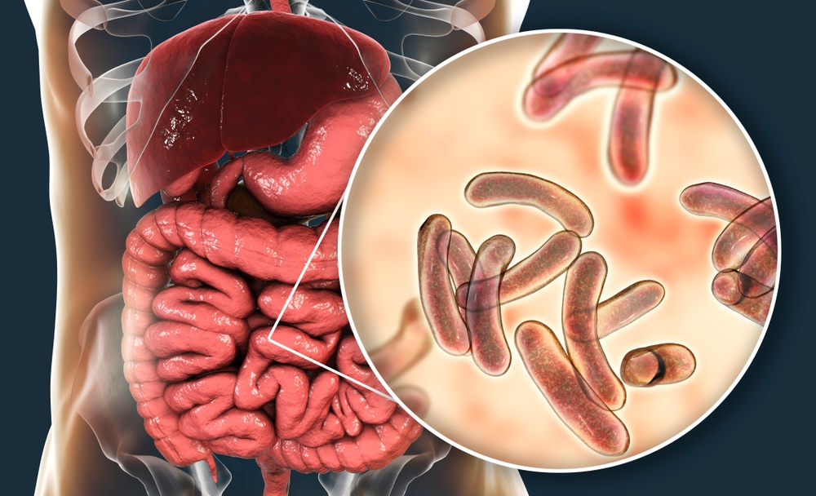
Outbreak Response to Cholera
Dr. Esther Tan, Senior Medical Officer, DHMOSH
Dr. Devika Dixit, Medical Consultant, DHMOSH
Jamie Jablonowski, Public Health Nurse Consultant, DHMOSH

Slide 2
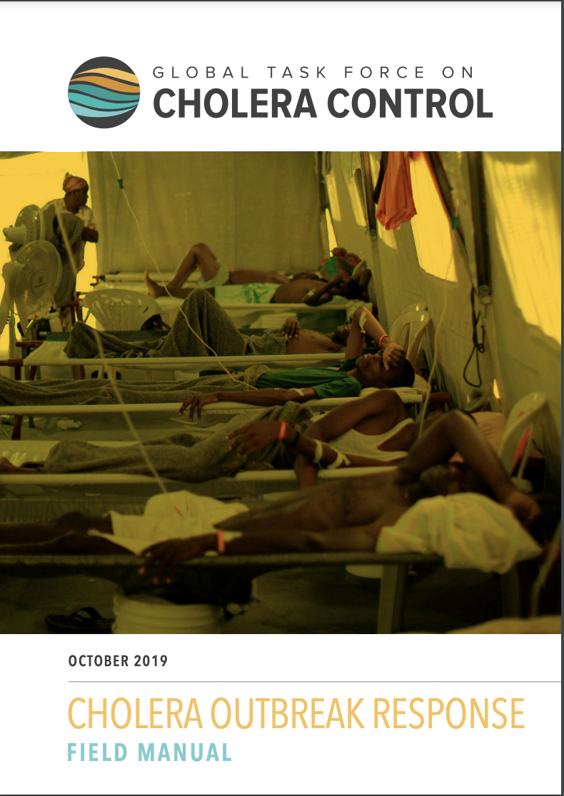
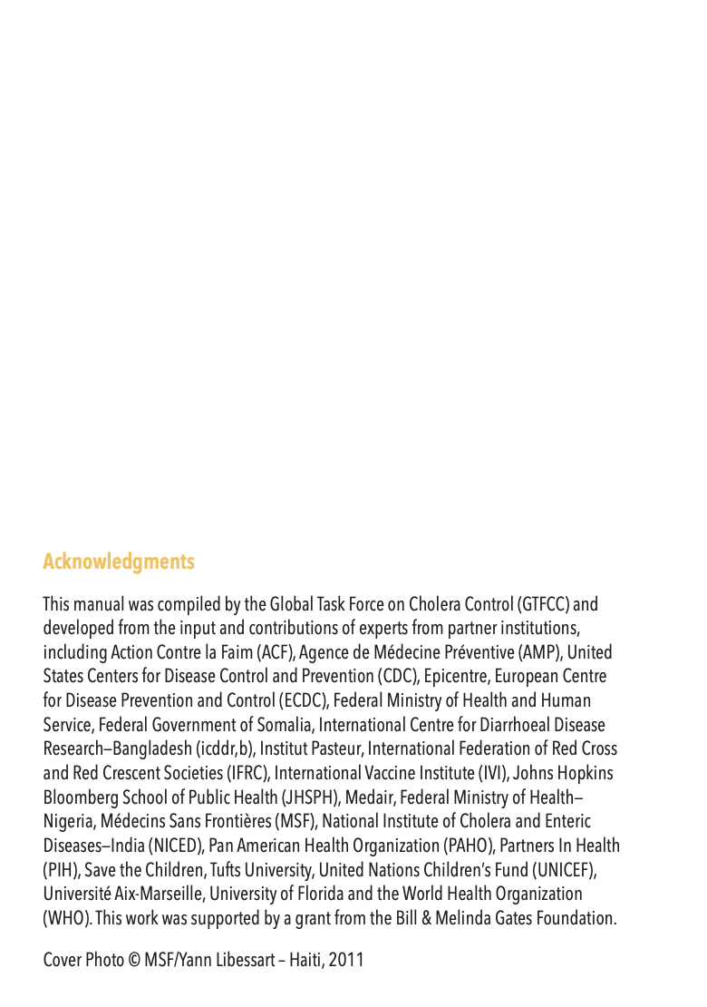
Presentation Outline
Introduction
Case management in treatment facilities
Outbreak detection and investigation
Outbreak confirmation
Organization of the response
Oral cholera vaccine
Monitoring the outbreak
Risk communication and community engagement
Reducing the spread of cholera in the community
Note: Complete guidelines can be found here:
Cholera Outbreak Response Field Manual https://www.gtfcc.org/wp-content/uploads/2020/05/gtfcc-cholera-outbreak-response-field-manual.pdf

Slide 3
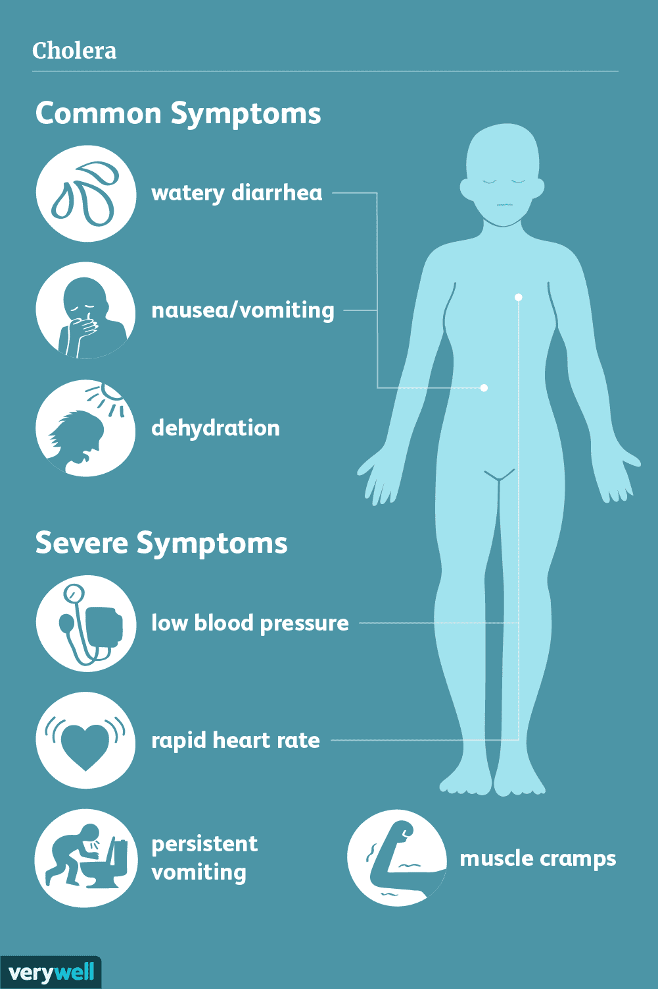
Introduction
Cholera is an acute diarrheal disease caused by infection of the intestine with the bacterium Vibrio cholerae, either type O1 or type O139
Both children and adults can be infected
About 20% of those who are infected with V. cholerae develop acute watery diarrhea
Approximately 20% of these individuals develop severe watery diarrhea, many also with vomiting

Slide 4
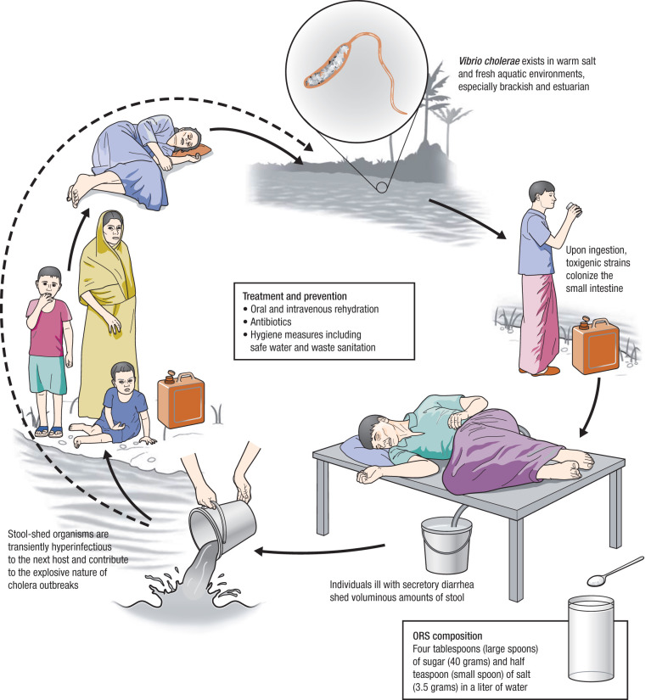
Introduction (cont.)
If these patients are not promptly and adequately treated, the loss of fluid and salts can lead to severe dehydration and death within hours
The case fatality rate in untreated cases may be 30–50%
However, treatment is straightforward (rehydration) and, if provided rapidly and appropriately, the case fatality rate should remain below 1%

Slide 5
Introduction (cont.)
Key point: Cholera is transmitted by the faecal-oral route

Slide 6
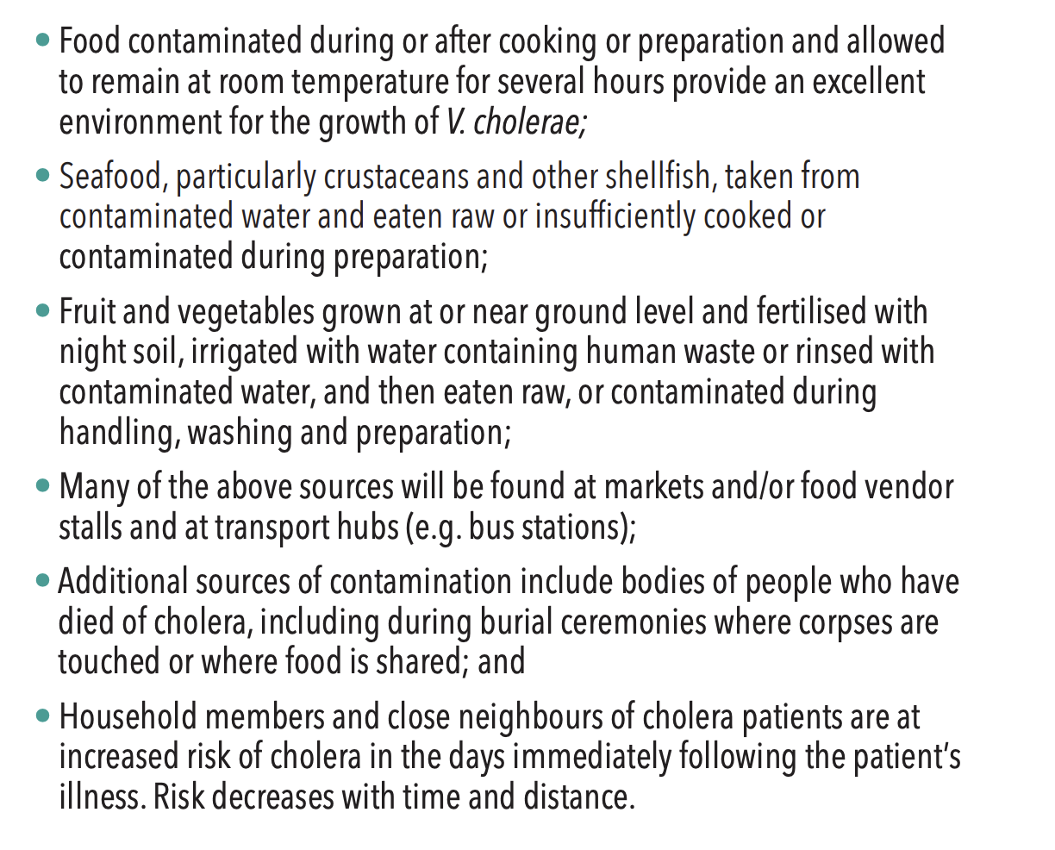
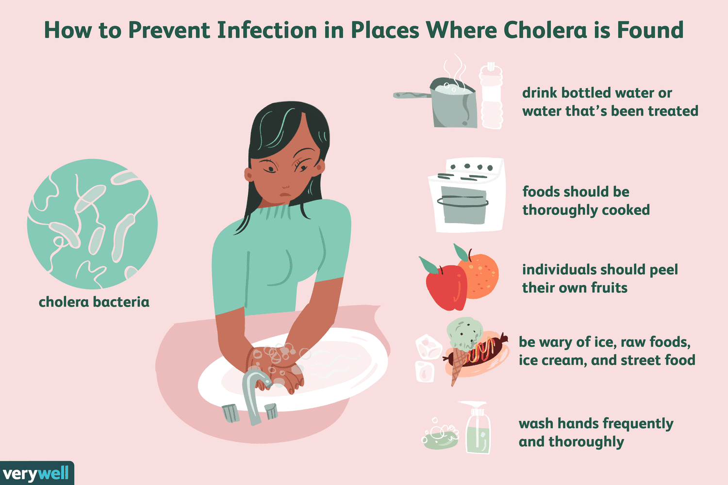
Introduction (cont.)

Slide 7
Case Management in Treatment Facilities

Slide 8
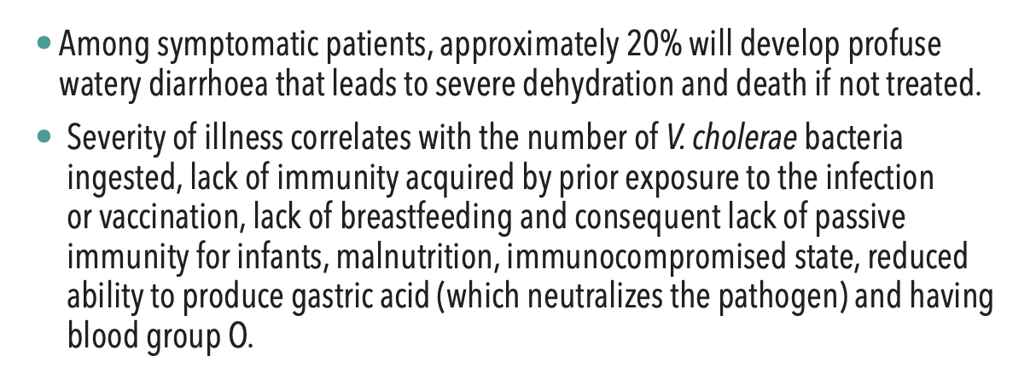
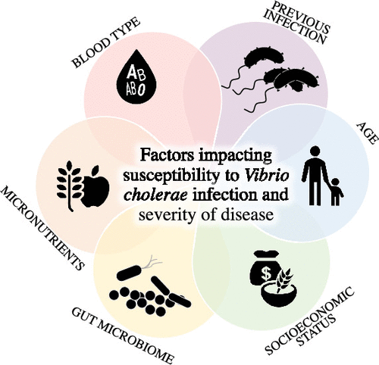
Case Management in Treatment Facilities (cont.)

Slide 9
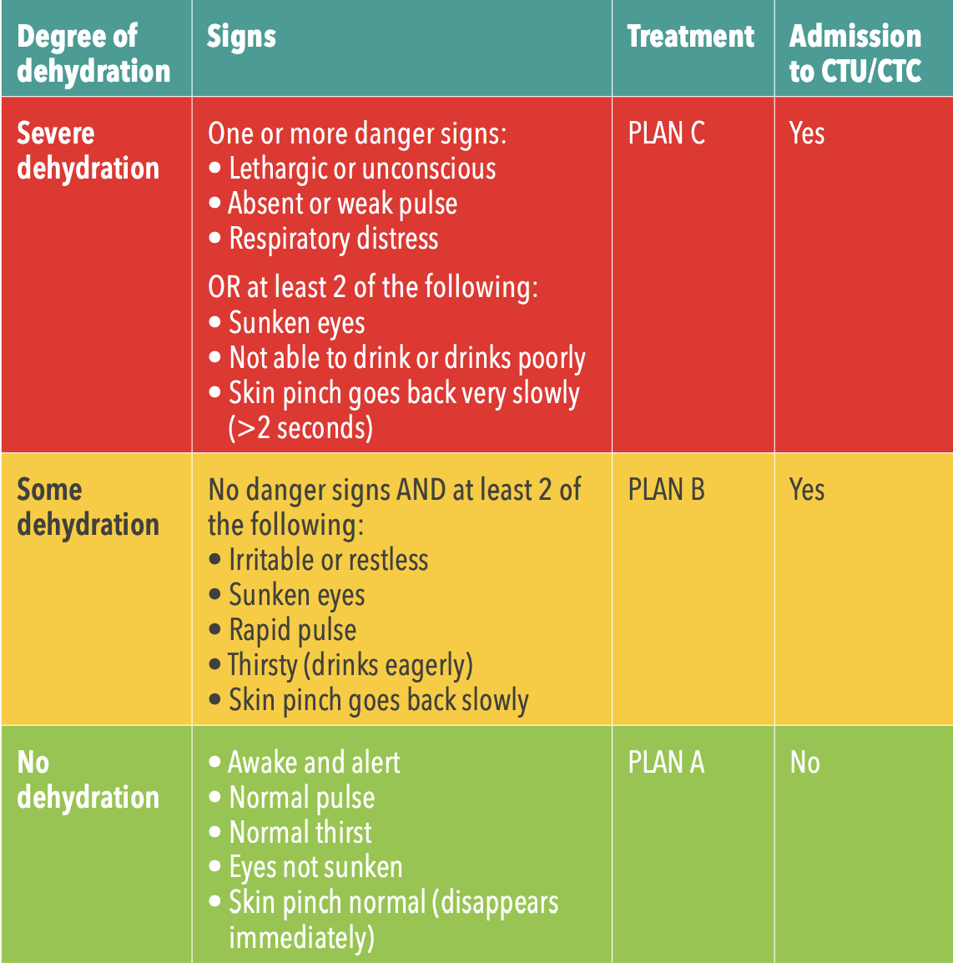
Case Management in Treatment Facilities (cont.)

Slide 10
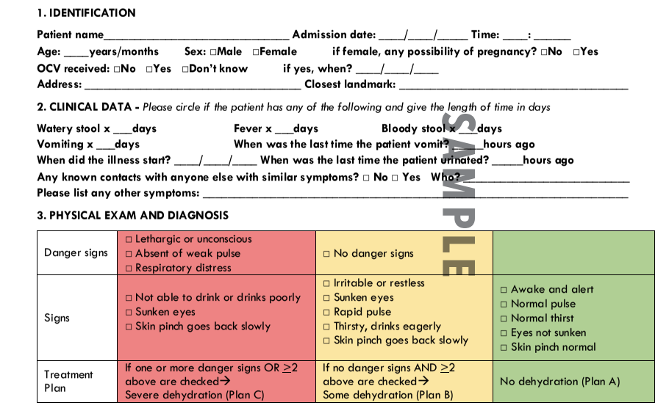
Case Management in Treatment Facilities (cont.)
*This form and others are available for download at www.gtfcc.org

Slide 11
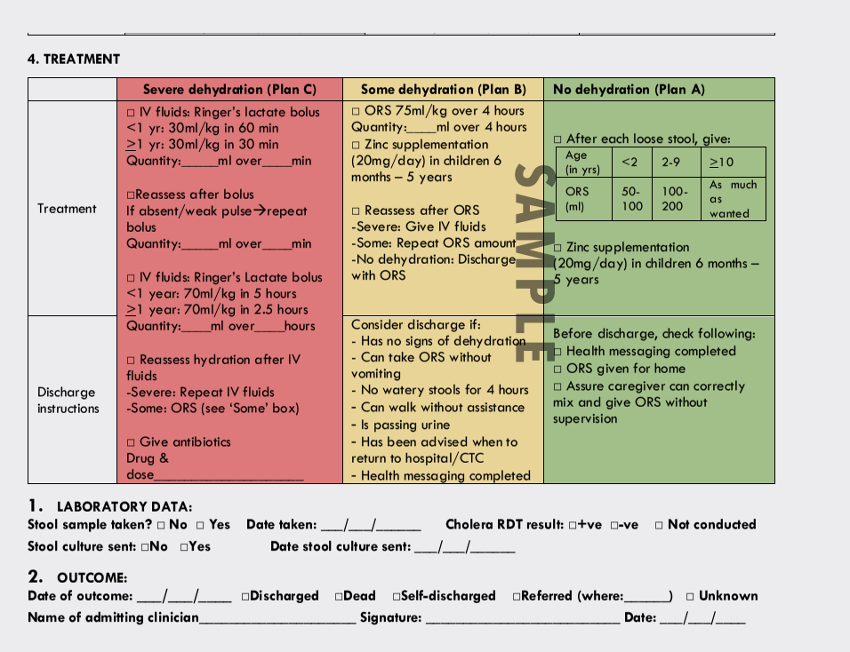
Case Management in Treatment Facilities (cont.)
*This form and others are available for download at www.gtfcc.org

Slide 12
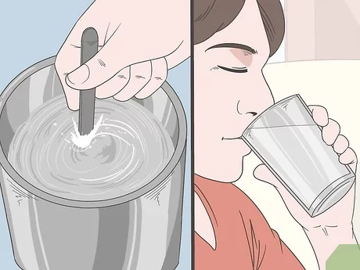
Case Management in Treatment Facilities (cont.)
Key point: ORS is primary treatment for mild cases

Slide 13
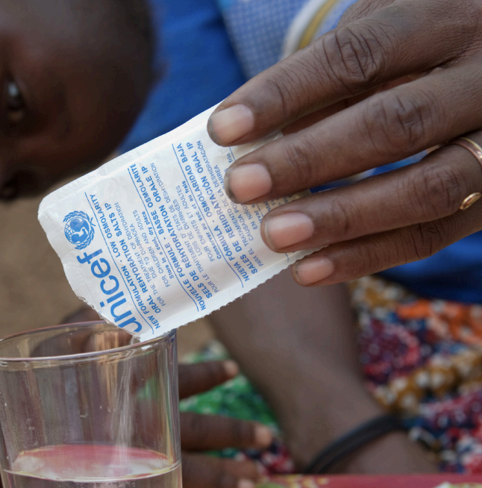
Case Management in Treatment Facilities (cont.)

Slide 14
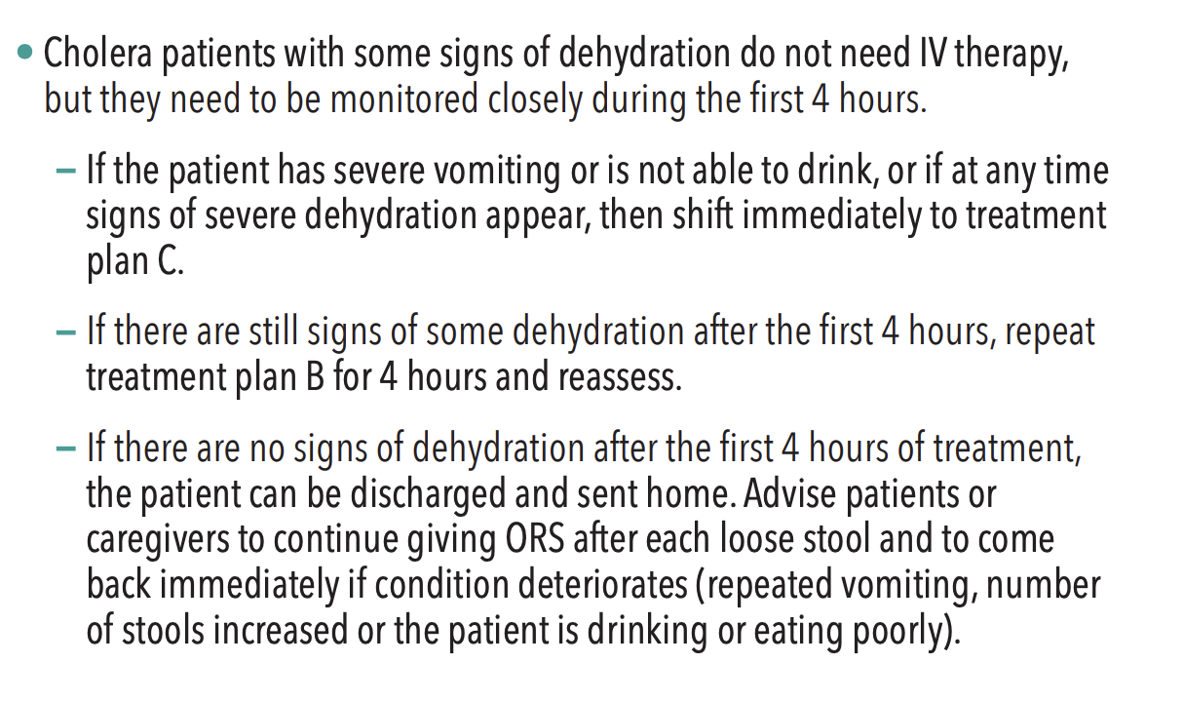
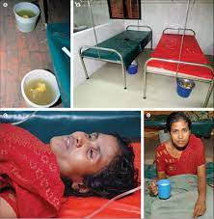
Case Management in Treatment Facilities (cont.)
Key point: Patients presenting with some dehydration require ORS and close monitoring

Slide 15
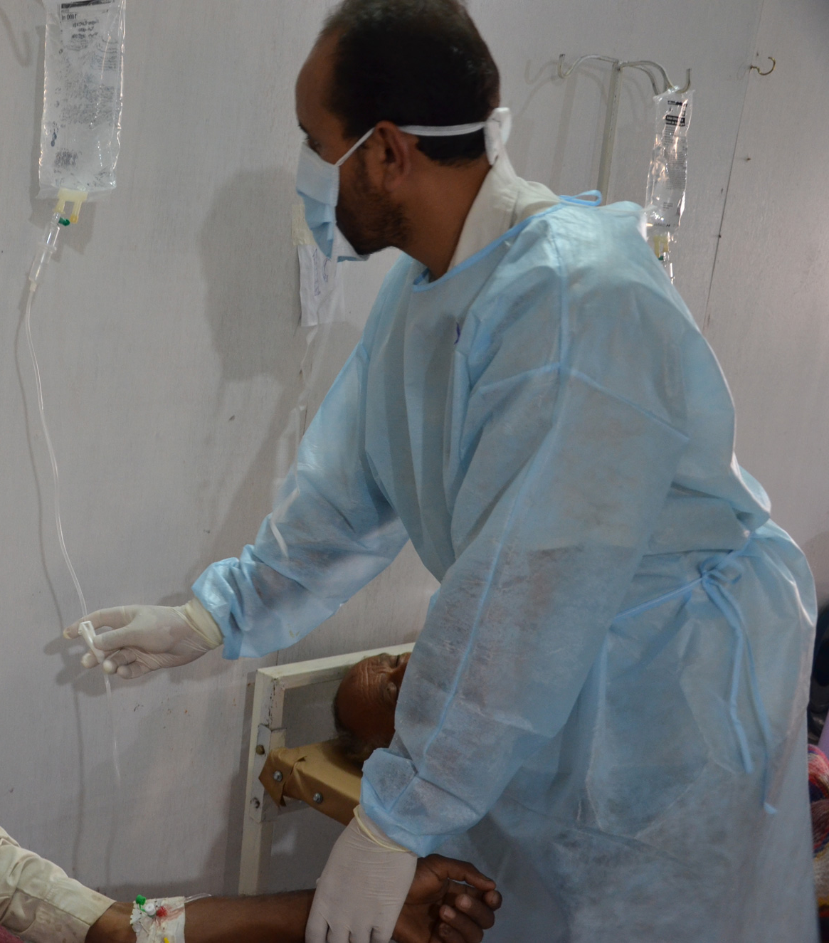
Case Management in Treatment Facilities (cont.)
Key point: Severe cases require IV fluids, ideally Ringer’s lactate and antibiotics

Slide 16
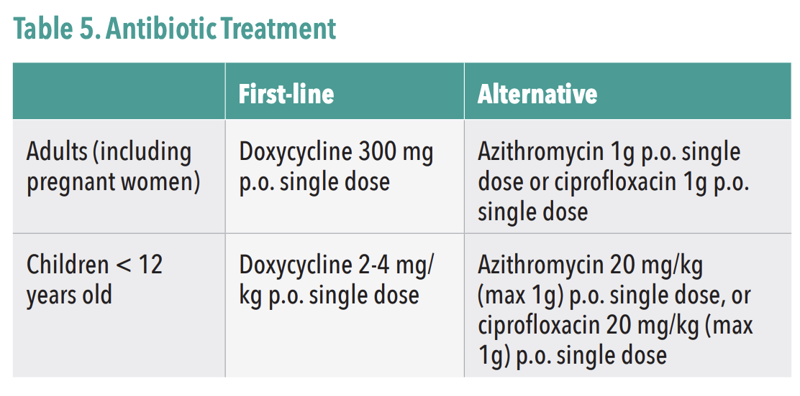
Case Management in Treatment Facilities (cont.)
*Per WHO, mass administration of antibiotics is not recommended, as it has no proven effect on the spread of cholera may contribute to antimicrobial resistance.

Slide 17
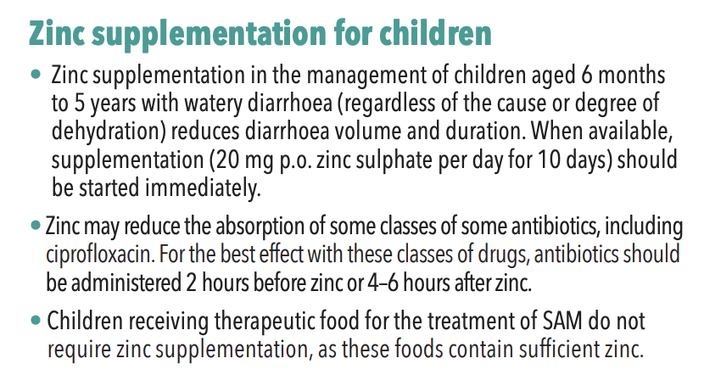
Case Management in Treatment Facilities (cont.)

Slide 18
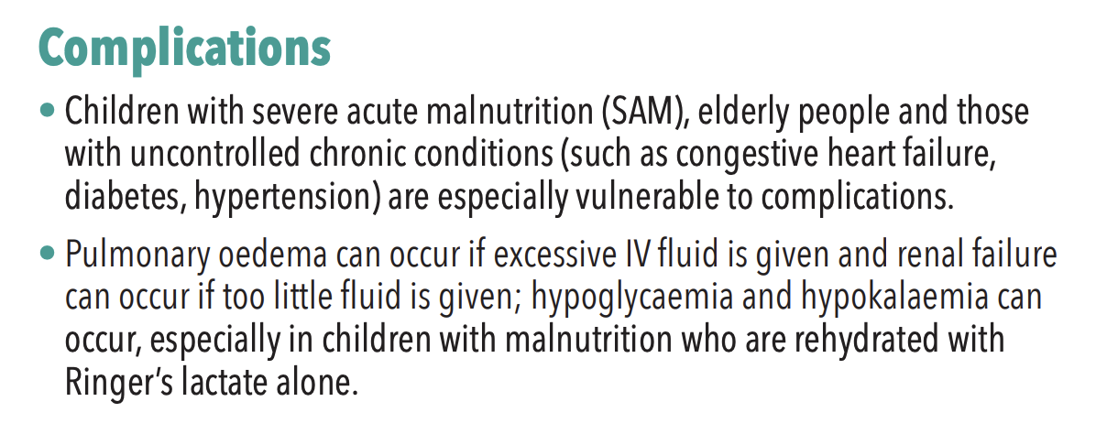
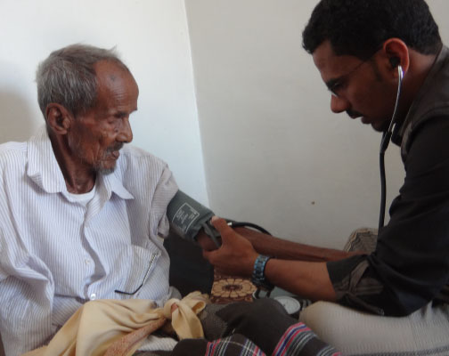
Case Management in Treatment Facilities (cont.)
Key points: Individuals at highest risk for complications include malnutrition in children, advanced age, and uncontrolled chronic conditions. Care needs to be given with IV fluid administration to avoid under or over hydration.

Slide 19
Case Management in Treatment Facilities (cont.)

Slide 20
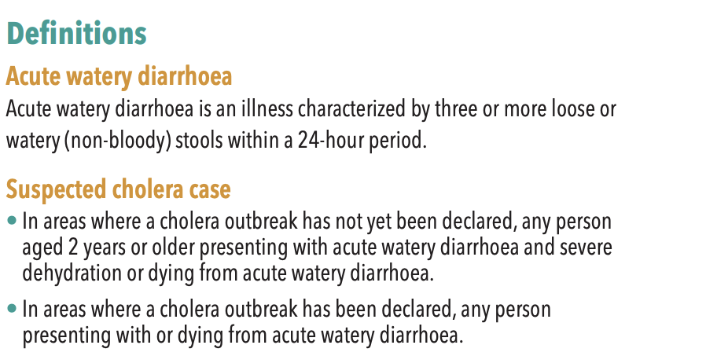
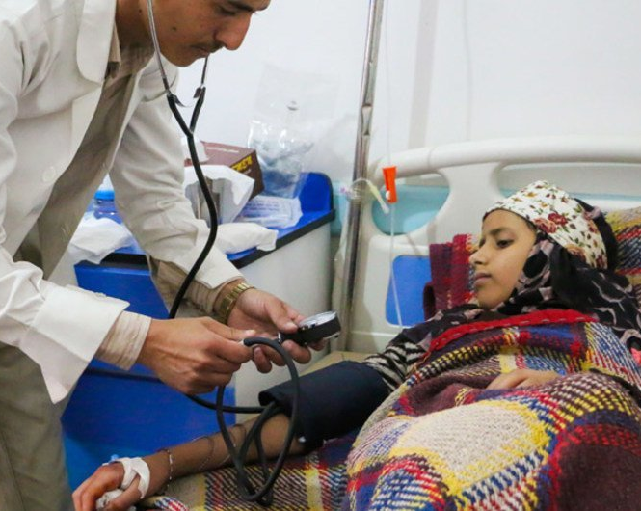
Outbreak Detection and Investigation

Slide 21
Outbreak Confirmation

Slide 22
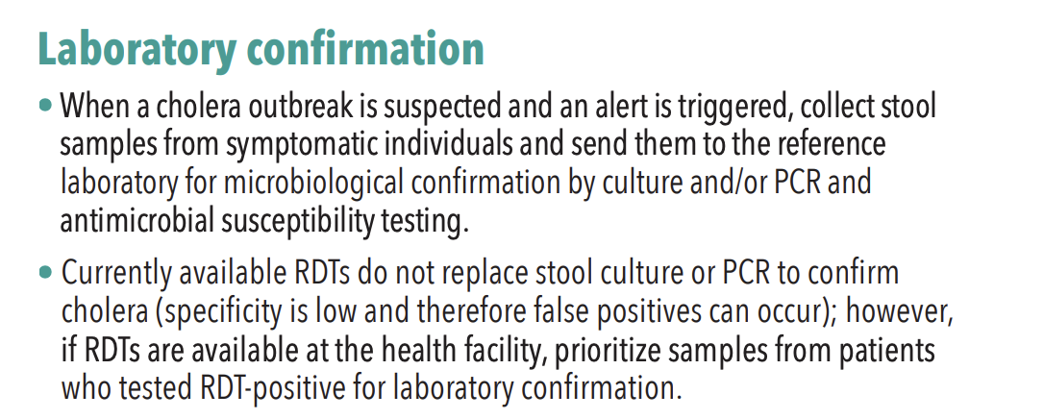
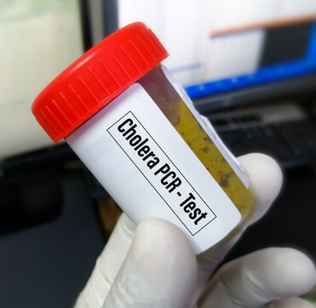
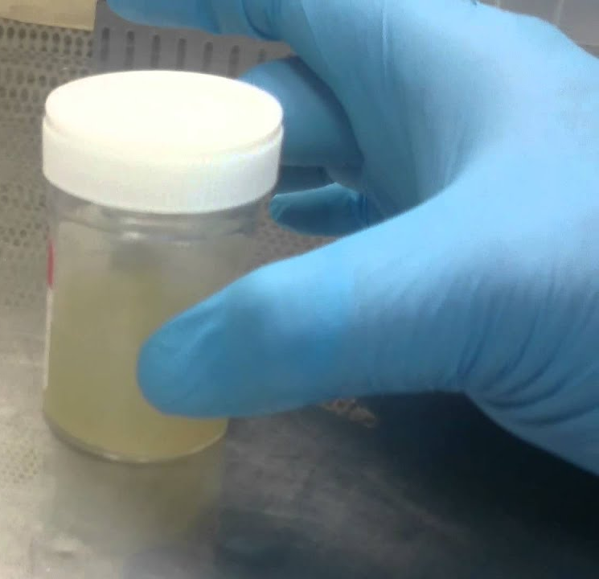
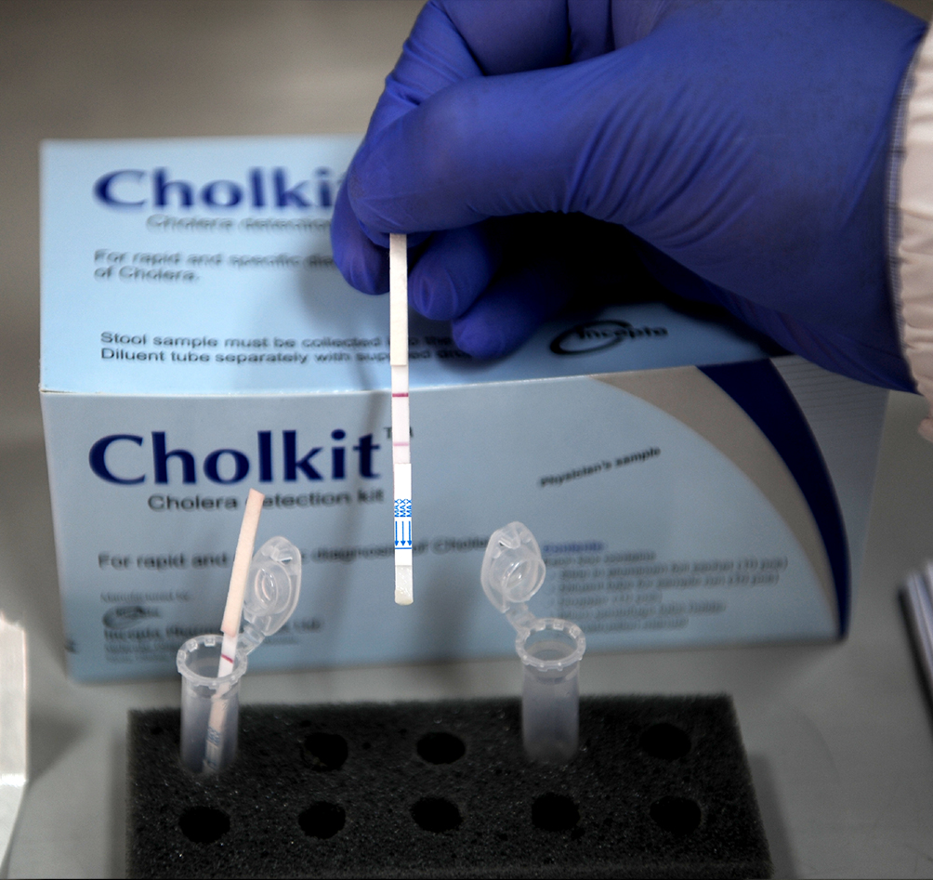
Outbreak Confirmation

Slide 23
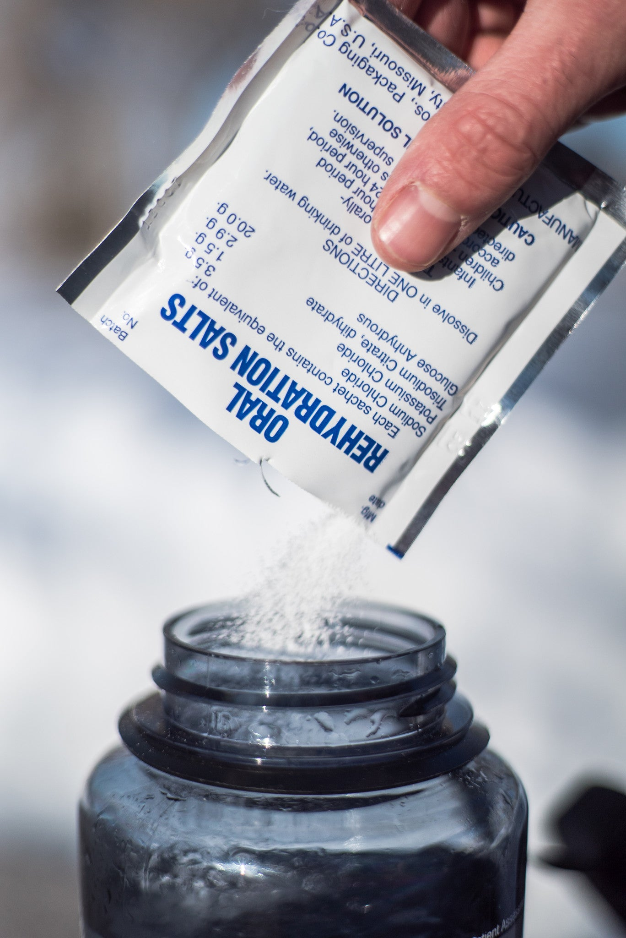
Organization of the Response

Slide 24
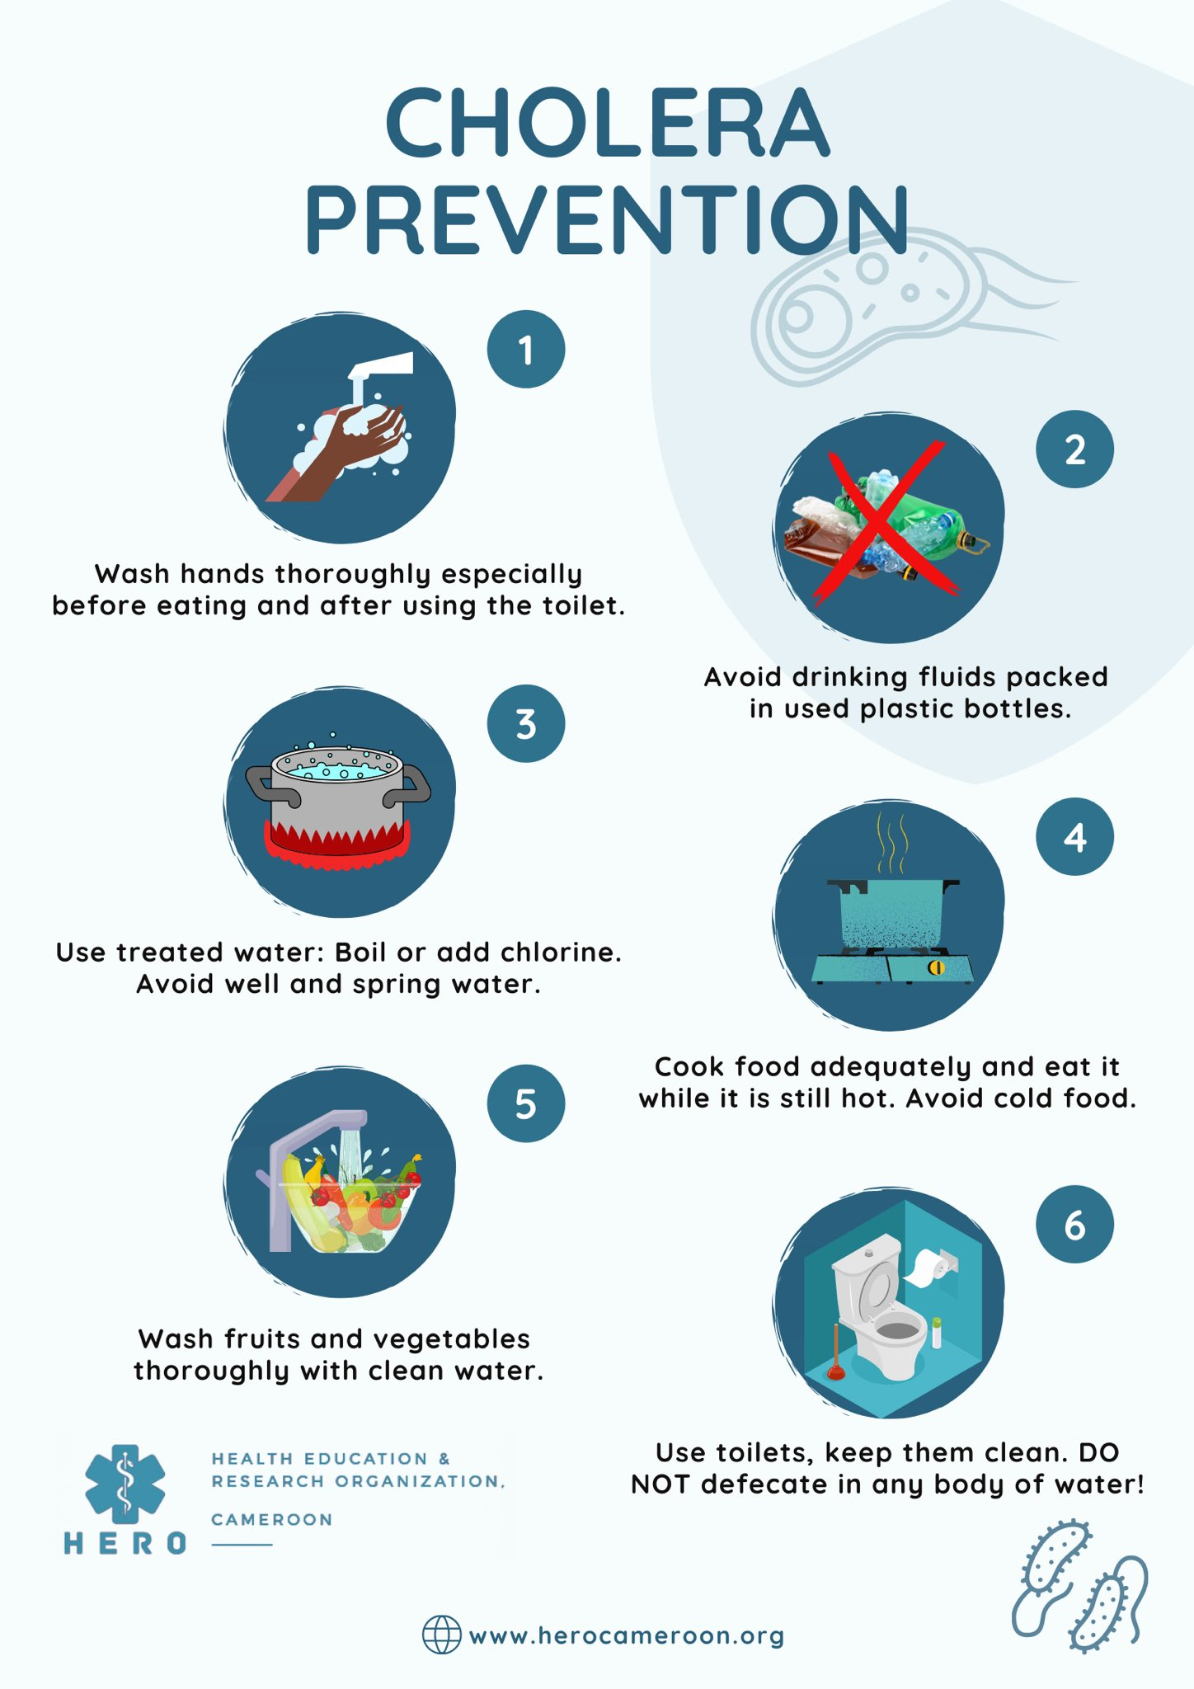
Organization of the Response (cont.)

Slide 25
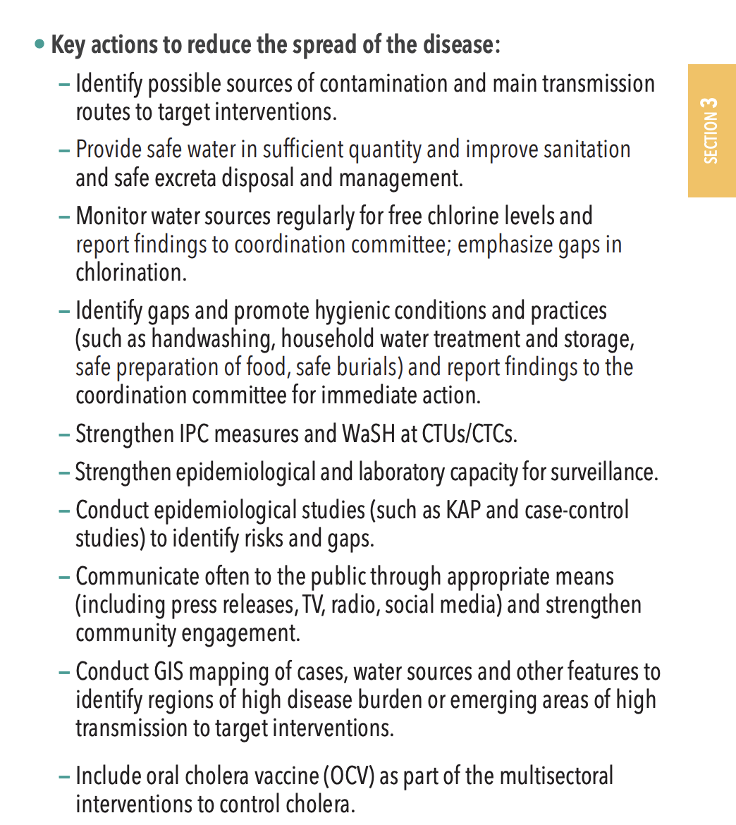
Organization of the Response (cont.)

Slide 26
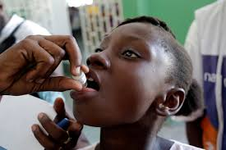
Organization of the Response (cont.)

Slide 27
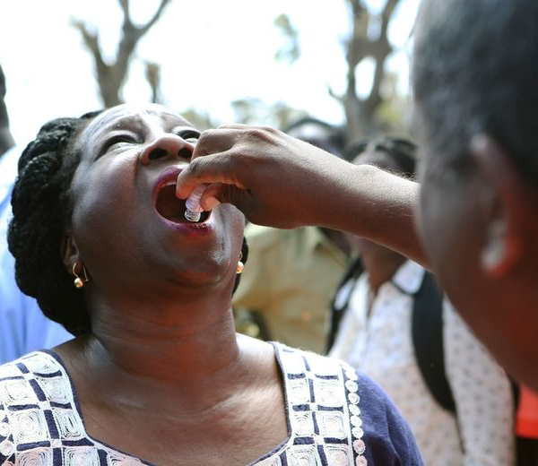
Oral Cholera Vaccine

Slide 28
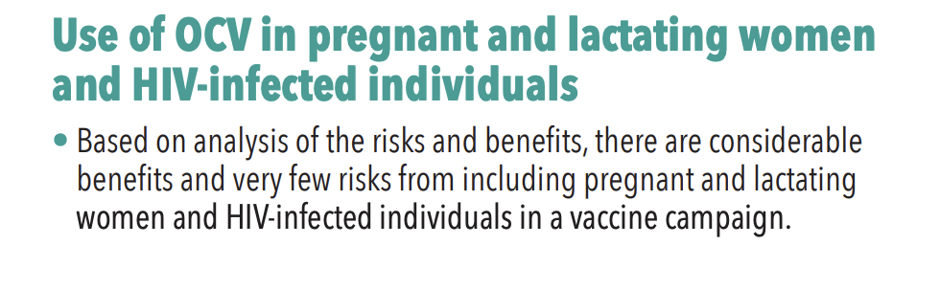
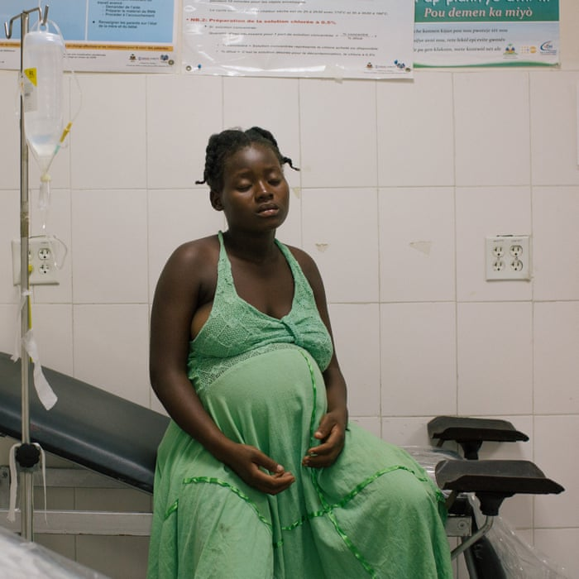
Oral Cholera Vaccine (cont.)

Slide 29
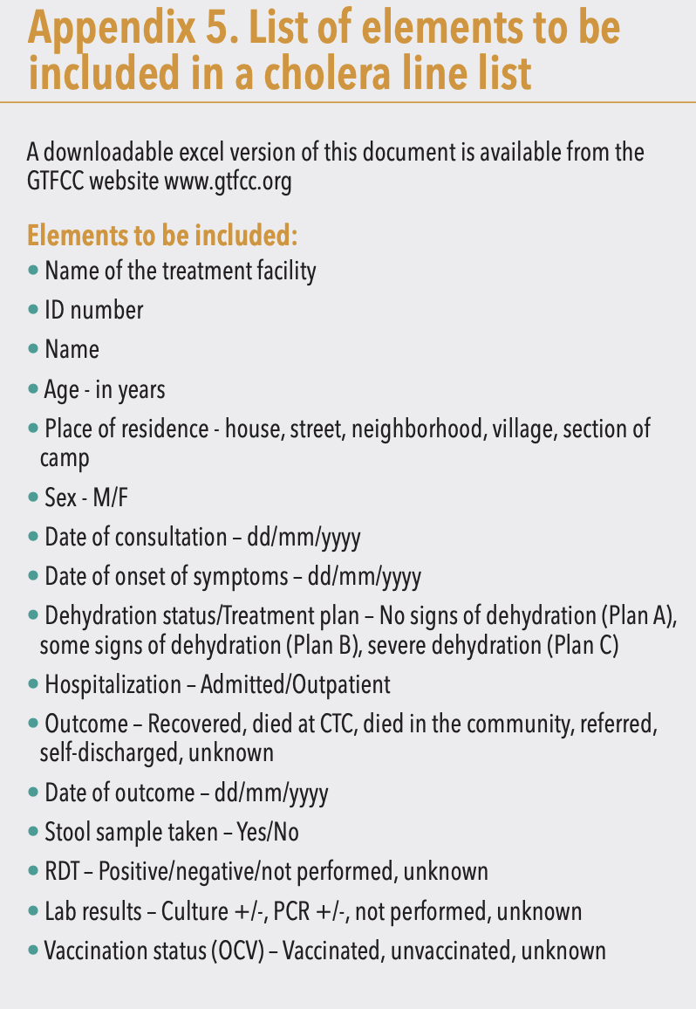
Monitoring the Outbreak

Slide 30
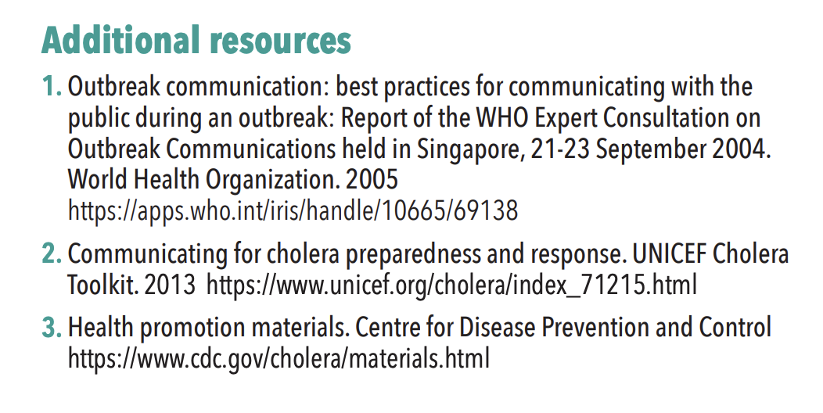
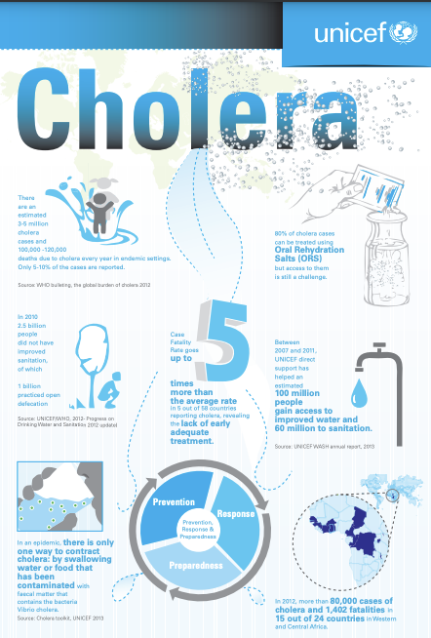
Risk Communication and Community Engagement

Slide 31
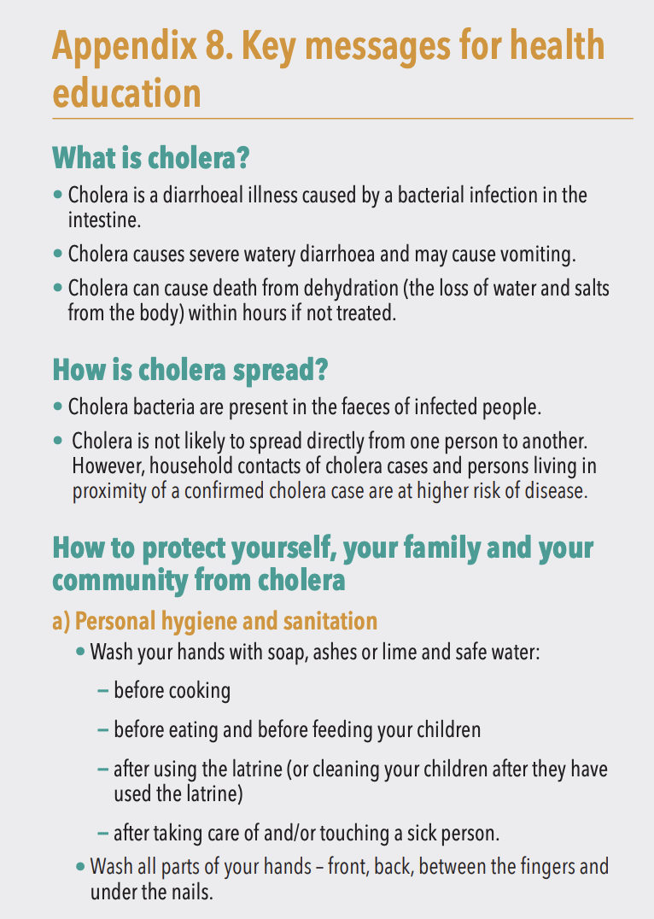
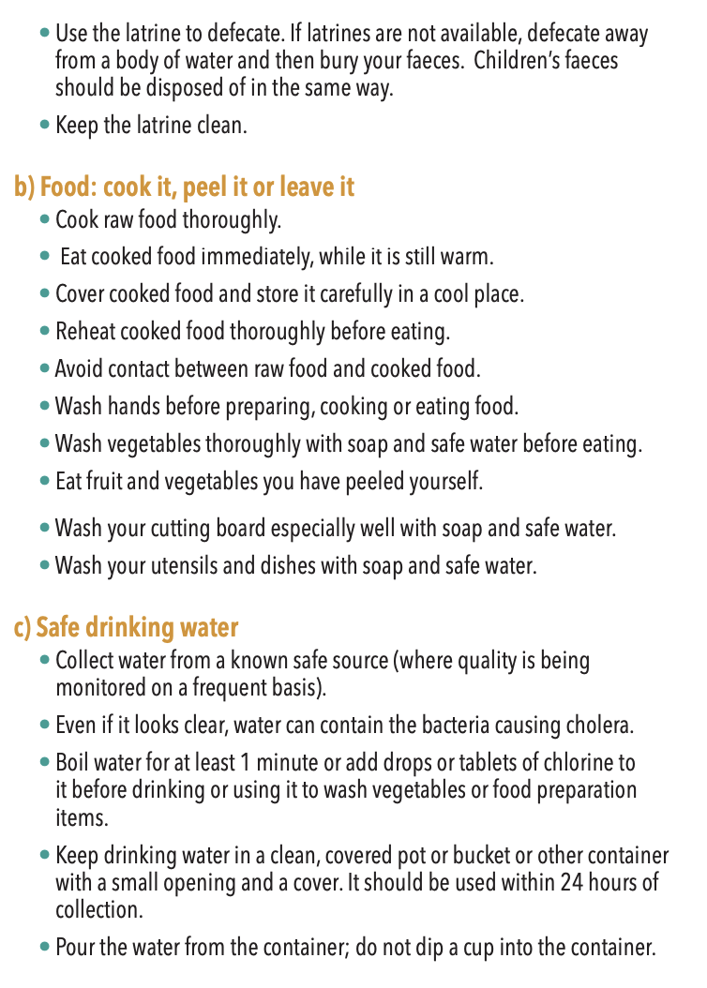
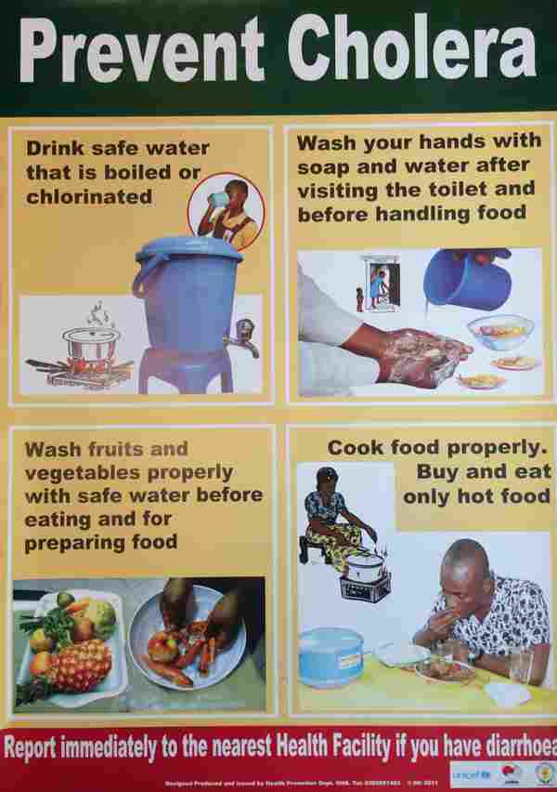
Reducing the Spread of Cholera in the Community

Slide 32
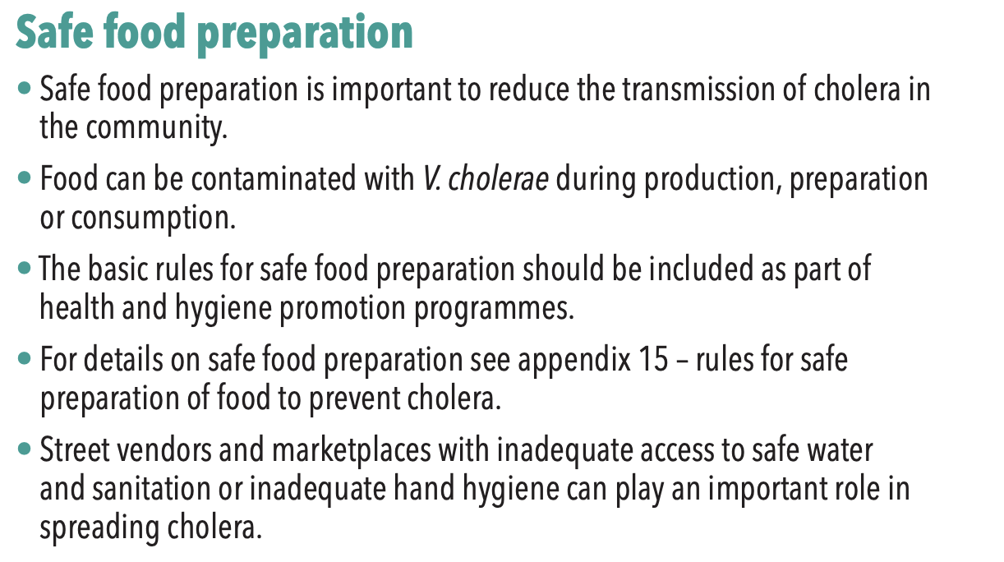
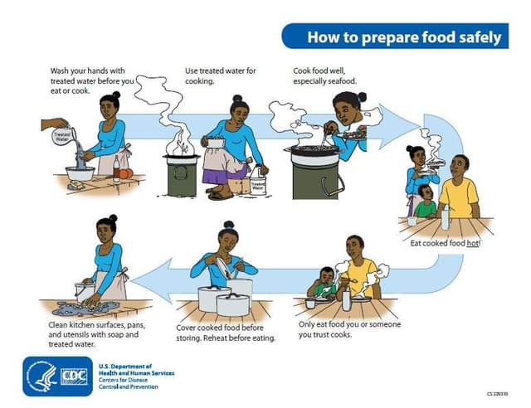
Reducing the Spread of Cholera in the Community (cont.)
Key point: Educate UN personnel on safe food handling and avoid high risk foods.

Slide 33
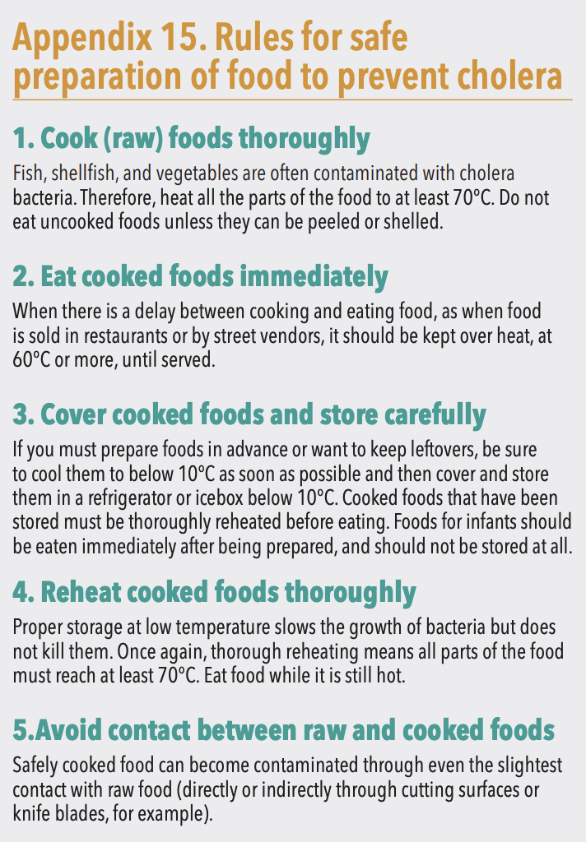
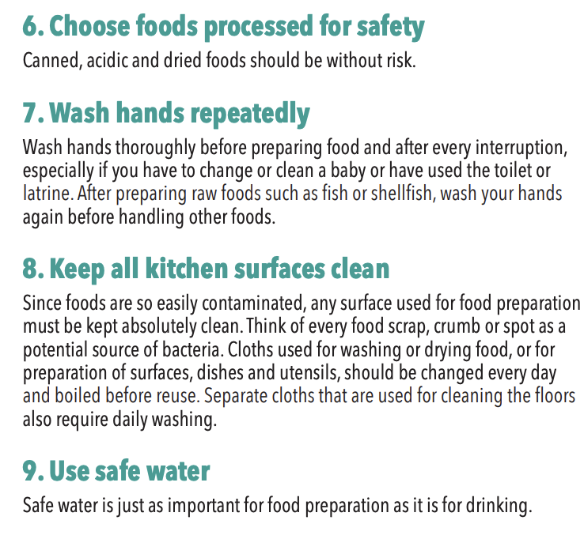
Reducing the Spread of Cholera in the Community (cont.)

Slide 34
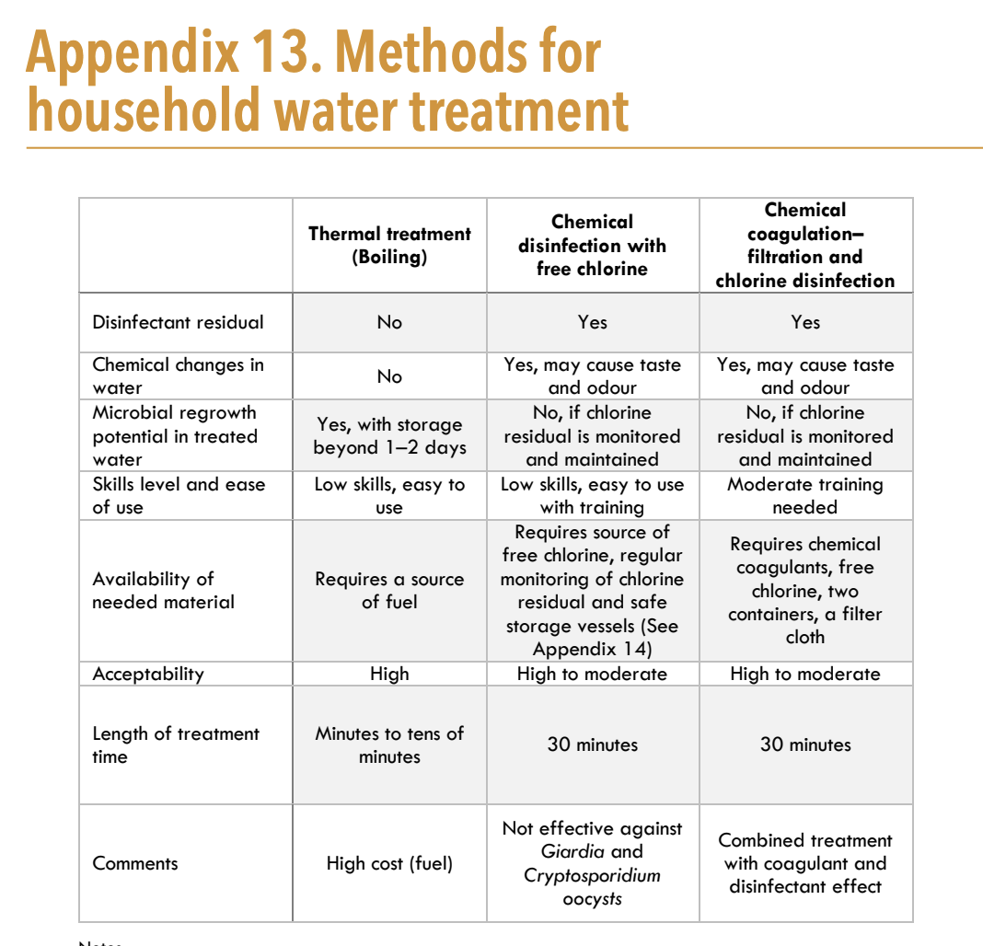
Reducing the Spread of Cholera in the Community (cont.)

Slide 35
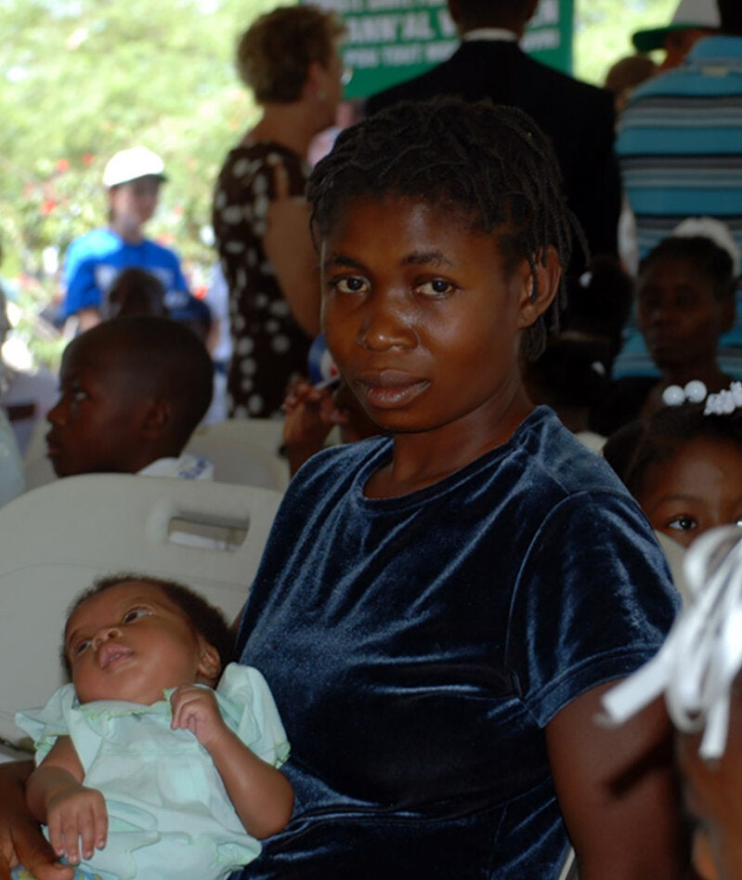
Reducing the Spread of Cholera in the Community (cont.)

Slide 36
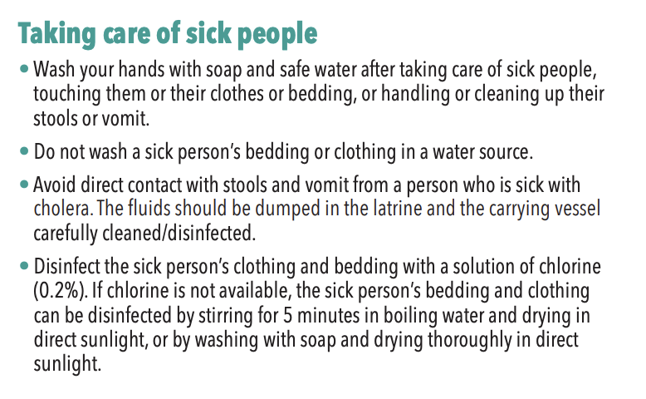
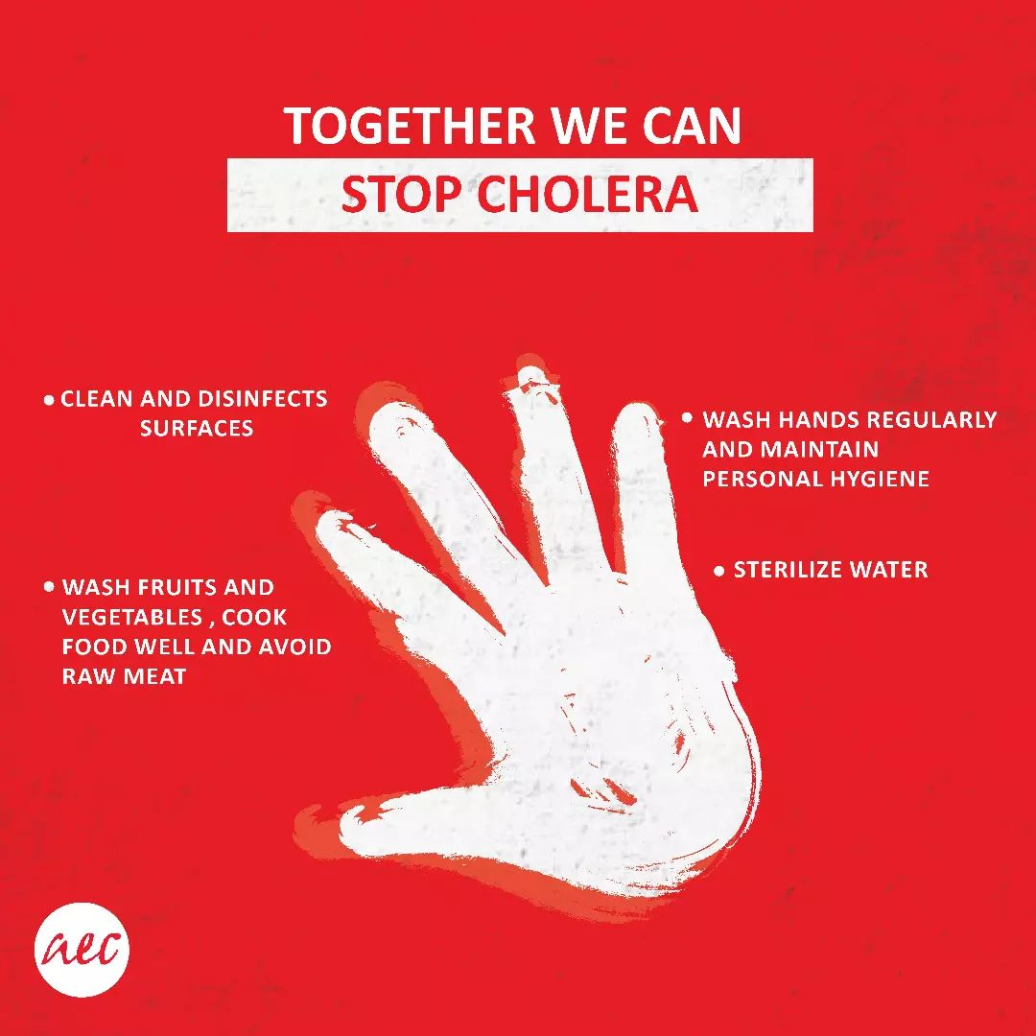
Reducing the Spread of Cholera in the Community (cont.)

Slide 37
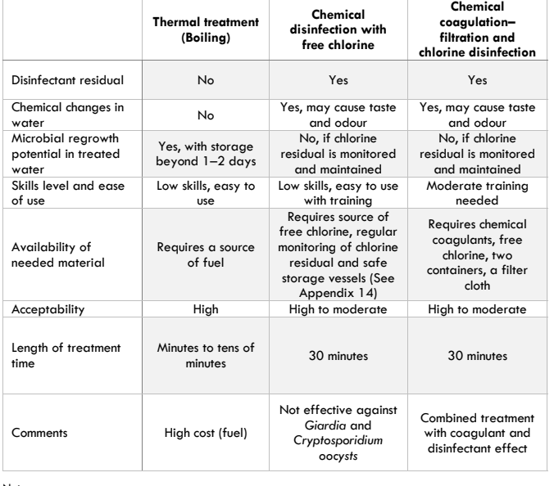
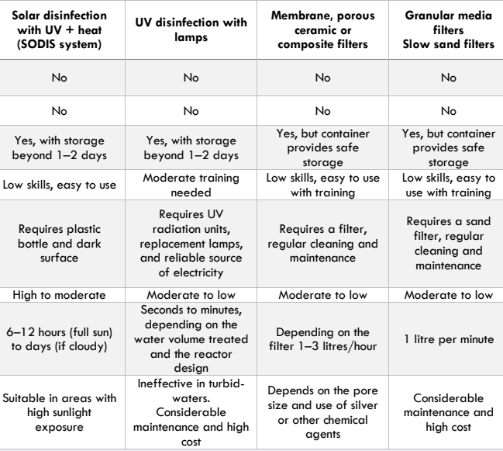
Reducing the Spread of Cholera in the Community – Water Treatment (cont.)

Slide 38
Reducing the Spread of Cholera in the Community – IPC (cont.)

Slide 39
Resources
Cholera Outbreak Response Field Manual https://www.gtfcc.org/wp-content/uploads/2020/05/gtfcc-cholera-outbreak-response-field-manual.pdf
UNMD Risk Mitigation Plan for Reducing the Risk of Acquiring Cholera
https://hr.un.org/page/cholera

